Slide 1
Our Pre-application offer at Croydon
How we manage to provide a comprehensive, proportionate and good value service
Nicola Townsend
London Borough of Croydon

Slide 2
Pre-application process: historic problems
  Silo working
  Inputs at the wrong stage – fixing problems rather than designing success
  A mindset of identifying problems rather than working to find solutions
  A tendency to only engage superficially with proposals in the pre-application phase
  Limited engagement with Members/public
  First time Members see a strategic item is when determining

Slide 3
Pre-application process
Aim
Improve the quality of development in Croydon
Objectives
Work with developers to align mutual objectives
Fully harness the planning skills in our service
Involve members constructively in the process
Create the conditions for effective engagement of the local community
Get Croydon building

Slide 4
Key ingredients
Get the organisation, processes & decision making right:
The structure of the Development Management service
The relationship between DM & Spatial Planning
The pre-app process itself
The use of project management
The wording of your constitution
Planning committee organisation
Member training
Member involvement
Delegation scheme

Slide 5
Departmental structure & working
Strategic Applications Team
  Virtual team
  Centre of excellence for dealing with big applications
Having a project management mindset
  Clear responsibilities & expectations
Spatial Planning working relationship with Development Management
  Integrated process

Slide 6
SP & DM integration: how not to do it
Spatial Planning
Development Management
Urban Design phase → Detailed application preparation phase

Slide 7
SP & DM integration: how we now do it
Development Management
Spatial Planning
Urban Design phase → Detailed application preparation phase

Slide 8
Pre-application: What we offer at Croydon
1. Duty planning officer service
15 minute appointment to discuss householder and business extensions
2. Correspondence service
Appropriate for domestic extensions or shop fronts, signs and alterations to small business premises
3. Pre-application meeting service
It is not suitable for complex, major developments, but it is ideal for other types of planning application
4. Development team service (DTS)
The DTS is a new enhanced service designed for development proposals that are more complex and likely to raise a number of issues

Slide 9
DTS approach
Strategic schemes are complex projects – recognise that and use the right tools to manage them properly
Preparing a major application costs a lot of money – efficiency saves time & money
Developers want as much certainty as possible – they are willing to pay for and engage in an enhanced service if they have confidence in it
There are two approaches to pre-apps:
  “Show & tell”
  Joint design team approach
Co-ordinated, collaborative & constructive

Slide 10
What is the DTS?
The stages | What we expect from the developer | What happens | What is the expected outcome
Initiation meeting | OS map and description of development | Meeting with more senior officers to look at strategic issues Consider the process needed | Planning statement covering: Strategic policy issues Project plan Draft Planning Performance Agreement
Urban design / Stage 1 | Draft Design Statement including an urban design analysis | One or more design workshops to understand the site, it’s surroundings and the nature of the development and how it can be accommodated | Design Statement and concept scheme PRESENTATION TO STRATEGIC PLANNING COMMITTEE
Community engagement | Illustrative material of proposed scheme, preferably including options | Meaningful engagement with the community affected An explicit feedback session | Consultation response report and amendments to concept scheme
Application preparation | Draft planning application Draft Impact Assessment Draft heads of terms of S106 legal agreement | One or more workshops to understand the details of the development, its impacts on immediate neighbours and the surrounding area generally | Completed planning application Planning Performance Agreement Agreed S106 heads of terms PRESENTATION TO STRATEGIC PLANNING COMMITTEE
Closedown phase | Final amendments to planning application Final amendments to heads of terms of S106 legal agreement | Address any final comments from members Finalise the application & S106 legal agreement | A valid planning application ready for submission A well-designed scheme that benefits from a fronted loaded process

Slide 11
How does the DTS work?
Start with a red line around a site
The scheme evolves through collaborative working
Requires commitment from both sides
Project focus
Deal with all issues prior to application submission
Planning application stage not place for negotiation
Clean and good application = determine in time
Cost
Payable in stages and varies depending on the scale and complexity of the development. Assuming one main meeting at each stage:
£1,800 (plus VAT) for minor applications
£3,600 (plus VAT) for major applications

Slide 12
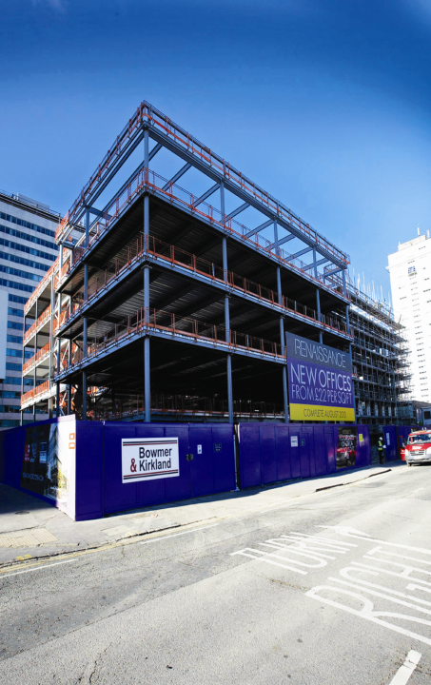
Can it work?
Scheme: 100,000 ft² spec offices
Location: close East Croydon Station
First Contact with LPA: January 2012
Application submitted: February 2012
Planning permission issued: March 2012
Construction starts on site: July 2012

Slide 13
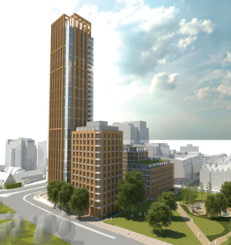
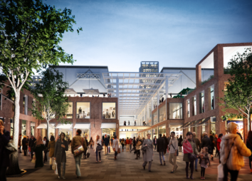
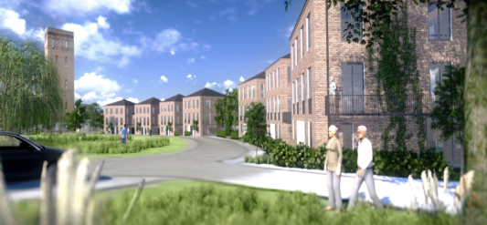
Other schemes to have been through DTS
Westfield/Hammerson
Cane Hill
Lion Green Road
Taberner House
Quest House
Tesco Purley Way
Schools applications

Slide 14
DTS conclusions
A culture change for members, most officers and many developers
Took time to fully introduce all elements of the process
Members are involved constructively in the process
Fully harnessing the skills in our service in an integrated way
Mind shift to pro-development
Developers are gaining confidence in Croydon
Most importantly better schemes are emerging
Croydon is open for business!

Slide 15
“ The integration of our pre-application process into the council’s committee process has meant that strategic planning committee members now play a greater role in the design process and input into the scheme’s development before it is submitted as a planning application. Our aim is to encourage high quality developments that enhance Croydon and this is enabling us to do that.”
Cllr David Osland, Former Chair of Strategic Planning Committee & Cllr Paul Scott RIBA, Current Chair of Strategic Planning Committee , London Borough of Croydon

