Slide 1
Lessons from benchmarking
What happens in planning authorities?
Toby Hamilton, Martin Hutchings
Positive Planning Day
March 2015
www.pas.gov.uk

Slide 2
Benchmark roundup – why bother?
Benchmarking since 2009
  276 councils participated, many more than once
  Confidential, but valuable dataset
Publish aggregate as a “state of the nation”
  Before we forget
  for future benefit

Slide 3
What we’ll cover
Costs and subsidy of planning
Fees
Productivity
Customer survey
Planning Quality Framework

Slide 4
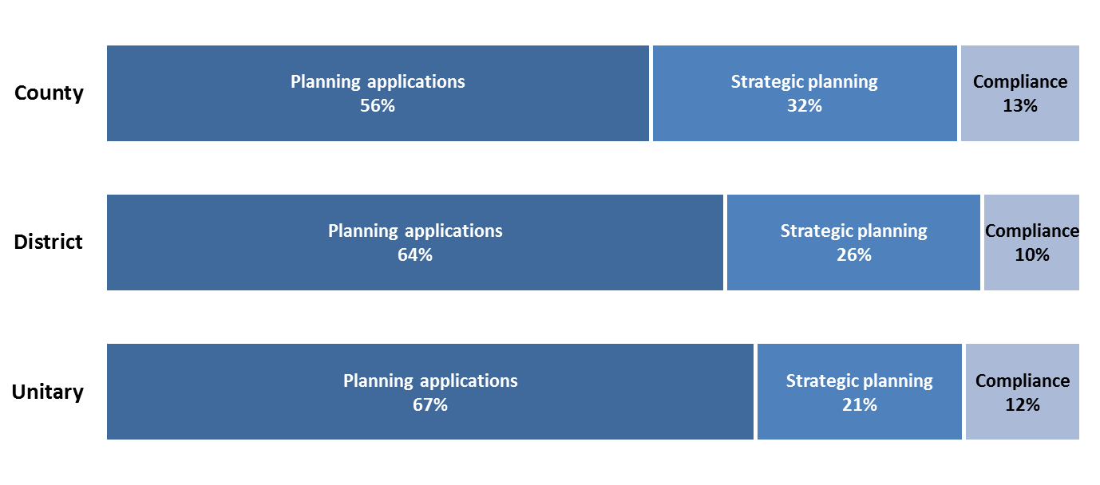
What do councils spend the money on?

Slide 5
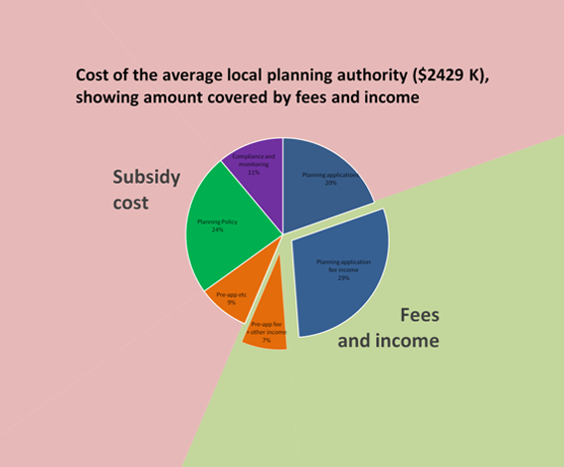

Slide 6
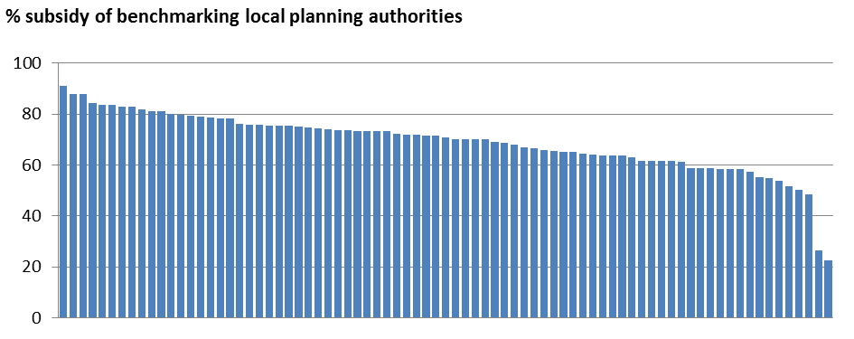
Percentage of LPA cost not covered by fees and income
Each vertical line represents a different LPA
Average subsidy = almost 70% (at the time)

Slide 7
Cost per hour
  - Productive hourly rate = £46
  - Compare this with pre-app charges (!)

Slide 8
Majors = profit. Avoid conditions !

Slide 9
Productivity
“We are not updating the 150 cases per officer thing”
  In the end, we have caved in

Slide 10
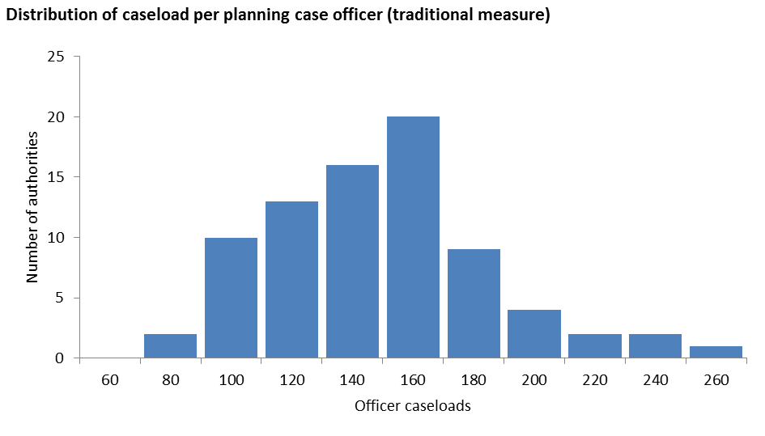
Caseload = 144 / case officer

Slide 11
Productivity revisited
In 2002, it was professional case officer + admin types. Now less differentiation.
Not cases per DC officer, but cases per person
  Derives total head count
  = less wiggle room
  In the ODPM study, this was “less than 100”

Slide 12
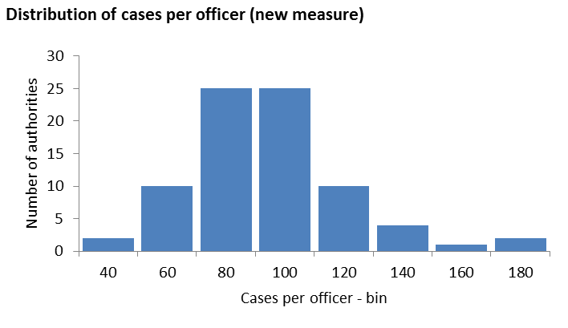
All-in figure is 88 cases per person

Slide 13
All-in figure is 88 cases per person

Slide 14
Why is there such a difference?
Drivers of productivity:
Work mix
  high numbers of simple applications. Fast track. Often urban.
Large authorities = often higher productivity
Plus local factors (e.g. contamination)

Slide 15
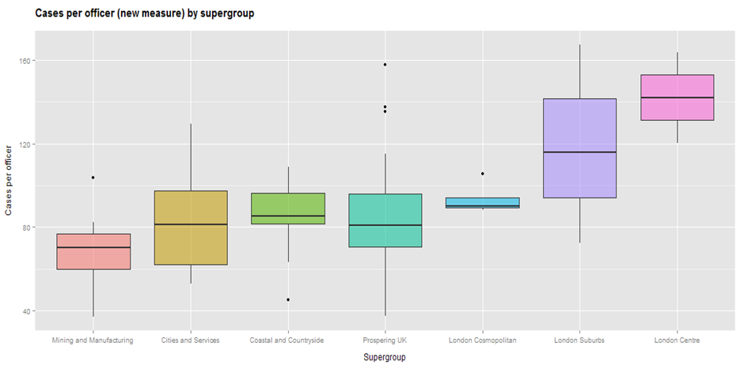
Supergroups = ONS classification

Slide 16
Customers
In aggregate there were clear messages
  Talk to us, generally. It’s just manners.
  Talk to us *especially* when there are issues
  We (generally) fail on customer care
We fail because we don’t acknowledge Work In Progress and follow a target culture

Slide 17
Reflections on the old benchmark
Massive shift in understanding
  Financial literacy
  Looking beyond NI157
National indicators hide almost everything about performance
Subsidy represents a risk to development
Communication is often weak

Slide 18
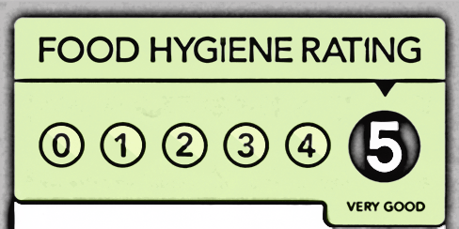
Benchmarking is dead. Long live PQF.
Basic building blocks adapted and recycled…
More focused on customers
Internal management tool / external ‘declaration’
Not an annual snapshot, but a continuous process
We want it to become a “badge”. Over time.

Slide 19
Planning Quality Framework
Contains information and data on 3 things
Performance
Customer experience
Good planning delivery

Slide 20
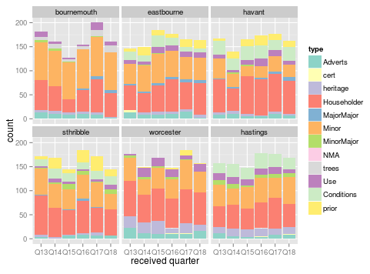

Slide 21
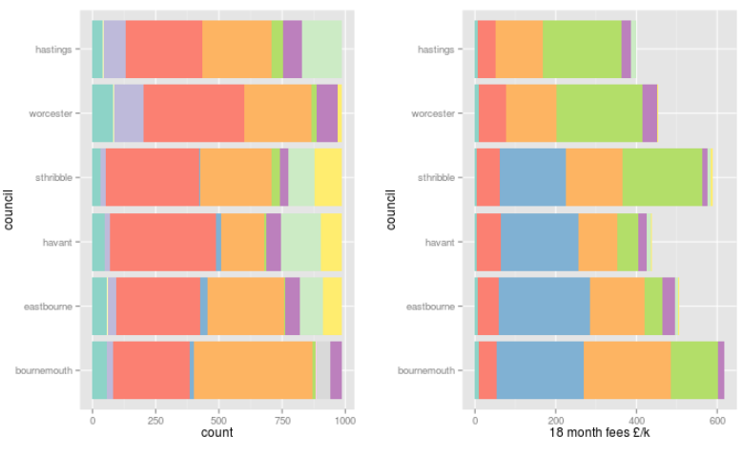
fee income

Slide 22
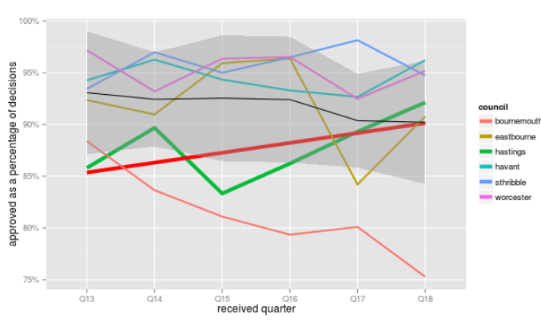
Approved ?

Slide 23
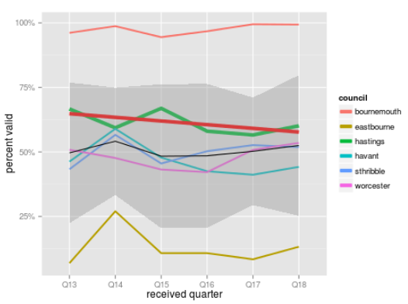
Valid ?

Slide 24
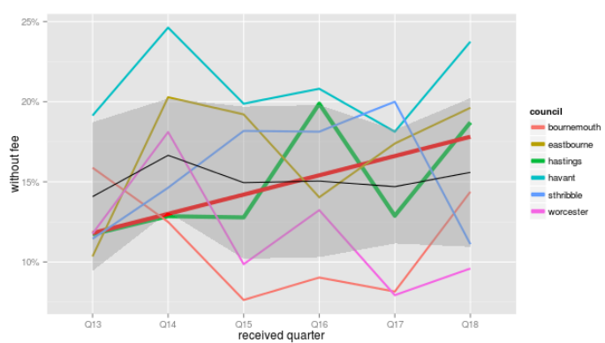
No fee ? (exc. heritage & trees)

Slide 25
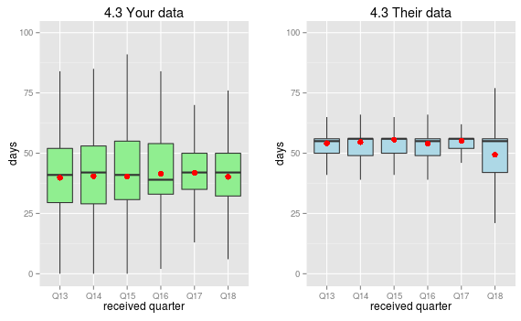
Customer or Target-driven?

Slide 26
More to come
Resources
Investment
[need more testing]
Pre-app
PPAs
[not invented yet]

Slide 27
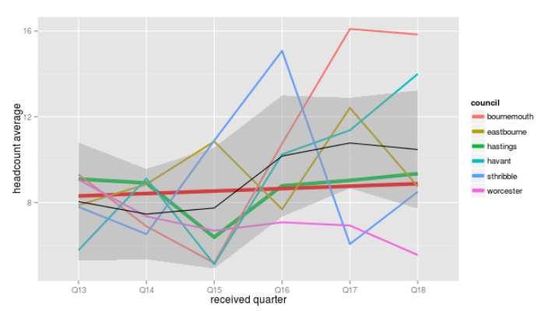
Is it getting busier ? [yes]

Slide 28
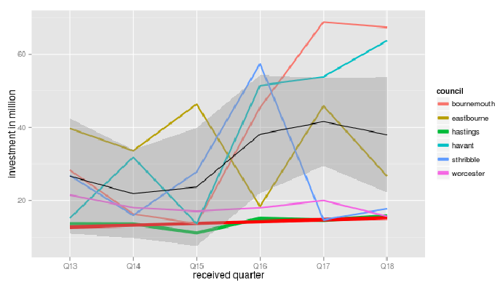
Development value in our place = £60m/yr

Slide 29
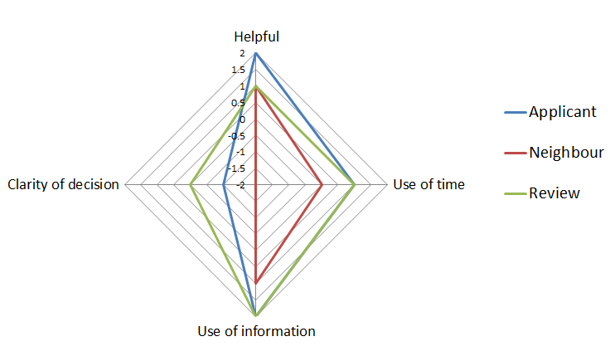
Customer survey results
Application Ref: HA/FUL/4456/14

Slide 30
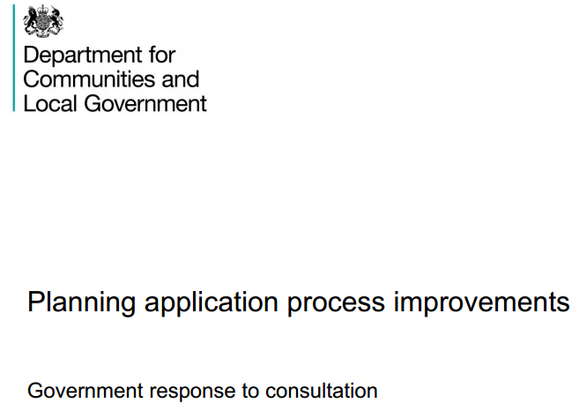
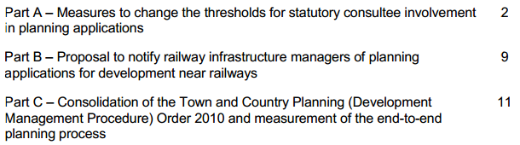
“PAS Planning Quality Framework = consistent, relevant information to benchmark performance” (p12):

