Slide 1

PAS Workshop:
Neighbourhood Planning
Ian Mackay
10th February 2015

Slide 2
Leeds Neighbourhood
Planning Context
Vision for Leeds
20 Neighbourhood Design Statements/Village Design Statements/48 Conservation Area Appraisals
Core Strategy
Site Allocations Plan
CIL introduction April 2015

Slide 3
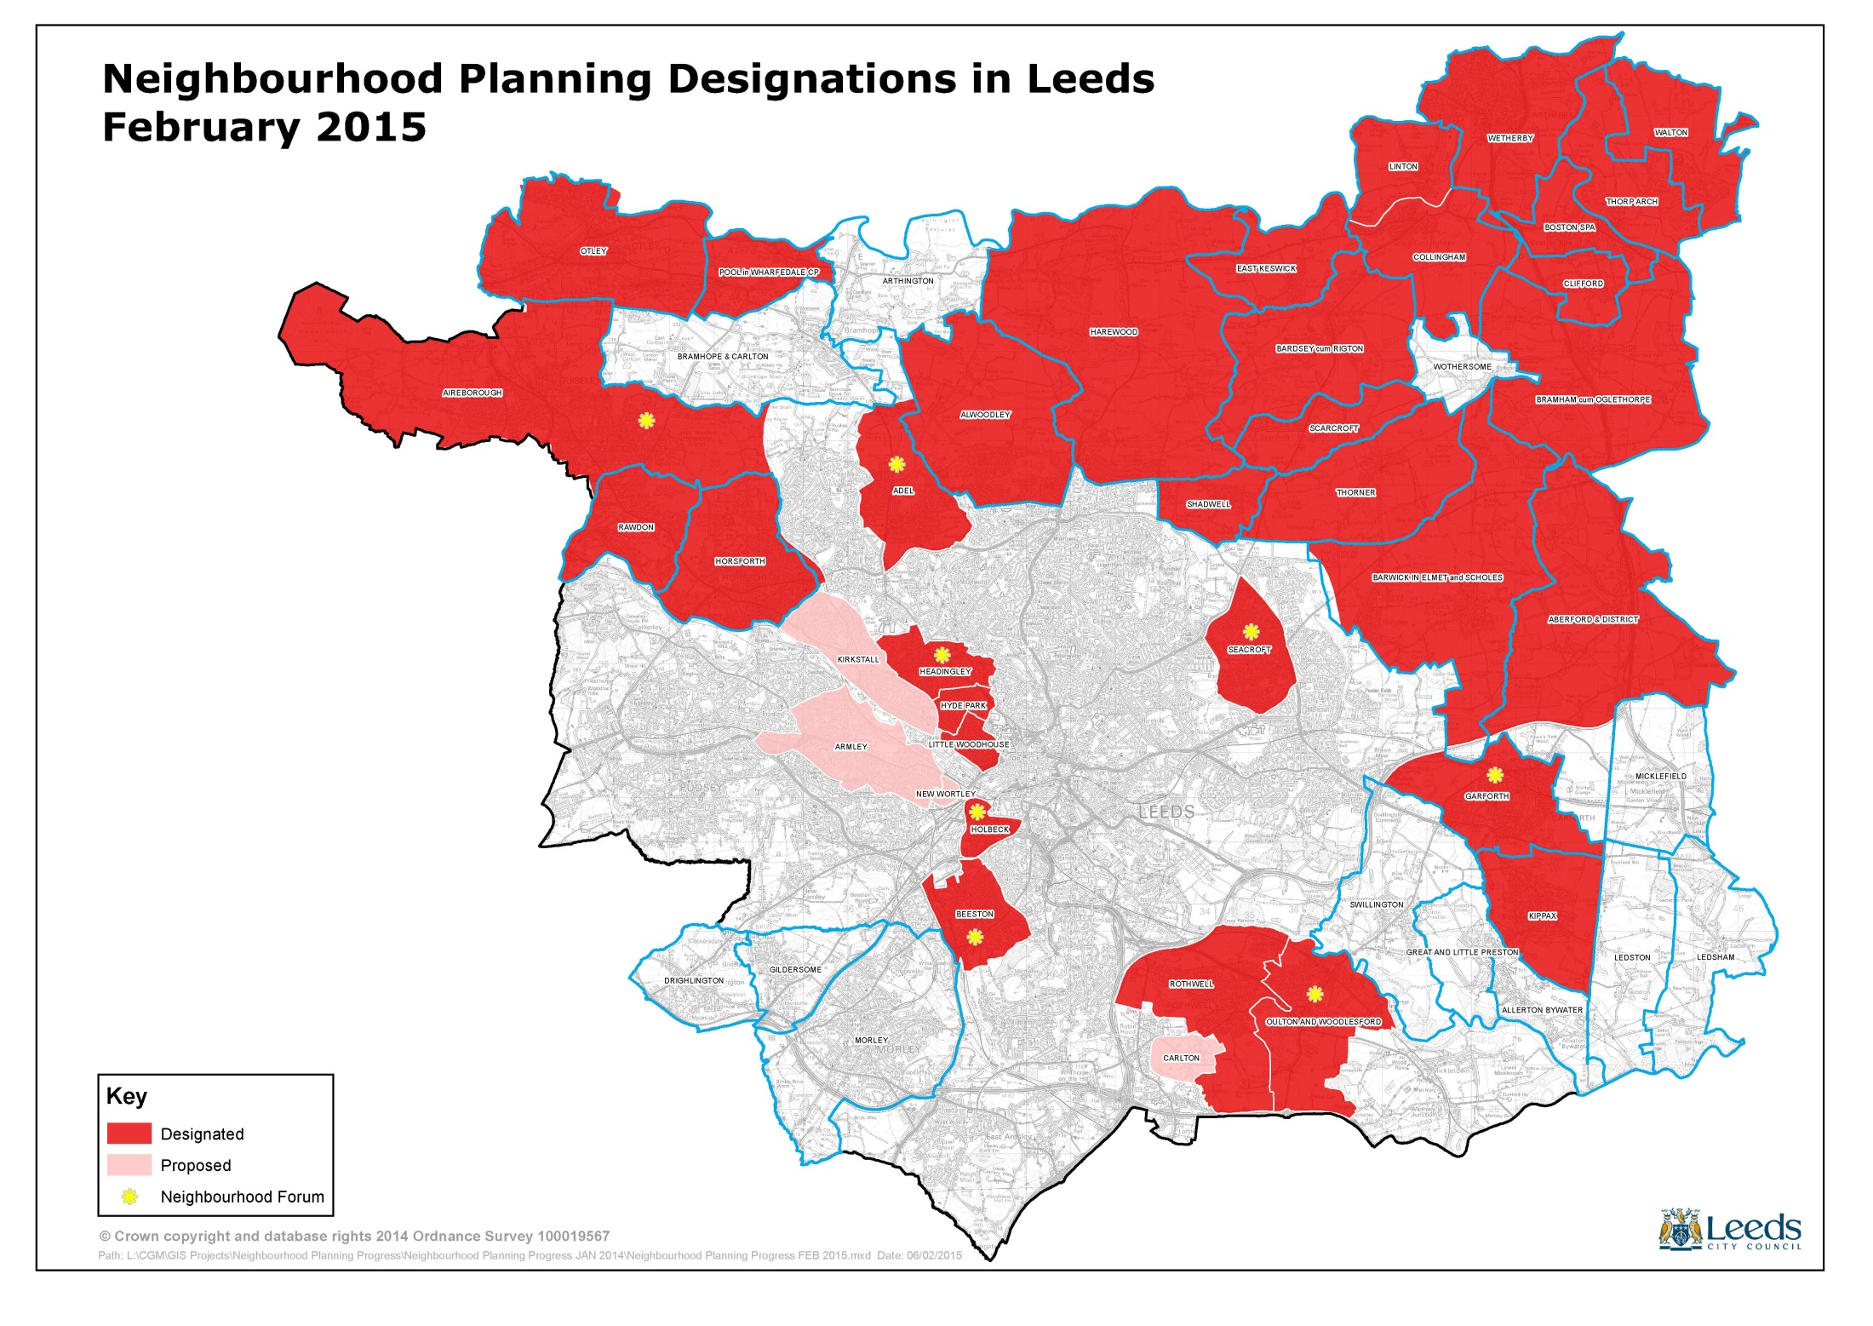

Slide 4
5 different approaches…
HOLBECK – inner-city disadvantaged community (non-parished)
SEACROFT – outer Council estate (non-parished)
GARFORTH – larger settlement (non-parished)
THORNER – small rural village
AIREBOROUGH – twin-settlements (non-parished)

Slide 5
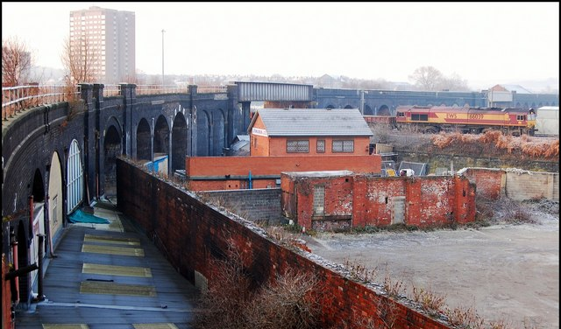
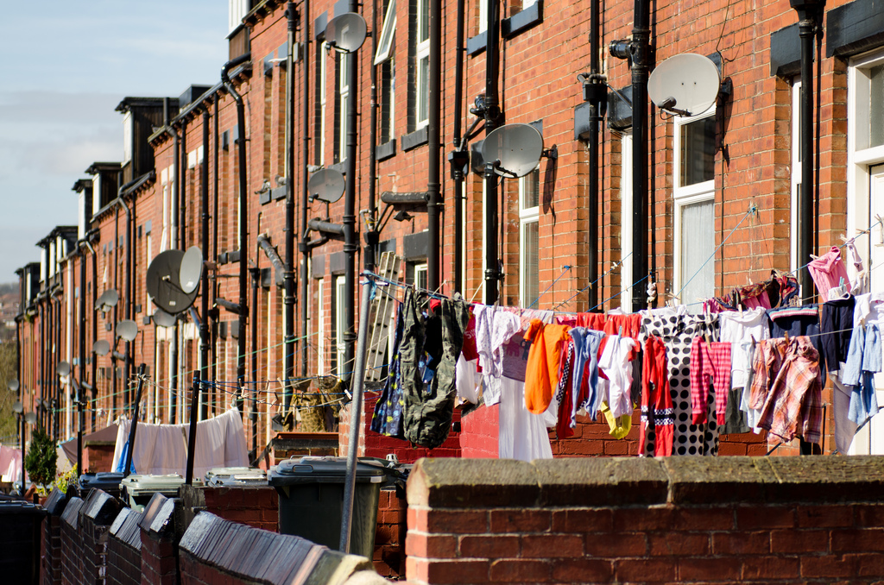
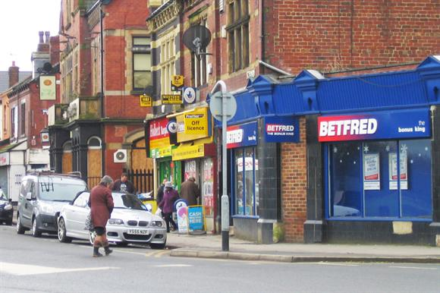
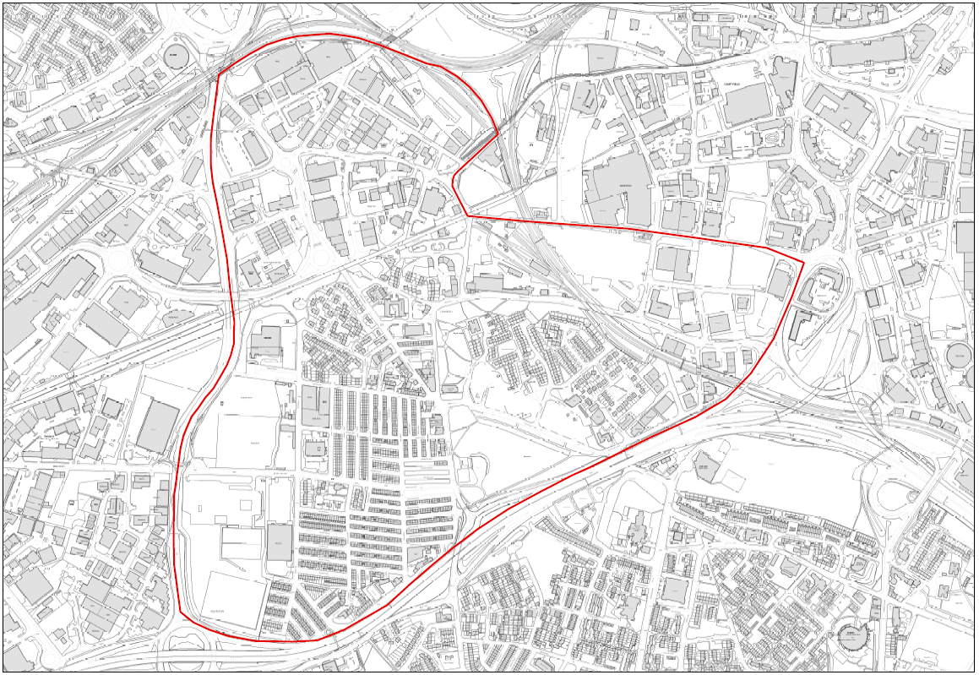
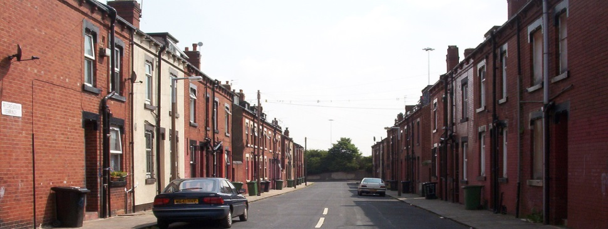
Holbeck

Slide 6
Holbeck: The Vision
‘To make Holbeck a more attractive and healthier place for everyone, it will have a thriving local centre with a range of community facilities, a choice of quality but affordable housing, a variety of local job opportunities, all set in a green environment, respecting the heritage of the area, and well connected to the city centre and adjoining neighbourhoods.
Updated and approved, Holbeck Neighbourhood Forum, Jan 2015

Slide 7
Holbeck: Achievements and Progress
Frontrunner pilot funding
Holbeck Neighbourhood Forum
Active board membership (community, business and voluntary sector Board)
Active ‘contents’, ‘community projects’ and ‘publicity and promotion’ groups
Changing perceptions of Holbeck
Business engagement (and involvement)
Community events and projects
‘Draft policy intentions’
Bridging grant Jan 2015

Slide 8
Holbeck: Issues/emerging issues
Managing expectations/raising aspirations
Transient community
Making neighbourhood planning (and planning!) relevant
Role of local Councillors
Connectivity, health, greenspace, housing, the local centre
Planning and non-planning
Designate new CA, extend existing
CIL expectations/wider funding opportunities

Slide 9
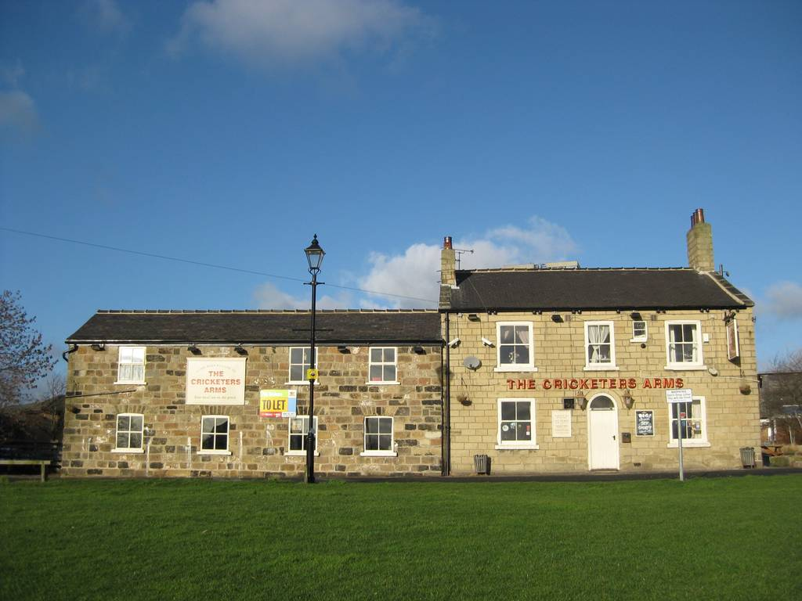
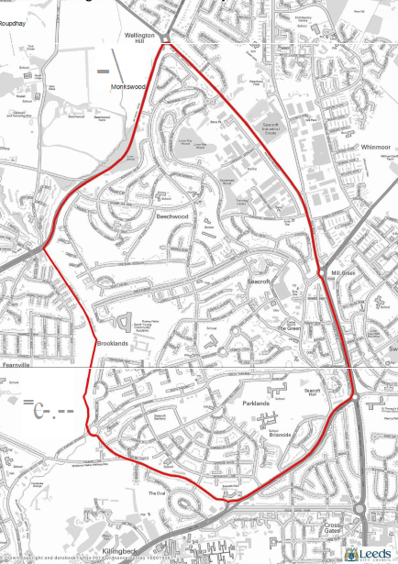
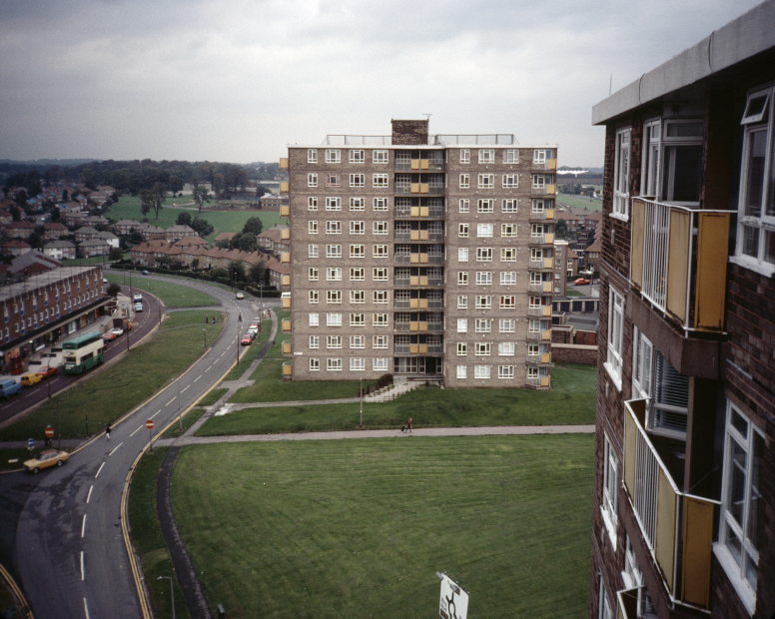
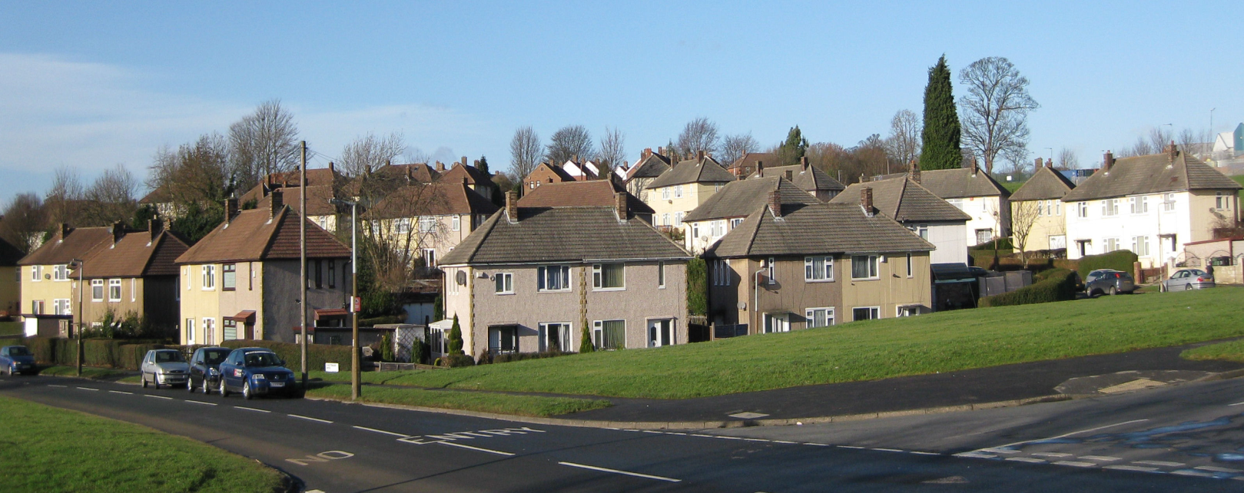
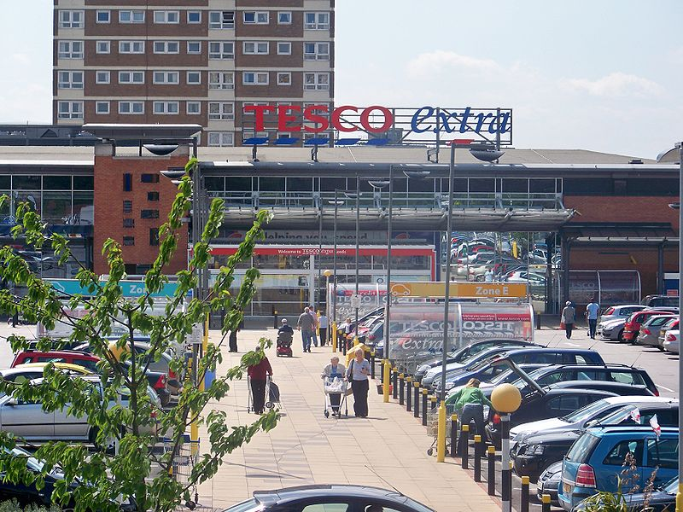
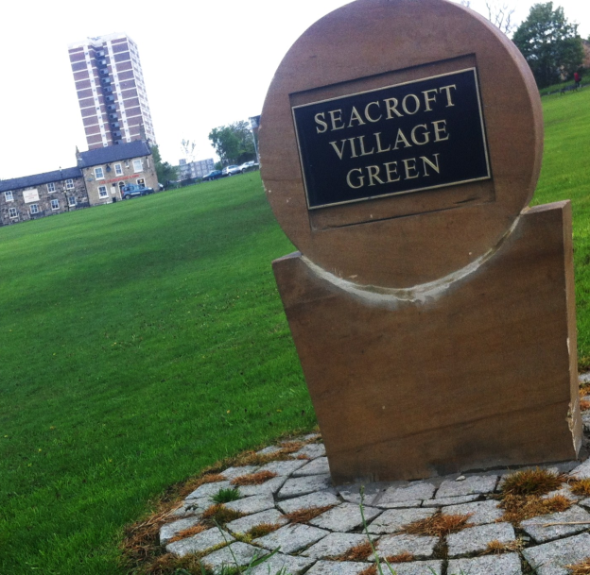
Seacroft

Slide 10
Seacroft: Initial engagement
I hope that neighbourhood planning in Seacroft will help those who live and work in Seacroft take more control over their lives and their environment. It will give them a voice, directly into the process by which key decisions which affect them are made. Initial engagement suggests that the forum will have things to say about issues such as housing, transport, green spaces and leisure amenities for adults and children.
Mike Benwell, Chair, Seacroft NP Steering Group, Feb 2015

Slide 11
Seacroft: Achievements and Progress
National Lottery and Locality funding
The decision to prepare plan…
Designation of Seacroft Neighbourhood area and forum (45 members)
6 Board nominations to date
Engagement with young people
Business involvement
Partnership working

Slide 12


Slide 13
Seacroft: issues/emerging issues
Trust
Capacity building and commenting on planning applications
Tailor-made support solutions…
Delivery of large brownfield housing sites/alignment with neighbourhood framework
Ensuring CIL monies make a difference
Reconfigure greenspace
A new (type of) local centre?

Slide 14
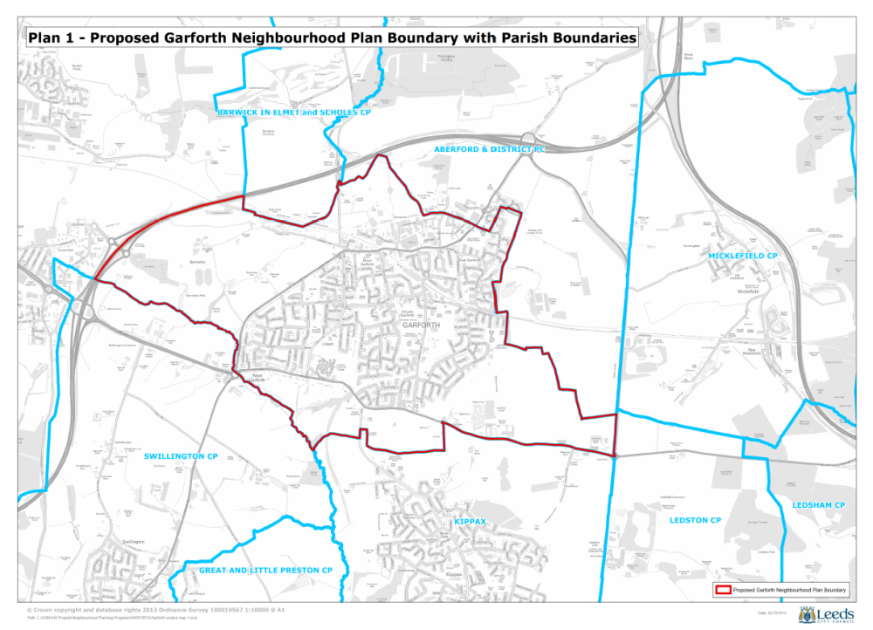
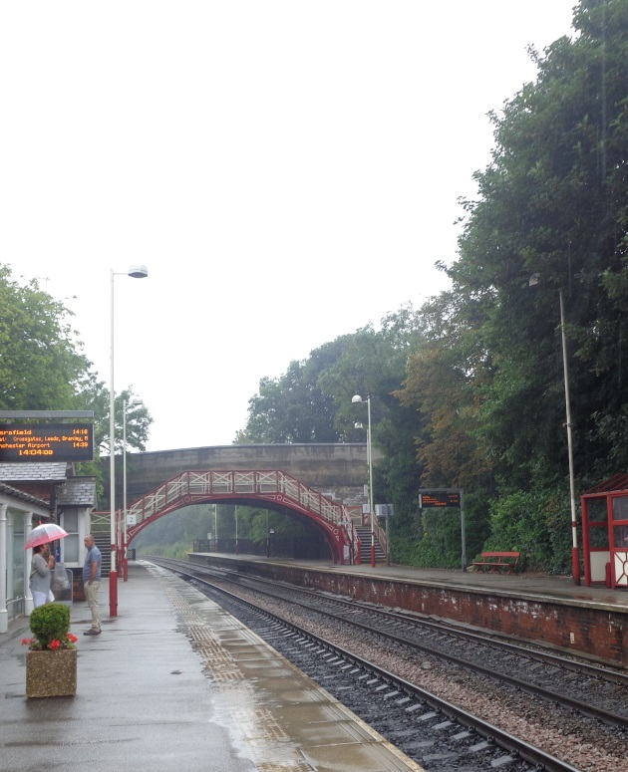
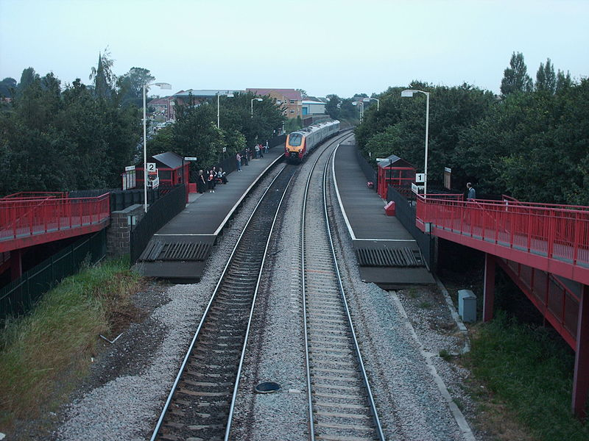
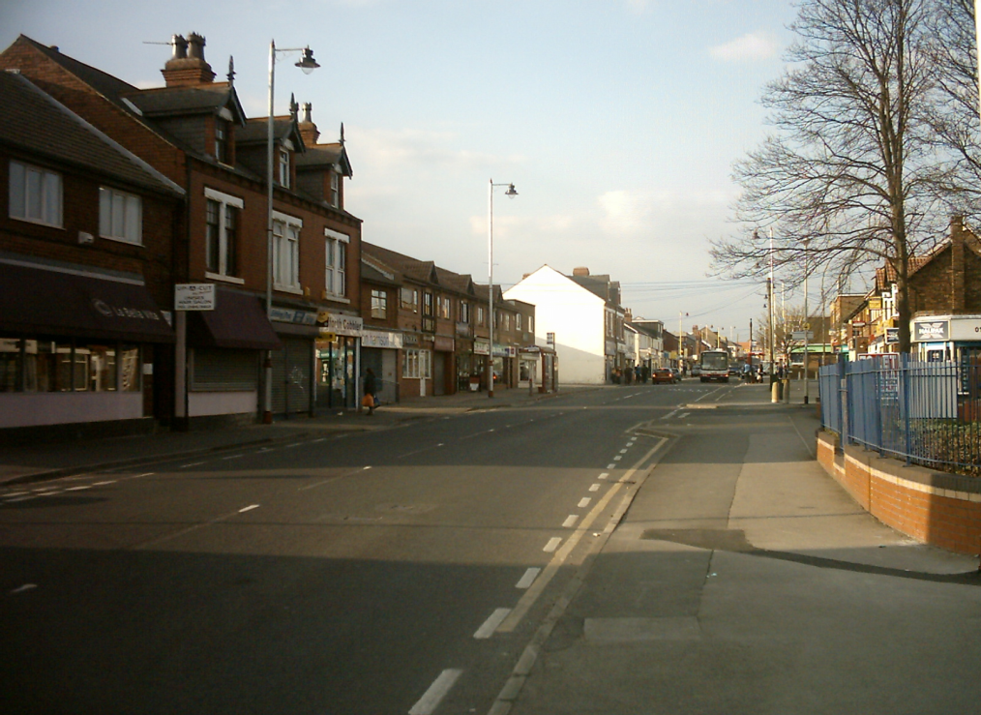
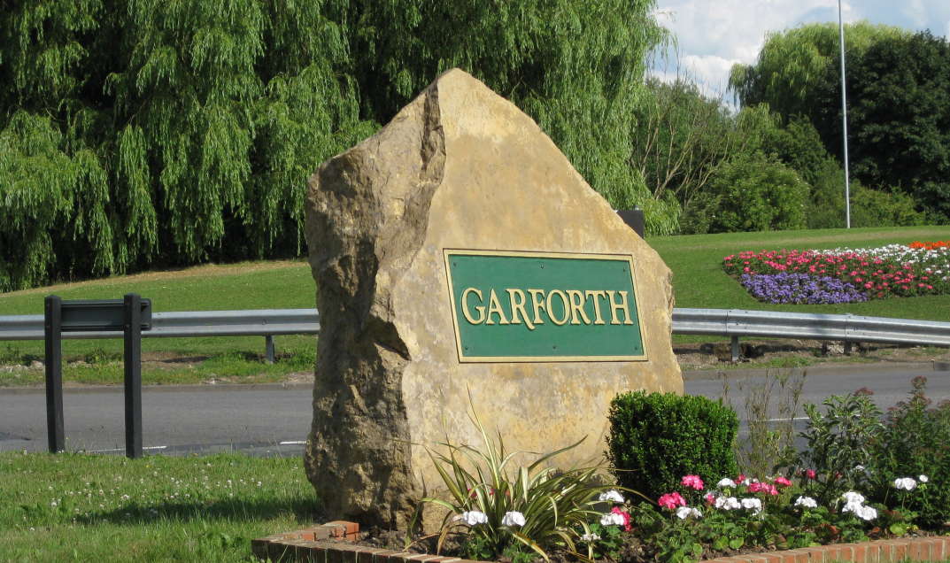
Garforth

Slide 15
Garfoth: Opportunities
“Overall I would say we see the Neighbourhood Plan as a real opportunity to protect and develop the assets we have, and to ensure that the inevitable growth that has to take place does so in such a way that future generations can enjoy a safe, healthy and pleasant environment in which to live.”
David Le Roy, Chair Garforth Neighbourhood Forum, Feb 2015

Slide 16
Garforth: Achievements and Progress
Early engagement event 100+
Locality funding
Designation of Garforth Neighbourhood Area/Forum
Campaign for a Garforth Town Council
In-house engagement and publicity skills
High proportion of active members

Slide 17
Garforth: Issues/emerging issues
Organisational challenges
For/against major proposed housing allocation (2,340 homes)
Flooding
Infrastructure needs/CIL
Neighbourhood area boundary challenge
Town Centre regeneration

Slide 18
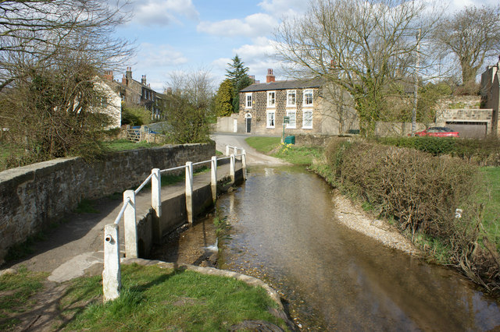
Thorner

Slide 19
Thorner: Aims and Objectives
“Thorner Parish Council wish to carry forward the Village Design Statement into a new legal framework so that Thorner has the potential to have some control of our local environment under current legislation.”
Thorner Parish Council, Feb 2015

Slide 20
Thorner: Achievements and progress
Exemplar Village Design Statement
Early engagement - mandate from community to use VDS as basis/evidence for neighbourhood plan
Locality funding/rural planning specialist
Character assessment
Emerging policies

Slide 21
Thorner: Issues/emerging issues
Use supplementary planning guidance as evidence (and not as the draft plan)
Agreeing a vision
Local leadership, involvement and agreement
Role of consultant
Delivery without development…

Slide 22
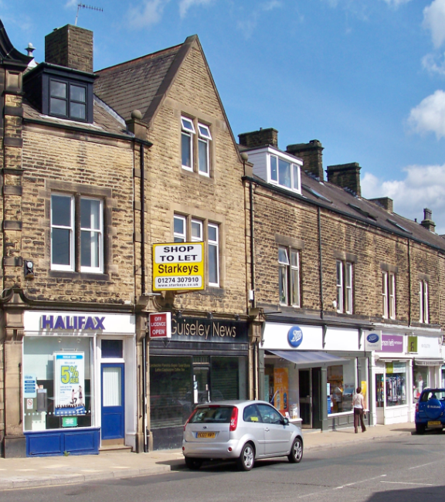
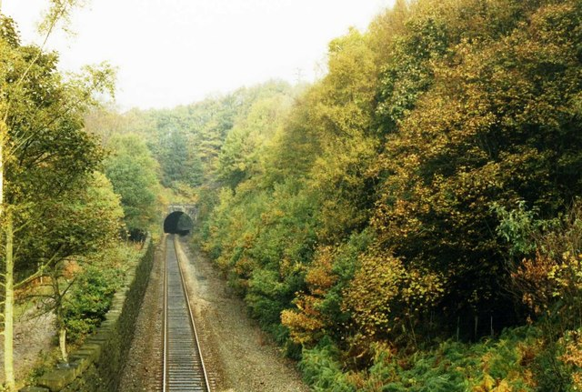
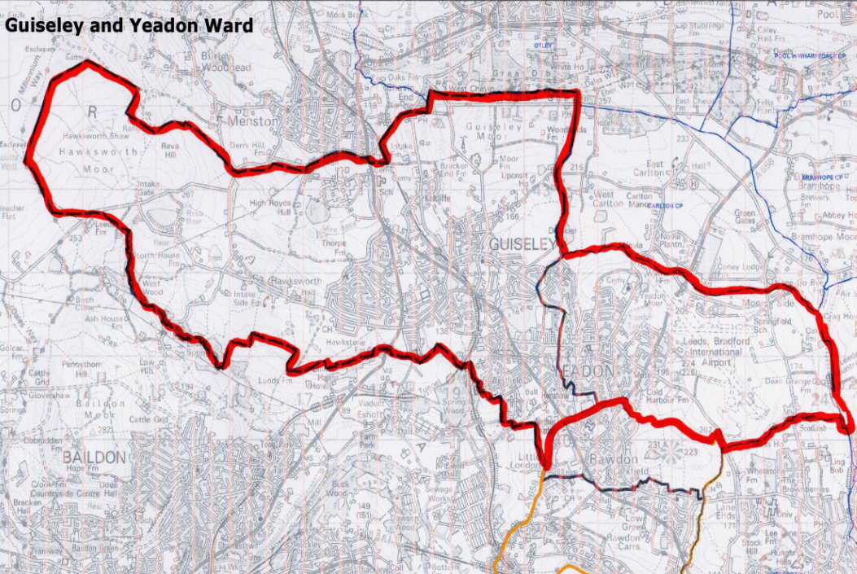
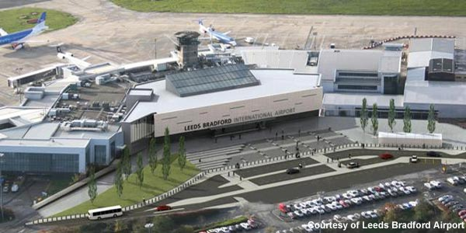
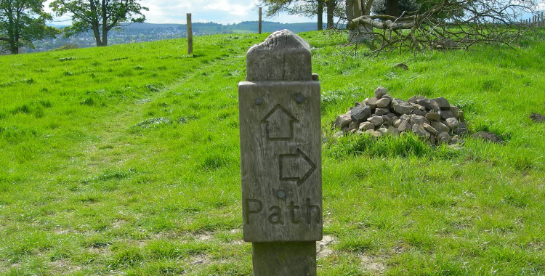
Aireborough

Slide 23
Aireborough: The Vision
“To stimulate identity in order to sustain vitality in this family of sibling settlements. Together, to grow into a new modern economy as a unique cornerstone of the Leeds City Region and the South Pennines National Area. To resist becoming a suburban dormitory.”
CABE enabled vision, adopted by forum 2014

Slide 24
Aireborough: Achievements and Progress
Designation of Aireborough Neighbourhood Development Forum
Active Management Board
Capacity building, training and engagement
Site Allocation survey
Aireborough Festival
Successful campaigning and community awareness

Slide 25
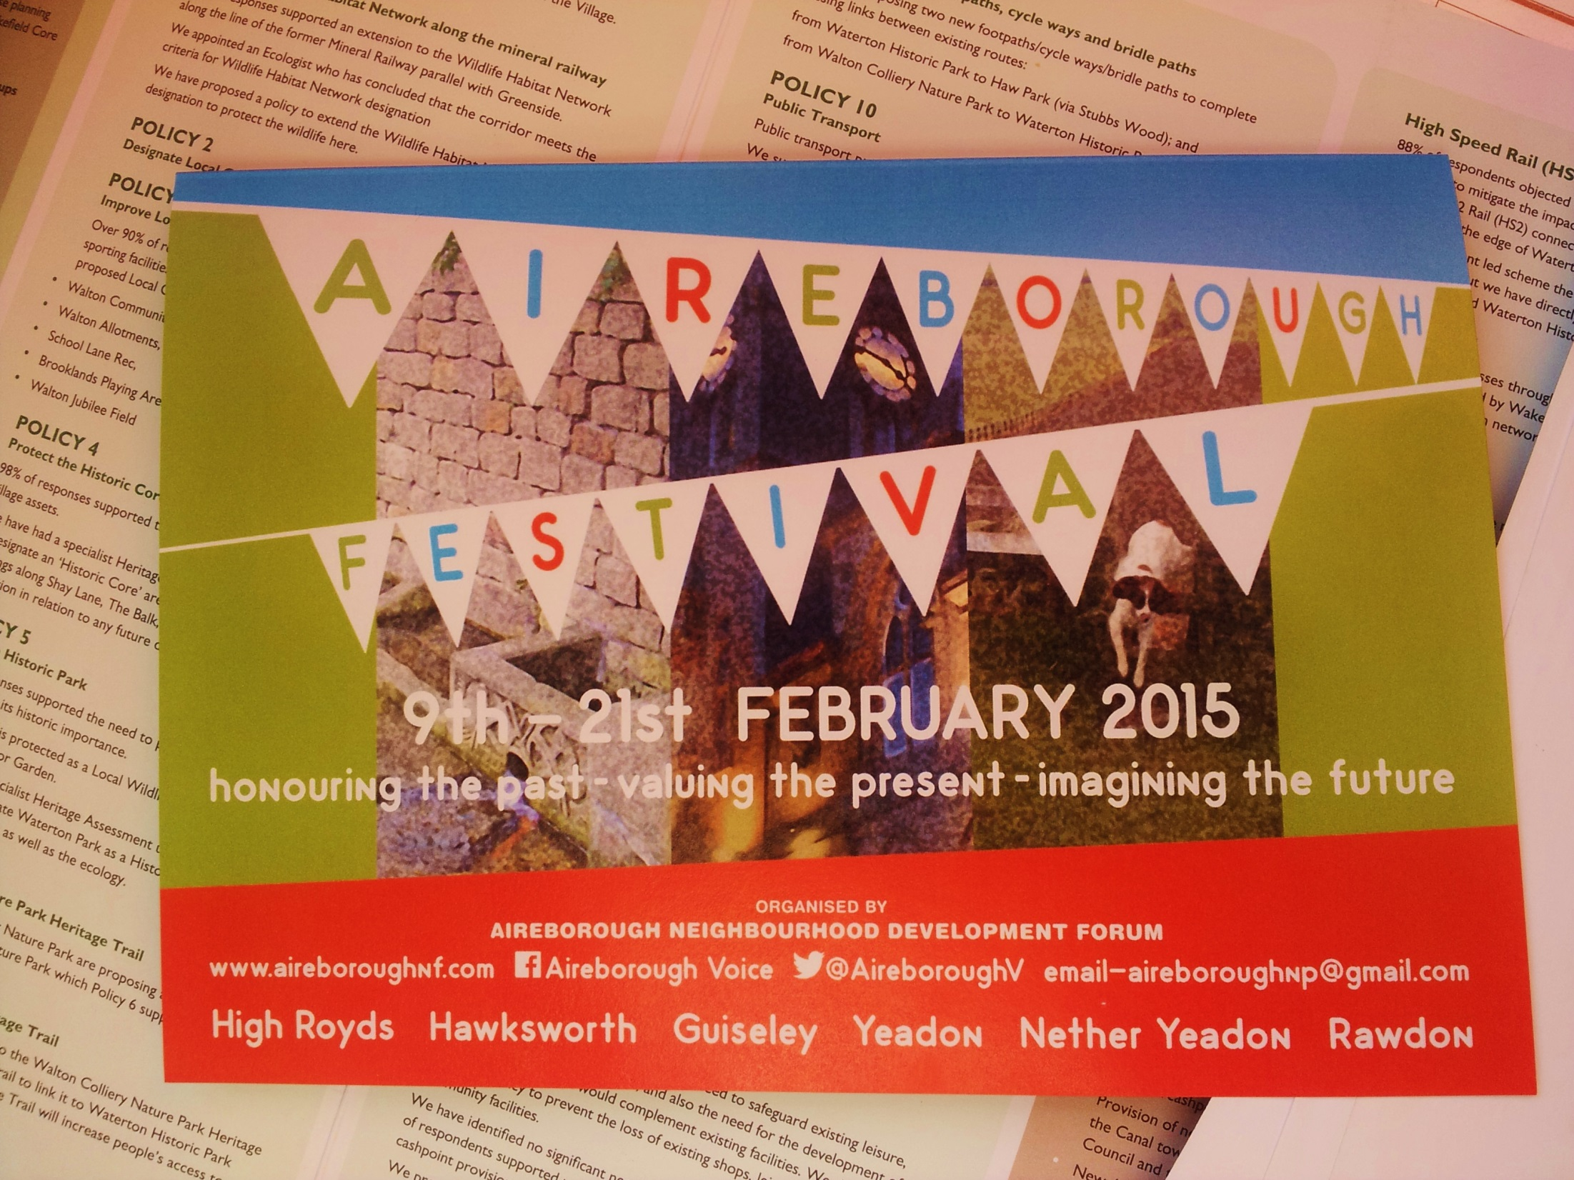

Slide 26
Aireborough: Issues/emerging issues
Role of Neighbourhood Forum
‘Duty to support’
An alternative vision for growth
Placemaking, urban design and community engagement in decision making
Community Interest Company?
Site Allocations Plan next steps

Slide 27
5 different areas/approaches, but the same delivery issues and opportunities
During preparation of the plan…
After the ‘made’ plan…
And in other ways…

Slide 28
Contact
Ian Mackay
City Development
Leeds City Council
2 Rossington Street
Leeds
LS2 8HD
0113 247 8079
Ian.mackay@leeds.gov.uk
www.leeds.gov.uk/neighbourhoodplanning.asx

