Slide 1

Leadership Essentials:
The Government & Planning Reform
Steve Barker
January 2017
www.pas.gov.uk
Notes:
To give you opportunities to understand the changes and most importantly think about how they will affect your planning service, discuss issues and solutions; sharing you concerns and ideas – the challenge for you all is not to just focus on way things are wrong/challenging!!!
We will be capturing your thoughts through about issue and feeding them back to DCLG where relevant.

Slide 2
Course Objective
This programme is designed to:
  help you understand more about what the reforms are
  get you to think about what it means for your planning service
  help us understand your perspective
  and what PAS can do to support councils

Slide 3
Key Facts
Started in 2004
Part funded by DCLG. Part of the LGA.
5 staff. Supplier framework. Peer community.
Grant money funds our work
Non-judgemental. Not inspectors. Not Government!
Respond to reform. Keep you current
Support, promote, innovate

Slide 4

Housekeeping
Food / Refreshments
Phones
Toilets
Fire
Evaluation
Presentations
    @pas_team

Slide 5
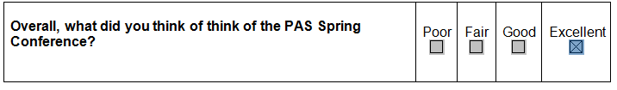
This is nice, but we want more
“Yes, I found it very interesting, thus I did not drop off during the session”
Notes:
We need to know what you think
Comments triply welcome
We read all of them
We use your ideas to change what we do and how we do it

Slide 6
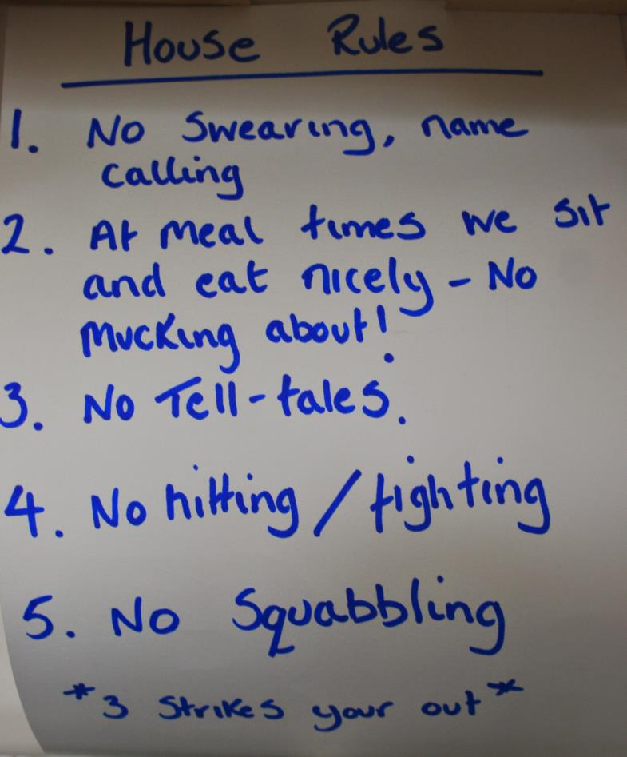

Don't talk over each other
Please keep to time
Respect
Chatham House rules
Notes:
Rules –
Chatham house,
don't talk over each other
Keep to time

Slide 7
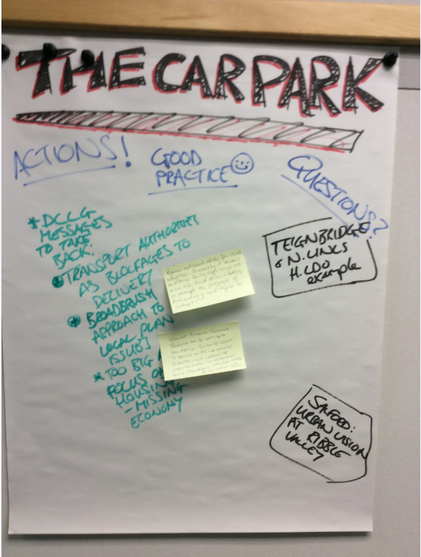
On the wall
The Car Park
Notes:
7
The Car Park
For any questions or issues that we don’t get chance to cover in a session or anything we can’t answer and will take away come back to you.
Please come up and add things
We will revisit anything that is added

Slide 8
Government agenda items and issues that concern you
Local plan production: DtC, 5YHLS, OAN, 2017 target,. 14
Affordable Housing, Starter Homes & Right to Buy 9
New Home Bonus Reform 6
Brownfield Register & Permissions in Principle 6
Fees/Resourcing 6
DM Performance 3
Neighbourhood Planning Reform 3
Alternative providers 2
Recruitment of experience planners 2
Delivery quality sustainable development 2

Slide 9
The Government & Planning Reform
Day1
The legislation
Affordable housing: Starter Homes, Right to Buy
CIL reform
A developer’s view: HBF
Brownfield Register & PIPs
Alternative Providers & fees
NHB Reform
DM performance
5pm finish
7pm bar & 8pm Dinner
Day2
9.00 start
Neighbourhood Planning Changes;
The Housing White Paper: Local Plan Changes, resourcing
Horizon scanning: Brexit effect, ….
Finish 1pm
Optional Lunch

Slide 10
The experience in the room
Portfolio Holders/Shadow (13)
Planning committee chairs, vices & members (10)
Deputy Leaders (3)
Plus many other responsibilities
over 300 years of local government experience in the room
Notes:
Different levels of knowledge
Sharing with each other
Learning from one another
There is a range of knowledge in the room – appreciate the differences
Different levels of knowledge and experience - roles in the room.
Roles:
13 chairs or vice chairs or members of planning committee
11 cabinet members for planning
3 Deputy leaders
1 Cabinet members for Housing & Economy
1 Leader
Some of this is new to everyone so it is important to share with one another and learn from one another
Mention that we want them to share experiences - collective knowledge

Slide 11
The Government’s Planning Reform Agenda
The key DCLG priorities focus on:
Manifesto Commitments - Budget - Productivity Plan
Supporting strong communities with excellent public services
Devolving powers and budgets to boost local growth
Increasing home ownership
Driving up housing supply

Slide 12
The Government’s Planning Reform Agenda
Manifesto commitments
200,000 Starter Homes for first time buyers by 2020
A new Right to Build for local people to build or commission their own home
Ensure that more than 90% of suitable brownfield sites have planning permission for housing by 2020
Strong protection for the Green Belt and other designations
Ensure communities know up-front that necessary infrastructure will be provided when new homes are permitted
Encourage communities engaged in neighbourhood planning to complete the process, and let people have more say over local planning
Give local people the final say on wind farm applications
Support safe development of shale gas

Slide 13
New team same old approach?
Theresa May: “more into building homes to ensure that young people have a better opportunity to get on the housing ladder”
Sajid Javid: “…make sure we build more homes, that local people are still involved in those decisions and that we find ways to speed it up”.
Gavin Barwell: I look forward to working with councils, housing associations, developers, investors and local communities to make sure we build what we need with the mix of tenures that people want and that those homes should be great places to live.

Slide 14
The Government’s Planning Reform Agenda
The Housing & Planning Act: Starter Homes, Brownfield Reg & Permissions in Principle, Alternative providers, Local Plan provision,
DM performance
The Neighbourhood Planning Bill: Neighbourhood Planning Reform, Local Plan provision, Planning Conditions, CPO
New Home Bonus changes
The Planning White Paper: ????

Slide 15
The Government’s Planning Reform Agenda
The Housing & Planning Act: Starter Homes, Brownfield Reg & Permissions in Principle, Alternative providers, Local Plan provision,
DM performance
The Neighbourhood Planning Bill: Neighbourhood Planning Reform, Local Plan provision, Planning Conditions, CPO
New Home Bonus changes
The Planning White Paper: ???? Due out in Nov!

Slide 16
The Government’s Planning Reform Agenda
The Housing & Planning Act: Starter Homes, Brownfield Reg & Permissions in Principle, Alternative providers, Local Plan provision,
DM performance
The Neighbourhood Planning Bill: Neighbourhood Planning Reform, Local Plan provision, Planning Conditions, CPO
New Home Bonus changes
The Planning White Paper: ???? Nov, Due out in Dec!

Slide 17
The Government’s Planning Reform Agenda
The Housing & Planning Act: Starter Homes, Brownfield Reg & Permissions in Principle, Alternative providers, Local Plan provision,
DM performance
The Neighbourhood Planning Bill: Neighbourhood Planning Reform, Local Plan provision, Planning Conditions, CPO
New Home Bonus changes
The Planning White Paper: ???? Nov, Dec, Due out in Jan!

Slide 18
The Government’s Planning Reform Agenda
The Housing & Planning Act: Starter Homes, Brownfield Reg & Permissions in Principle, Alternative providers, Local Plan provision,
DM performance
The Neighbourhood Planning Bill: Neighbourhood Planning Reform, Local Plan provision, Planning Conditions, CPO
New Home Bonus changes
The Planning White Paper: ???? Nov, Dec, Jan, … Feb?, March?

Slide 19
The Government’s Planning Reform Agenda
The Housing & Planning Act: Starter Homes, Brownfield Reg & Permissions in Principle, Alternative providers, Local Plan provision,
DM performance
The Neighbourhood Planning Bill: Neighbourhood Planning Reform, Local Plan provision, Planning Conditions, CPO
New Home Bonus changes
The Planning White Paper: ????Local Plan reform, CIL Reform, Fees, Increasing planner no.?????

Slide 20
Affordable Housing – a new definition
Allowing for ‘innovation’ in housing products
Now to include ‘discount market sales’ and ‘rent to buy’
Removal of ‘in perpetuity’ in new products
Wider range of products – including ‘Starter Homes’
Notes:
Current definition (in NPPF) includes social rented, affordable rented and intermediate housing, provided to eligible households whose needs are not met by the market.
There is no new definition written down as yet
Consultation document talks about the limitations of the current definition and potential for innovative new products.
Intention is clear. “Plan for the requirement for the housing needs of those who aspire to home ownership alongside those whose needs are best met through rented homes, subject as now to the overall viability of individual sites”

Slide 21
Starter Homes
200,000 target by 2020 (David Cameron)
For sale at a maximum of 80% of market rates
20% saving coming from removal of S106 and CIL provisions
Limited to first time buyers under 40
Price reduction will last for 5 years (or a taper?)
Price capped:£450k/£250
Legal duty on councils to deliver
Notes:
This is the big one. Very important to the government. Using levers of the planning system to increase home ownership. Expect local authorities to plan for, and developers to build, this type of housing.
The Housing and Planning Act 2016
Legal duty on councils to deliver Starter Homes on all reasonably sized new development sites, and promote scheme to first time buyers in the area, and prepare reports about the actions they have taken under the starter homes duties.
Policy implementation:
Technical consultation on proposed regulations -
all schemes on 10 units or over, or 0.5 ha or over
20% standard minimum rate nationally
exemptions where starter homes would make a site unviable
various other exemptions for specialist housing and circumstances
off-site provision for apartments and by agreement with the LPA
other possibilities not taken forward at this time, eg differential requirements by region
a specific monitoring regime to be published alongside the AMR
The SoS will also have the power to make a compliance directive directing that an incompatible policy in a local plan should not be taken into account when planning decisions are taken
Exemptions?
Certain types of residential development eg older persons housing
Where makes development unviable
Will there be any local discretion (set out in policy) allowed?
Implications for local plans
Since promoting starter homes will be a duty, even where plans are at an advanced stage it will not be safe to press on without addressing them
We can expect local plan Inspectors to begin immediately asking how they will be secured relative to CIL and genuine affordable provision
As a duty, starter homes will come before affordable housing and proposed CIL as calls on development
So policy for affordable housing and ideas for the CIL will have to be revised downwards to allow for starter homes and self-build
Implications: Viability evidence
Arguably, all current viability evidence is now out-of-date
The evidence will need to be updated to assist the re-working of policy
How will starter homes be dealt with in carrying out viability assessment?
Will it be sufficient to simply say that their value is 80% of that of the full market version of the same house?
Or will something more sophisticated be necessary?
Will the same principles of approach serve for both plan viability and development management assessment?
Perhaps we shall have to wait and see how practice develops
Political priorities
Elected members will need to re-consider their priorities
Starter homes will squeeze out real affordable housing
Where there is no charging schedule in place, they will also put downward pressure on the level of CIL which can be justified
So Members should be asked to re-consider the balance between CIL, affordable housing and other planning policy requirements
DM and starter homes
Developers are already seeking to re-negotiate permissions and S106 agreements to replace affordable housing with starter homes -
it will be very difficult to resist such moves given the imminent duty
so some affordable housing which LPAs thought had been secured will be lost
Expect some developers to seek to replace affordable housing entirely by starter homes
Until the Regs are in place and practice has developed, LPAs will have to make the best of things
Pending local plan coverage, should be OK to rely on the minimum requirement in the Regs
Starter homes are to be secured through S106 agreement, including any off-site provision
So there will have to be a S106 for every qualifying site
Standard forms of agreement or standard clauses?
Since LPAS will forego other benefits they could secure for the community, will they need to ensure that the discount is genuine rather than just accept builders’ assertions?
evidence of prices on genuinely comparable sites?
What about special starter homes designs where there are no comparators?
Will they need to check that purchasers truly qualify?
Enforcement?

Slide 22
Starter Homes
H&P Act has introduced a statutory duty to promote the delivery of starter homes
And a requirement for a proportion of starter homes on all suitable reasonably sized housing developments.
Exception sites for unviable and underused employment land
LPAs will be able to negotiate the tenure of houses with a developer
We are still waiting for the level of required to be delivered to be annouced

Slide 23



Questions? Comments!

Slide 24
New Homes Bonus Reform

Slide 25
New Homes Bonus consultation
Withholding new homes bonus if you haven’t got a plan in place
Reducing payments for homes allowed on appeal
Notes:
Withholding the Bonus where no Local Plan has been produced
Government should delay proposals to withhold the Bonus where there is no Local Plan and reconsider as part of its wider response to the Local Plans Expert Group, which is due to report on its findings later this year.
The LGA has welcomed the government’s intention to simplify Local Plan making. Councils too often find the process expensive, slow and uncertain. The LGA has contributed to the government’s Local Plan Expert Group aiming to streamline the plan-making process, recommending:xyz
Furthermore Local Plans will likely be increasingly undermined by national interventions – such as permitted development and, potentially, starter homes - that will deliver homes regardless of the Local Plan’s strategy to deliver a mix of housing, infrastructure and growth across in line with local assessments of need and viability.
Reducing payments for homes allowed on appeal
Reduced payments should only apply to homes granted on appeal where the council is directed to meet the costs of the applicant’s appeal due to being judged as acting unreasonably in refusing an application.
A plan led system is the most effective way of ensuring that land with community support for housing is made available and providing long term certainty to encourage investment in new build housing with the necessary infrastructure.
A democratically led planning system is crucial to building strong communities and there is a risk proposals will undermine the capacity for councils to represent the views of local communities when making a decision on a planning application.
Councils do not refuse applications because they oppose the principle of development, but because there may be issues of importance to communities, such as on funding for infrastructure, flood defence or affordable homes, that are unresolved with the applicant.
A potential loss of Bonus for all homes allowed on appeal will serve to undermine local democratically led plan making. Instead, the loss should only apply where the council is judged to have behaved unreasonably, whereby an applicant has been successful in recovering appeal costs from the council.
^{[1]} New Housing Developments Survey, Local Government Association, 2012

Slide 26
New Homes Bonus Reform
Growth Baseline of 0.4% - under this level of growth NHB won’t be paid.
Affordable Home premium (£370 per unit) will continue
Previous years payments will continue
Payment period will be reduced: 6 years presently, 5 years for 2017/18, 4 years from 2018/19. After this point??
£240 million is being taken out of the process by the reform – to help fund the required adult social care but “local government will retain the saving to contribute to adult social care” (SoS)
Notes:
Growth Baseline of 0.4% - under this level of growth NHB won’t be paid.
Affordable Home premium (£370 per unit) will continue
Previous years payments will continue
Payment period will be reduced: 6 years presently, 5 years for 2017/18, 4 years from 2018/19. After this point?? But I assume that it not link to the 2020 aim of LG self-sufficiency agenda.
£240 million is being taken out of the process by the reform – to help fund the required adult social care issue.
Com Sec has said that local government will retain the saving to contribute to adult social care.
Authorities are unable to grow either through housing market or geographical or planning constraints will be penalised under the new process.

Slide 27
Questions? Comments!

Slide 28
Coffee – 15 mins

Slide 29
Future of CIL and Developer Contributions
LGA/PAS Leadership Essentials – Jan 2017
Gilian Macinnes

Slide 30

Gilian Macinnes-
gilian@gmacinnes.co.uk
0771 4394046
Website- gmacinnes.co.uk
Twitter: @gilianGMAC
Notes:
Gilian Macinnes Associates can advise you on all aspects of planning and place making. If you are a local planning authority (LPA) or other public service we will help you build capacity and improve your planning and place making services to deliver effective outcomes for your community. If you are a development Industry organisation Gilian Macinnes Associates can improve your knowledge of planning, place making and working with LPAs, aid your interaction with Council’s, LPAs and communities to deliver development. In addition, in times of stretched LPA resources, Gilian Macinnes Associates can be appointed by you to work with Councils to increase their capacity to deliver your projects.
Gilian Macinnes (Director) has worked in Local Government for over 30 years -the majority of which was delivering planning on the ground and managing planning services; and more recently, with the Planning Advisory Service, advising English LPAs delivering improvement programmes, seminars, and councillor and officer training. She was appointed to the Government’s CIL Review Panel in October 2015.
Gilian is a very well respected expert, communicator and trainer in planning and related areas. She was named as one of the most influential women in planning (2016) by ‘Planning’ magazine.

Slide 31
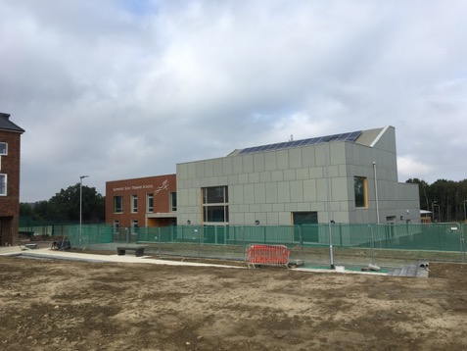
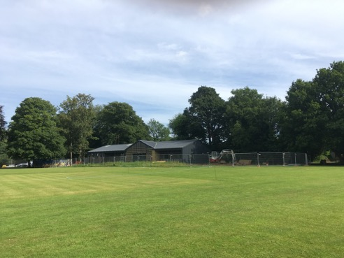
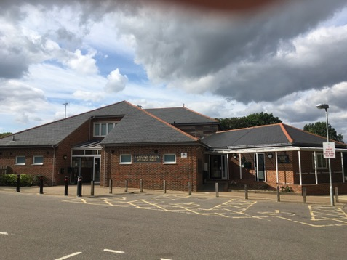
Making a Place
Delivering sustainable communities requires infrastructure and facilities to support growth

Slide 32

Developer contributions-
What are the Mechanisms?
Community Infrastructure Levy
S106 obligations/agreement of the Town and Country Planning Act 1990 (as amended)
S278 of the Highways Act
Other funding streams:
Neighbourhood proportion
Central Government (e.g. Dept. of Transport)
Local Enterprise Partnership (LEP)
Growing places funds
EU
Low interest Govt Loans - consultation

Slide 33
S106 – tests and restrictions
If the development is capable of being charged CIL, the S106 obligation must meet these legal tests:
    NECESSARY to make the development acceptable in planning terms
    DIRECTLY RELATED to the development
    FAIRLY AND REASONABLY related in kind and scale to the development
These are also now the policy tests in the NPPF
Pooling restrictions – no more than 5 obligations
Notes:
33
For development capable of being charged CIL– Not for other s106 obligations e.g. affordable housing, habitats except infrastructure for habitats ( visitor centre)
The Community Infrastructure Levy regulations 2010 (as amended):
Limitation on use of planning obligations
122.—(1) This regulation applies where a relevant determination is made which results in planning permission being granted for development.
(2) A planning obligation may only constitute a reason for granting planning permission for the development if the obligation is—
(A)NECESSARY TO MAKE THE DEVELOPMENT ACCEPTABLE IN PLANNING TERMS;
(B)DIRECTLY RELATED TO THE DEVELOPMENT; AND
(C)FAIRLY AND REASONABLY RELATED IN SCALE AND KIND TO THE DEVELOPMENT.
(1)
NPPF:
204. Planning obligations should only be sought where they meet all of the
following tests:
●necessary to make the development acceptable in planning terms;
● directly related to the development; and
● fairly and reasonably related in scale and kind to the development.
205. Where obligations are being sought or revised, local planning authorities
should take account of changes in market conditions over time and,
wherever appropriate, be sufficiently flexible to prevent planned development
being stalled.
S106 can-
restrict the development or use of the land in any specified way
require specified operations or activities to be carried out in, on, under or over the land
require the land to be used in any specified way; or
require a sum or sums to be paid to the authority (or, to the Greater London Authority) on a specified date or dates or periodically.
be subject to conditions,
specify restrictions definitely or indefinitely,
And in terms of payments the timing of these can be specified in the obligation.
If the s106 is not complied with, it is enforceable against the person that entered into the obligation and any subsequent owner.
The s106 can be enforced by injunction.
Site specific mitigation measures
Limitation on Pooling contributions where s106 has been taken into account on 5or more Planning permissions
NPPF- planning obligations should take into account changes in market conditions over time and, where appropriate, be flexible to prevent stalling (para. 205)

Slide 34
What is a Community Infrastructure
Levy (CIL)?
A mechanism for developer contributions
It operates like a tax
Whats it for? -
To help pay for infrastructure needed to support new development
But not to remedy existing deficiencies unless the new scheme will make it worse
Councils must spend the income on infrastructure – but what- can change
Notes:
The aim is to allow local authorities to raise funds from developers to fund a wide range of infrastructure that is needed as a result of new development. Almost all development has some impact on the need for infrastructure, services and amenities, so it should contribute to the cost.
Planning Act says that authorities can only spend CIL on providing infrastructure to support the development of their areas:
“Infrastructure” legally includes (so the list in the Act is not exhaustive):
flood defence, open space, recreation and sport, roads and transport facilities, education and health facilities
CIL Regulations 2010 removed affordable housing, which will continue to be funded by S106s
Localism Act clarifies that CIL can be spent on the ongoing costs of providing infrastructure (Maintenance, Operational and Promotional);
Update: Act - 2008
CIL Regulations – April 2010
Last regulations update – Feb 2014
Statutory guidance now contained in NPPG - http://planningguidance.planningportal.gov.uk/blog/guidance/community-infrastructure-levy/
Localism Act 2011

Slide 35
Charging CIL – some basics
£ per square metre on net additional (internal) floorspace
Rates can vary by geographic area, use, or scale (or a combination)
Due when the development starts
It is index linked
The landowner is responsible for paying it
The local planning authority is the charging authority (& sets the CIL)
Notes:
CIL is charged on net additional floorspace – so any floorspace that has recently been in use ( 6 months use in the last 3 years prior to pp being granted)
Reg 40 11(2)contains a part that has been in lawful use for a continuous period of at least six months within the period of three years ending on the day planning permission first permits the chargeable development
Will be charged on most buildings that people use – not just housing.
Unlike floorspace calculations that are normally carried out in planning for CIL internal measurements are required
The definition of commencement of development is the same as already exists in planning legislation. Development is to be treated as commencing on the earliest date on which any material operation begins to be carried out on the relevant land.
The Index is the : The All- in tender price index of construction cost published by Building cost information service of the RICS
The collecting authority issue a liability notice setting out the requirements to pay the levy and encourages someone to assume liability – ultimately the owner of the land is liable – the liability transfers when the land is sold – the liability runs with the land.
Existing permissions will never be caught. Nor will any permission granted before a charging schedule is brought into effect locally

Slide 36
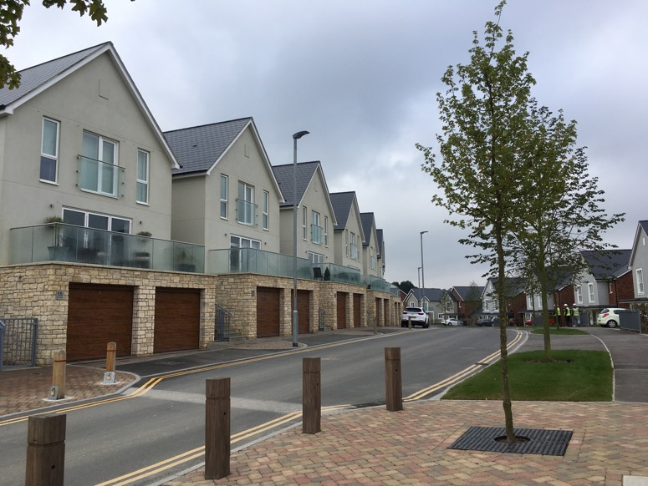
What pays CIL?
Development which creates net additional floor space.

Slide 37
What doesn’t Pay CIL
Buildings people don’t normally go into
Development of less than 100 sq m except for whole residential unit
Self build – houses and extensions
Where the development meets relief criteria
Vacant building brought back into the same use
Where the charge is less than £50
Mezzanines less than 200 sq m unless they are part of a wider PP
No payment is required where the CIL rate set is Zero.
Notes:
Paragraph: 003 Reference ID: 25-003-20140612
What kind of development does not pay the levy?
The following do not pay the levy:
development of less than 100 square metres (see Regulation 42 on Minor Development Exemptions) – unless this is a whole house, in which case the levy is payable
houses, flats, residential annexes and residential extensions which are built by ‘self builders’ (see Regulations 42A, 42B, 54A and 54B, inserted by the 2014 Regulations)
social housing that meets the relief criteria set out in Regulation 49 or 49A (as amended by the 2014 Regulations)
charitable development that meets the relief criteria set out in Regulations 43 to 48
buildings into which people do not normally go (see Regulation 6(2))
buildings into which people go only intermittently for the purpose of inspecting or maintaining fixed plant or machinery (see Regulation 6(2))
structures which are not buildings, such as pylons and wind turbines
specified types of development which local authorities have decided should be subject to a ‘zero’ rate and specified as such in their charging schedules
vacant buildings brought back into the same use (see Regulation 40 as amended by the 2014 Regulations)
Where the levy liability is calculated to be less than £50, the chargeable amount is deemed to be zero so no levy is due.
Mezzanine floors of less than 200 square metres, inserted into an existing building, are not liable for the levy unless they form part of a wider planning permission that seeks to provide other works as well.
Revision date: 12 06 2014

Slide 38
What are the absolute basic requirements of setting a CIL?
To set a CIL you need to:
1. demonstrate that you need funding for infrastructure to support your development (a funding gap)- this proves need for a CIL; and
2. evidence that the amount you are going to charge CIL at is not so high as it will threaten the delivery of the growth strategy for the area.

Slide 39


VIABILITY
HOUSING
EMPLOYMENT
RETAIL
Infrastructure
Local Plan Policies
CIL Guidance: When deciding the levy rates, an appropriate balance must be struck between additional investment to support development and the potential effect on the viability of developments. Achieving the right balance is at the centre of the charge-setting process.
Notes:
This is a balance not a calculation

Slide 40
S106 changes – pooling restrictions
Without a CIL in place your council is at risk of significantly reducing income from developer contributions
Without a CIL in place you may not have a mechanism to obtain necessary mitigation for a development.
Notes:
After 1 April 2015, you will not be able to have a planning obligation as a reason for granting / refusing planning permission where you have already pooled 5 or more of the same obligation.
You may be in the position that you cannot mitigate a proposed scheme as you do not have a s106 or CIl mechansim with which to achieve the requirement – e.g. flood relief scheme pooling for all local development.
It take a year but usually more like 18 months to get a CIL to examination.
From April 2015 – pooling restrictions for 5 or more s106

Slide 41
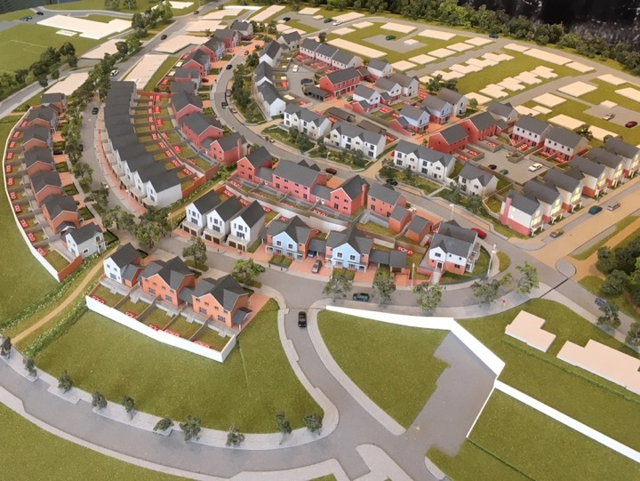
Recent or Proposed Changes to s106
Knights Park – houses, school, shops, transport
-Dandara Homes

Slide 42
Speeding up s 106
March 2015 changes to PPG- Extensive additional advice to improve implementation of s106 and add clarity
Housing and Planning Act 2016 – s158 &159 – s106 Dispute resolution and Enforceability of s106 regarding affordable housing- become s106 ZA and s106 ZB of the 1990 Act
Notes:
View the changes to the practice guidance following the response to the consultation.
View the government response to consultation: Section 106 Planning obligations – speeding up negotiations (Student accommodation and affordable housing contributions).
View the original consultation.
Changes include:
Involve communities in s106 policy
Does not now say public art is unnecessary
More open book advice and making information available to the public
Advice on discussion and negotiation encouraging early engagement – pre app
Encouraging two tiers to work together
Use of standardised templates
More timely approach
Encouraging collaborations and shared specialist
Advice on negotiation and appeal
Making it very clear that ministerial statements are national policy and generally minor changes throughout for clarity.
Housing and Planning Act 2016 s158 and 159 changes to s106 ZA and 106 ZB respectively

Slide 43

CIL – The Future

Slide 44
CIL Review Panel-
Liz Peace (Chair), Advisor (formerly British Property Federation)
Gilian Macinnes, Advisor, Gilian Macinnes Associates (formerly Planning Advisory Service)
Andrew Whittaker, Planning director, Home Builders Federation
Cllr John Fuller, Leader of South Norfolk District Council
Michael Gallimore, Partner, Hogan Lovells
Steve Dennington, Interim service head – Spatial Planning, Croydon Council
Tom Dobson, Director, Quod

Slide 45
Purpose of the CIL Review
“Assess the extent to which CIL does or can provide an effective mechanism for funding infrastructure, and to recommend changes that would improve its operation in support of the Government’s wider housing and growth objectives.”
Notes:
specifically requested to look at;
The relationship between CIL and Section 106 in the delivery of infrastructure, including the role of the regulation 123 list and the restriction on pooling planning obligations;
The impact of CIL on development viability, including any disproportionate impact on particular types or scales of development;
The exemptions and reliefs from CIL;
The administrative arrangements and governance associated with charging, collecting and spending CIL;
The ability of CIL to fund and deliver infrastructure in a timely and transparent way;
The impact of the neighbourhood portion on local communities’ receptiveness to development; and
The geographical scale at which CIL is collected and charged.

Slide 46

Approach
The original principles of CIL – to be
  faster,
  fairer,
  more certain and
  transparent.
These were the tests that the panel used to review CIL
Considering CIL’s performance to date in making a reasonable contribution to help meet the cumulative costs of infrastructure required as a result of development in an area.
Recognising it was early days.

Slide 47
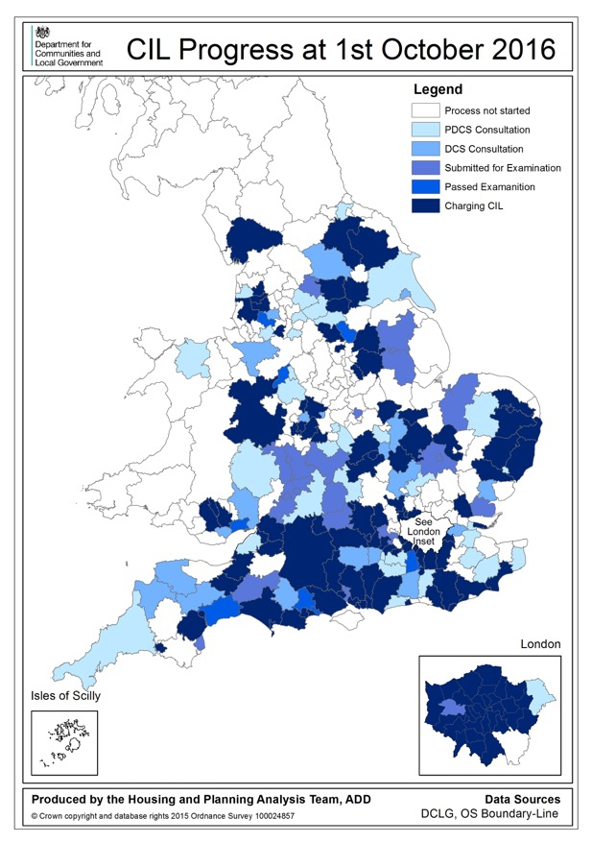
CIL Progress

Slide 48
Evidence
Included:
Raising less than envisaged – but more as it matures
Amount reduced by the number of exemptions
CIL commonly raises between 5-20% of infrastructure funding
Some areas -CIL is set at a ‘lowest common denominator’ level – strategic approach – s106 could achieve more on some sites
Originally envisaged that all types of development would contribute – but most CILs require only Residential and Retail to pay.

Slide 49
Evidence (cont.)
Timing of payment an issue,
Risk of delivering infrastructure transferred to the Local Planning Authority (LPA)
Developers and communities do not know where the CIL will be spent and therefore uncertainty about infrastructure delivery
Forward funding
Complexity
S106 Pooling limitation

Slide 50
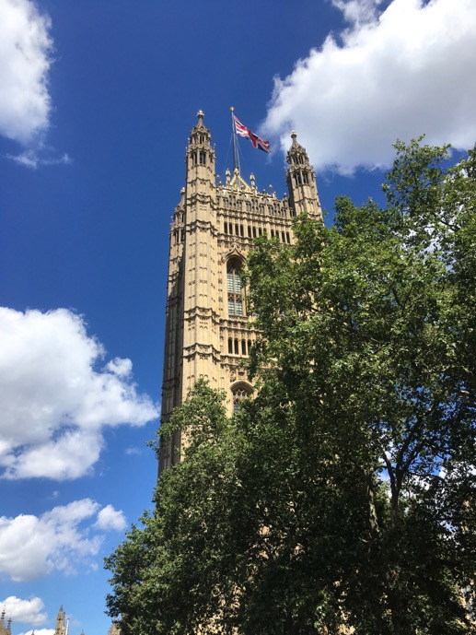
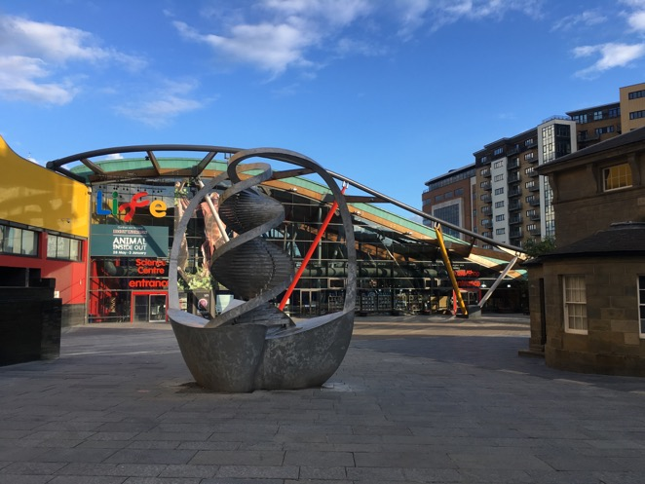
CIL -The Future

Slide 51
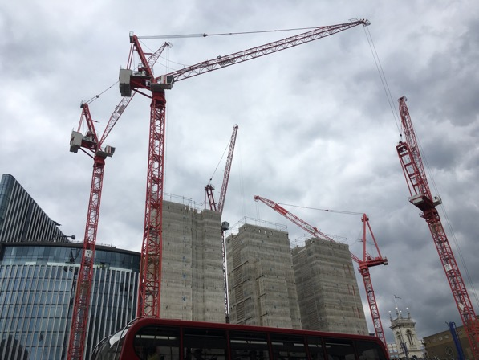
Government Loans –
HM Treasury
Consultation on introducing the Local Infrastructure Rate
Published 15 December 2016

Slide 52

Contact me
gilian@gmacinnes.co.uk
0771 4394046
Website- gmacinnes.co.uk
Twitter: @gilianGMAC
Notes:
Gilian Macinnes Associates can advise you on all aspects of planning and place making. If you are a local planning authority (LPA) or other public service we will help you build capacity and improve your planning and place making services to deliver effective outcomes for your community. If you are a development Industry organisation Gilian Macinnes Associates can improve your knowledge of planning, place making and working with LPAs, aid your interaction with Council’s, LPAs and communities to deliver development. In addition, in times of stretched LPA resources, Gilian Macinnes Associates can be appointed by you to work with Councils to increase their capacity to deliver your projects.
Gilian Macinnes (Director) has worked in Local Government for over 30 years -the majority of which was delivering planning on the ground and managing planning services; and more recently, with the Planning Advisory Service, advising English LPAs delivering improvement programmes, seminars, and councillor and officer training. She was appointed to the Government’s CIL Review Panel in October 2015.
Gilian is a very well respected expert, communicator and trainer in planning and related areas. She was named as one of the most influential women in planning (2016) by ‘Planning’ magazine.

Slide 53
Lunch – 1 hour

Slide 54
The Government’s Planning Agenda and Local Government: the developers’ view
Andrew Whitaker MA MRTPI FRSA
Planning Director

Slide 55
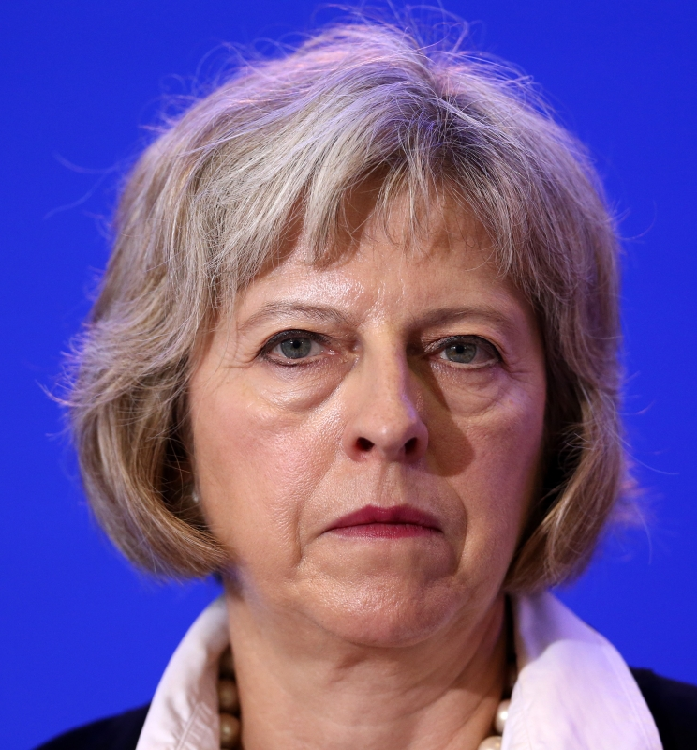



Slide 56
Private sector share
1991-2014: 84%

Slide 57
Private sector share
1991-2014: 84%

Slide 58


Slide 59


Slide 60


Slide 61
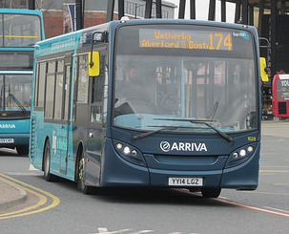

Slide 62
Build costs
Profit, overheads, interest
GDV
Cost of CIL & S106 inc. Affordable Housing
Land value (residual)
GDV = Gross Development Value

Slide 63
GDV
GDV
GDV = Gross Development Value

Slide 64
GDV
GDV
GDV = Gross Development Value

Slide 65
GDV
GDV
GDV = Gross Development Value

Slide 66


Slide 67


Slide 68


Slide 69
Think of a number
Subtract 1 from it
Multiply it by 3
Add 12 to the result
Divide by 3
Add 5 to the result
Take away the number you first thought of

Slide 70
8

Slide 71


Slide 72
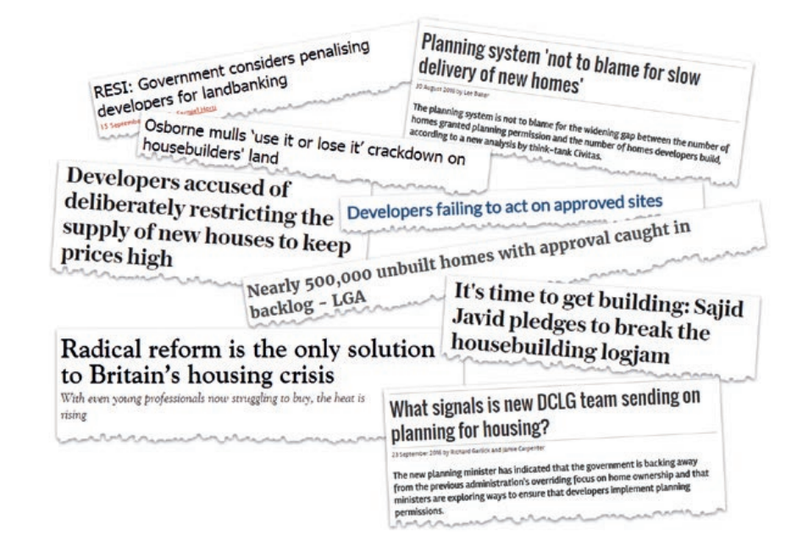

Slide 73
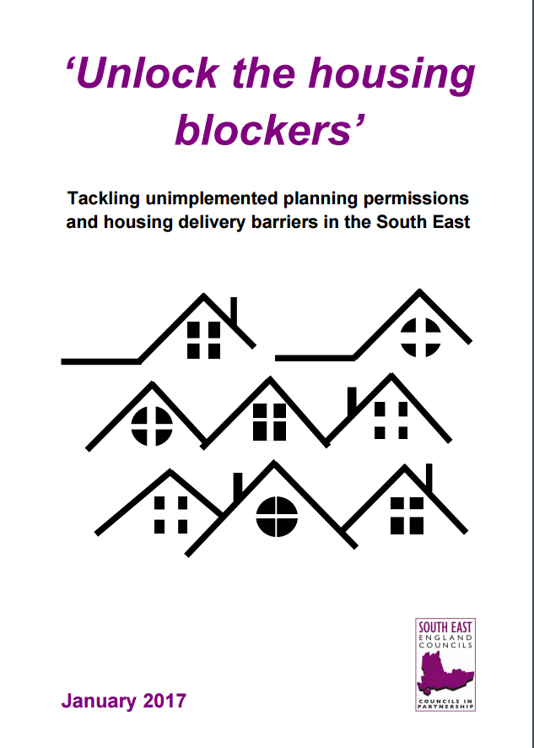
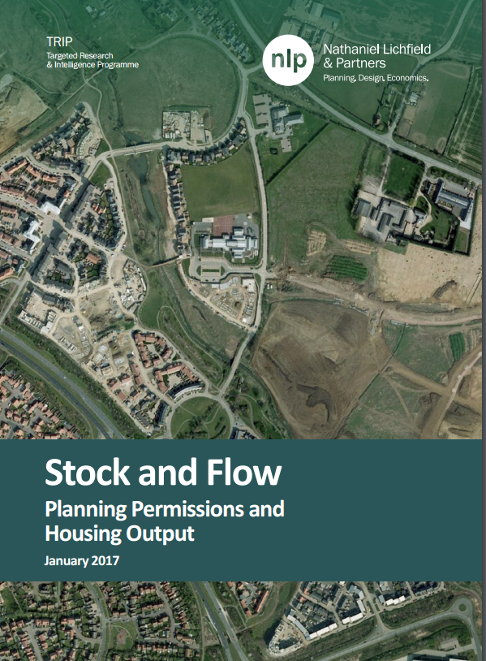

Slide 75
Do the Maths
Plan period 2016 – 2031 (15 years)
Housing requirement = 1,200 net additional dwellings
Annual requirement = 1,200 / 15 = 80 dwellings per year
5 year housing supply = 80 x 5 = 400

Slide 76
5 Year Trajectory Plan

Slide 78
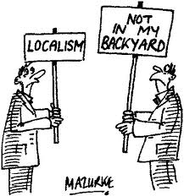

Slide 79
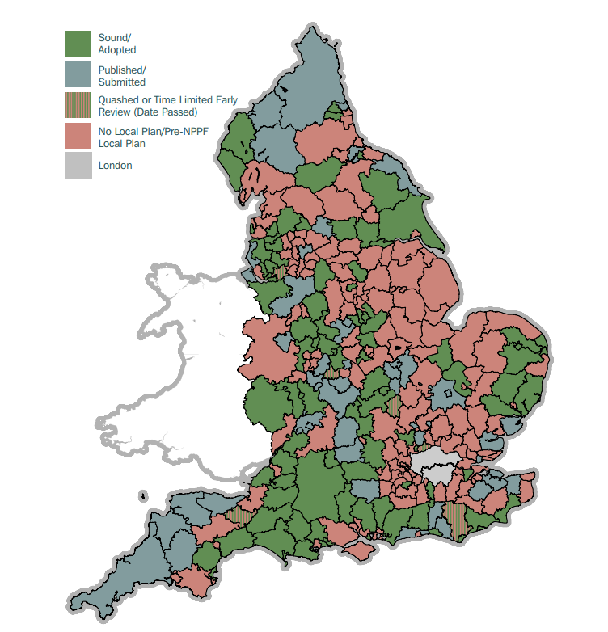

Slide 80
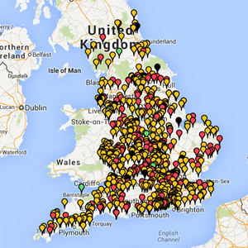

Slide 81
NEIGHBOURHOOD PLAN PROGRESS
Applied | Designated | Pre-sub draft | Submitted | Examined | Ref held | Made
2121 | 1994 | 617 | 442 | 321 | 271 | 231
127 | 1377 | 175 | 121 | 50 | 40 | 231

Slide 82
Planning fees and costs recovery

Slide 83


Slide 84


Slide 85


Slide 87
Coffee – 15 mins

Slide 88
NPPF – brownfield land
Planning policies and decisions should encourage the effective use of land by re-using brownfield land provided that it is not of high environmental value
‘Brownfield first’ went
Local councils can set locally appropriate targets for using brownfield land

Slide 89
Housing and Planning Act
2 relevant aspects:
  Councils to keep a register of brownfield land suitable for housing
Permissions in principle (PiP)
  2 kinds:
    By application decided by councils
    Granted by the SoS through a development order

Slide 90
Brownfield Register
Issue:
How to incentivise the development of previously developed land, given that this land may have higher development costs and not initially be attractive (or profitable)
Policy Aims:
improve the availability and transparency of information, providing certainty and encouraging investment
help to measure progress in delivering permissions
Build on existing plan making processes to avoid additional work
Notes:
In compiling the register, the local authority will need to have regard to its own development plan as well as considering national policies and guidance.
So, for example, if a piece of brownfield land has been designated for employment use in the local plan, then the council will not have to enter it on to the register as a site that is suitable for housing.
Councils may also have discretion to exclude certain sites from the register, such as land that already has permission for housing. There will be scope, in exceptional cases such as especially controversial schemes, for authorities to use the conventional planning application route rather than a PPIP granted by the brownfield register.

Slide 91
Brownfield register – H&P Act
Requirement for councils to compile a register of local brownfield land suitable for housing development and to keep it up to date.
SoS will be able to prescribe criteria that sites must fulfil for entry on the register
  For example, he may stipulate that the land must be available already or in the near future for housing development, that it must not be affected by physical or environmental constraints that cannot be mitigated, and that it must be capable of supporting five dwellings or more.

Slide 92
Brownfield Register
From the February consultation
Is the site:
  Deliverable;
  Free of Constraint (that cannot be mitigated);
  Capable of Development;
  Capable of supporting 5 or more dwellings (on sites 0.25ha and above*).
We don’t know if this will be the same in regulations/secondary legislation
Being piloted in 70 councils
Aim is that by 2020 90% of brownfield sites have planning permission for housing
Notes:
Councils will be required to compile a register of local brownfield land suitable for housing development, and to keep it up-to-date. The secretary of state will be able to prescribe any criteria that the land must fulfil for entry on to the register. The government states that it could, for example, stipulate that the land must be available already or in the near future for housing development, that it must not be affected by physical or environmental constraints that cannot be mitigated, and that it must be capable of supporting five dwellings or more.
every council will be required to compile a register of local brownfield land suitable for housing development and to keep it up to date. The secretary of state will be able to prescribe criteria that sites must fulfil for entry on the register, although councils will also need to have regard to their own development plan as well as national policy and guidance. For example, he may stipulate that the land must be available already or in the near future for housing development, that it must not be affected by physical or environmental constraints that cannot be mitigated, and that it must be capable of supporting five dwellings or more.

Slide 93
Brownfield Register
Register likely to be in several parts:
  Land suitable for housing that meets specified criteria
  Land that the LPA considers is suitable for the grant of PiP and which has been through a consultation process eg site allocation (but not incl. land with planning permission)
  Land which does not meet the criteria, but which the LPA wishes to include e.g. suitable for 4 of fewer houses
Exemptions?

Slide 94
Permission in principle
  Issues
  How to ensure upfront certainty on in principle issues before getting into detailed, technical considerations?
  Policy Aims
  Up front, binding certainty on fundamental issues for all users – reducing upfront costs/resource
  Improve the efficiency of the planning system by minimising repeated effort by both developers and local planning authorities
Notes:
Many experts are positive about PPIP's possible benefits. But there are also concerns over the potential for the measure to increase the workload of hard-pressed planning policy teams. For example, the change could trigger the need for environmental impact assessment (EIA) work on plans, due to the fact that they would now effectively constitute development consents under the EIA Directive, suggests Richard Harwood QC of 39 Essex Chambers. "The document will therefore need to contain sufficient detail to enable a decision to be taken as to whether EIA is required," he says. "This will involve consideration of the mitigation proposed, even though that will not be secured until the TDC stage."
Harwood also suggests that consultation and publicity measures will need to be ramped up in the immediate locality of a proposed allocation and that neighbour notification and site notices will need to apply to proposed allocations as a result of the change.

Slide 95
Permission in Principle
Permission in principle model
“Permission in Principle” (PIP)
certainty on “in principle issues” of land use, the location and the amount of development
“Technical Details Consent” (TDC)
Sufficient process to deal with technical matters
Permission in Principle (PIP)
Technical Details Consent (TDC)
Permission to Build

Slide 96
Permission in Principle
Type 1: granted by development order S59(A)
Type 2: granted by councils S59(A) (i)
Plan and Registers grant permission in principle
Application for permission in principle
(Small sites)
Local Plan
Neighbourhood Plan
Brownfield register
Application for Technical Detail Consent (S70)
Notes:
Before we get into the detail is would be useful to have a chat about the problem (print off and circulate)
Type 1 PiP – allocations and registers
Initially only for land allocated in brownfield register, DPDs and NPs
The Order will set out type and scope of development to be granted PiP
Current intention - limited to housing sites
PiP will indicate site, location and amount of development
PiP will only be granted when the register, DPD or NP is adopted or made by the council (not retrospective)
The Order will specify how long the PiP will last and what transitional arrangement will follow when it expires
Relates to future allocations, not existing
Type 2 PiP – the application
The DMPO will specify the steps for the council to take following an application for a PiP
And steps for a technical detail consent application
Councils cannot grant PiP subject to conditions
Applications likely to be for less than 10 units
Councils will hold a register of all PiPs (both kinds)

Slide 97
Permission in principle
Technical details consent
Fee consistent with applications fees for similar development
Can’t reopen the principle of development through a TDC application
Conditions can be imposed at this stage
PiP may not bind where there has been a change of circumstances….

Slide 98
The package of brownfield register and PiPs
Some unknowns/unanswered questions:
Previously suggested 90% requirement – has it been dropped?
Will existing SHLAA process give LPAs enough confidence in the principle of development?
Deliverability – more viability testing - who pays?
More up front work for Councils (and neighbourhood groups) at a time of tough resource constraints?
Consultation with communities and statutory consultees?
Appeals – by both landowners and by neighbours?
Will it impact on plan preparation?

Slide 99
Questions? Comments!

Slide 100
NHB

Slide 101
New Homes Bonus consultation
Withholding new homes bonus if you haven’t got a plan in place
Reducing payments for homes allowed on appeal
Notes:
Withholding the Bonus where no Local Plan has been produced
Government should delay proposals to withhold the Bonus where there is no Local Plan and reconsider as part of its wider response to the Local Plans Expert Group, which is due to report on its findings later this year.
The LGA has welcomed the government’s intention to simplify Local Plan making. Councils too often find the process expensive, slow and uncertain. The LGA has contributed to the government’s Local Plan Expert Group aiming to streamline the plan-making process, recommending:xyz
Furthermore Local Plans will likely be increasingly undermined by national interventions – such as permitted development and, potentially, starter homes - that will deliver homes regardless of the Local Plan’s strategy to deliver a mix of housing, infrastructure and growth across in line with local assessments of need and viability.
Reducing payments for homes allowed on appeal
Reduced payments should only apply to homes granted on appeal where the council is directed to meet the costs of the applicant’s appeal due to being judged as acting unreasonably in refusing an application.
A plan led system is the most effective way of ensuring that land with community support for housing is made available and providing long term certainty to encourage investment in new build housing with the necessary infrastructure.
A democratically led planning system is crucial to building strong communities and there is a risk proposals will undermine the capacity for councils to represent the views of local communities when making a decision on a planning application.
Councils do not refuse applications because they oppose the principle of development, but because there may be issues of importance to communities, such as on funding for infrastructure, flood defence or affordable homes, that are unresolved with the applicant.
A potential loss of Bonus for all homes allowed on appeal will serve to undermine local democratically led plan making. Instead, the loss should only apply where the council is judged to have behaved unreasonably, whereby an applicant has been successful in recovering appeal costs from the council.
^{[1]} New Housing Developments Survey, Local Government Association, 2012

Slide 102
New Homes Bonus Reform
Growth Baseline of 0.4% - under this level of growth NHB won’t be paid.
Affordable Home premium (£370 per unit) will continue
Previous years payments will continue
Payment period will be reduced: 6 years presently, 5 years for 2017/18, 4 years from 2018/19. After this point??
£240 million is being taken out of the process by the reform – to help fund the required adult social care but “local government will retain the saving to contribute to adult social care” (SoS)
Notes:
Growth Baseline of 0.4% - under this level of growth NHB won’t be paid.
Affordable Home premium (£370 per unit) will continue
Previous years payments will continue
Payment period will be reduced: 6 years presently, 5 years for 2017/18, 4 years from 2018/19. After this point?? But I assume that it not link to the 2020 aim of LG self-sufficiency agenda.
£240 million is being taken out of the process by the reform – to help fund the required adult social care issue.
Com Sec has said that local government will retain the saving to contribute to adult social care.
Authorities are unable to grow either through housing market or geographical or planning constraints will be penalised under the new process.

Slide 103
Questions? Comments!

Slide 104
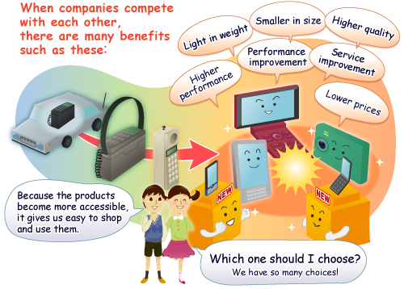
Alternative providers

Slide 105
Piloting competition in planning application processing
Cross sector agreement that resourcing in planning departments is a significant issue and risk to current and future performance.
LPAs have a monopoly in processing planning applications – may not incentivise innovation, service improvement and cost reduction.
Evidence that the public want choice in the services they use.
Running pilots to test the benefits of introducing competition to the processing of planning applications.
In pilot areas, an applicant will be able to submit their application for processing to either the LPA or an alternative approved provider.

Slide 106
Current picture
Many shared (to a degree) services
Some complete outsourcing (Salford, Breckland, to Urban Vision)
NE Lincs and N Tyneside - Cofey
Joint venture – Barnet
Some boroughs outsources some householders, or the registration/validation part
But this is the local authorities choice and a selected provider. Not a rival.

Slide 107
Piloting competition in planning application processing
Pilots will be time limited and in a small number of specific areas.
LPAs will continue to determine applications – approved providers will just process.
May enable an LPA to compete to process applications in other LPA areas, and enable the private sector to compete.
Flexibility in the setting of fees for pilot participants.
Implemented through regulations – the detail of how the pilots might operate is still to be worked out with colleagues, local authorities and professional bodies.
Possible December 2016 start.

Slide 108
Piloting competition in planning application processing
It is not privatisation or forced outsourcing – LPAs will still be able to provide a processing service, others will simply be able to compete against them.
It is not an end to democratic input to planning decisions – decision remains with the LPA, communities still able to comment on applications.
It is not permanent competition – small number of time limited pilots to test benefits.
It is not developers buying planning permission – approved providers must meet professional and ethical standards, nor process applications where have interest.
It is not about changing existing processes/safeguards, just who runs them.

Slide 109
Provisional project plan and timeline
POSSIBLE ‘GO-LIVE’ DATE OF 1 APRIL 2017
 | Feb. | Mar. | April | May | June | July | Aug. | Sept | Oct. | Nov. | Dec. | Jan. | Feb. | Mar.
Bill handling
Evidence base
Engagement
Policy development
Developing legislation
Identify pilot participants
Technical changes
Pilot set-up
Governance | (a) Internal project board, (b) Technical Advisory Group, (c) Possible Ministerial Working Group
Existing knowledge
Impact Assessment
Potential procurement of evaluators
For example, planning portal, websites etc
Prospectus
Announce pilot areas
Lay regulations
Announce designated providers

Slide 110
Areas to explore (1)
The pilots have not already been designed.
The detail of how the pilots will operate will be informed by a detailed dialogue with local authorities and professional bodies.
Consulting soon.
Scope
Fees
Roles and procedures
Standards and performance
Information sharing
Funding
Technical
Evaluation
Selecting participants

Slide 111
Areas to explore (2)
Scope
Who, what, how?
All applications? Only some?
Fees
Powers to act on excessive fees or require fees to be returned to the applicant where promised service standards are not met.
Market may work best by allowing approved providers and the LPA in pilot areas to set their own fee levels, enabling different fees for different levels of service.
We could:
  Restrict approved providers and LPAs to setting fees within a range;
  Limit LPAs to charging no more than cost recovery (“Managing Public Money”);
  Require providers to provide a low-cost option in pilot areas;
  Allow the decision making LPA to charge a small fee for its work in reviewing an approved provider’s recommendation and taking the decision.
Balance to be struck between enabling the fair recovery of costs without introducing duplication and excessive costs to the applicant.

Slide 112
Areas to explore (3)
Roles and procedures
An AP could undertake all the tasks an LPA ordinarily would, except decide the planning application. Are there any tasks which exceptionally may be less suited to approved providers, keeping in mind the need not to unnecessarily diminish or undermine the role?
There are some new actions specific to the competition model e.g. an approved provider will need to notify the LPA within a set period that it has received an application in the LPA’s area to update the register and possibly ‘call-in’. Are there other new actions?
When an LPA gets a report and recommendation from an approved provider it will be expected to take a decision within a short period (a week or two). Could an LPA be allowed to ask the approved provider to do more work on a ‘poor’ report, or the LPA take it over?
Standards and performance
APs would not be able to process applications in which they or their staff handling an application have an interest.
APs would need to be able to demonstrate high ethical, professional and performance standards.

Slide 113
Areas to explore (4)
Information sharing
APs and LPAs will need to share information. eg the planning history for the site relevant to the application and approved providers will need to share summary details for the application to be quickly registered.
Both APs and LPAs will need to share performance information with DCLG.
What information needs to be shared, what safeguards are needed to protect the sharing of information and what costs, if any, might be involved?
Funding
Are there potential risks to participating in the competition pilots that it might be possible or desirable to mitigate or minimise through limited Government grant?
Technical
A number of technical changes may be needed to facilitate effective pilots. For example, changes to the planning portal to enable a planning application to go to an approved provider or to LPA websites to enable applications being processed by an approved provider to be shown/listed.
What technical changes do you think might need to be explored to support the pilots?

Slide 114
Areas to explore (5)
Evaluation – potential metrics
Developing a robust programme of evaluation, with metrics, is essential. Metrics might include, although we would welcome ideas:
  Volume of applications processed by each provider, by application type;
  Cost of processing the applications;
  Application fee level, including end-to-end fees;
  Profits;
  Speed of processing, including end-to-end timeframes;
  Number of appeals, quality of decisions;
  Number of applications called-in by planning committee;
  Level of consultation responses from the public;
  Resource levels in planning departments;
  Community and applicant satisfaction and attitude levels.
Should we procure an external evaluator and if so, any ideas on who and what they should cover?
Selecting participants
We will need to identify pilot areas and LPAs and/or private providers who want to compete to process planning applications.
We could invite expressions of interest, use devolution deals to agree participation or directly select participants.
We would welcome views on how we might finalise pilot participants and the criteria for identifying them.
Notes:
The balance of risk and reward on offer to such alternative providers may look very different to that to which the big outsourcing firms are accustomed. Such firms are used to drawing up five year partnerships with councils, in which they take on specific development management tasks for an agreed fee. That sort of arrangement offers a much more predictable income stream than seems to be promised by the pilots, which merely offer the opportunity to win ad hoc work from applicants who decide that your service is preferable to the planning authority's.

Slide 115
Planning fees and cost recovery

Slide 116
Inflation related planning fees increase?
Government will consult on plans to allow ‘well-performing’ planning departments to raise application fees in line with inflation
providing that the revenue reduces the cross subsidy that the planning function currently gets from council tax payers
Notes:
Greg Clark announcement on 8 Feb
Planning fees last went up in England in 2012, when Clark – then the decentralisation minister – announced a one-off increase of 15 per cent.

Slide 117
Questions?

Slide 118
Performance on planning applications
Major apps performance target
  50% in 13 weeks (excl. EoT, PPAs & EIAs)
  over a rolling two year period.
This target has increased over time
The next increase will be to 60%
LPAs below the target are “designated”
If “designated” applicants have option to go to PINs for decision rather than LPA
Notes:
It is worth noting that the period of performance that will be reviewed is already in the 6th of the 8 quarters which make up this time with earliest quarters performance being removed.
The consequence of designation for majors or non-majors is that applicants will have the option to go straight to the Planning Inspectorate rather than the local authority for their application to be decided. Experience has shown that they are not that keen to do this, especially as the one that did had their application refused!
PAS is offering help to local authorities that might have an issue with performance, focussing reviews on a part of a service, a full Development Management health check or a full, planning improvement peer review. We also have various bits of support and guidance on Development Management matters including proportionate use of conditions, pre apps, standard S106.
Report Financial Benefits
The Housing & Planning Bill includes a requirement for reports to planning committees to outline the financial benefits likely to accrue to a local authority if a proposed development is carried out. This is even though they may not be a material planning consideration.

Slide 119
Performance on planning applications
Regime is being expanded to include “non-majors” (minor & others)
First period of performance is Oct 2014 to Sept 2016 - continuing on rolling two year period
Target is 65%
Going up to 70% next time

Slide 120
Questions?

Slide 121
Leadership Essentials:
Government & Planning Reform
Steve Barker
January 2017
www.pas.gov.uk
Notes:
To give you opportunities to understand the changes and most importantly think about how they will affect your planning service, discuss issues and solutions; sharing you concerns and ideas – the challenge for you all is not to just focus on way things are wrong/challenging!!!
We will be capturing your thoughts through about issue and feeding them back to DCLG where relevant.

Slide 122
The Government & Planning Reform
Day1
The legislation
Affordable housing: Starter Homes, Right to Buy
CIL reform
A developer’s view: HBF
Brownfield Register & PIPs
Alternative Providers & fees
NHB Reform
DM performance
5pm finish
7pm bar & 8pm Dinner
Day2
9.00 start
Neighbourhood Planning Changes;
The Housing White Paper: Local Plan Changes, resourcing
Horizon scanning: Brexit effect, ….
Finish 1pm
Optional Lunch

Slide 123
Neighbourhood planning
Agree the whole area applied (if fulfils criteria), or take too long.
SoS to set time limits for LPAs to decide on referendum, and after that, to ‘make’ the plan
SoS can intervene if requested, if LPA ‘dragging feet’ or doesn’t follow Examiner’s recommendations
LPA to notify neighbourhood forum of applications
Notes:
In relation to applications to delineate a neighbourhood area, the secretary of state will be able to order local authorities to designate the entire area applied for if the application fulfils certain criteria or has not been determined within a prescribed period, subject to specific exceptions. This is an alteration to existing law, under which local authorities only have to designate "at least some of the area applied for", and will enable subsequent regulations to introduce automatic designations for neighbourhood area applications in certain circumstances.
The communities secretary will also be able to set time limits for local authorities to decide whether to hold a neighbourhood plan referendum, and to set a date by which a local authority must make a neighbourhood plan that has been approved at referendum, except where the council thinks this would breach international obligations or rights. Currently, local authorities only have to do this "as soon as reasonably practicable after the referendum is held".
Where requested by the relevant parish council or neighbourhood forum, the communities secretary will be able to intervene in a local planning authority's decision as to whether to stage a referendum on a neighbourhood plan proposal in certain circumstances - such as when an authority has failed, by a specified date, to decide whether to hold one - or where it does not follow the recommendations that have been made by the independent examiner.
A new provision in the bill will require a local planning authority, at the request of a neighbourhood forum in their area, to notify the forum of planning applications in that neighbourhood. This will extend to such forums a right already held by parish councils.
Comment: Experts highlight the extra burdens that these measures could impose on local authorities. "These provisions involve tighter timescales and a much clearer duty to assist neighbourhood forums in preparing their plans," says Kiely. "Although there is some support from the Department for Communities and Local Government (DCLG) at the moment to assist with these additional costs, there is no certainty that this will continue, so there is a risk that this could become a very significant financial burden for those councils that enjoy high levels of neighbourhood planning activity in their area."

Slide 124
Neighbourhood Planning Changes
Clarifying the weight given to plans at stages of production – decision makers must take regard of NPs post examination.
Requirement to outline the support LPAs will give to NPs
NPs become part of the local plan document suite as soon as they pass a referendum.
Councils need to review their SCI every five years and this should include statement of how NPs will be supported.
Agree process to update the area or content of “made” NPs where changes are significant.
Notes:
Neighbourhood Planning Bill
Clarifying the weight given to plans at stages of production – decision makers must take regard of NPs post examination.
Requirement to outline the support LPAs will give to NPs
NPs become part of the local plan document suite as soon as they pass a referendum.
Councils need to review their SCI every five years and this should include statement of how NPs will be supported.
Agree process to update the area or content of “made” NPs where changes are significant.
SoS power to direct LPAs to produce joint plans
Requirement for LPAs to identify strategic priorities for development and use of land.
Prescription of evidence base requirements for local plans by SoS – set a standard required to lessen burden on LPAs.
Planning conditions – SoS to be ableble to limit the type of conditions used
and for applicants to have to agree pre commencement
Alter CPO powers to have a “no-scheme” value on CPO land – aim is to limit land value around a site to allow great uplift in land value to be captured to allow infrastructure delivery.
NP Support
Gavin Barwell Written Ministerial Statement (so it carries weight as a material consideration)
Statement is inp0lace until; December 2018. – so only presently a short term thing.
NPs that are part off thye development plan and allocate housing sites will not automatically be deemed out of date as long as a LPA hyas at least three years of housing land supply.
After Dec2018 NPs must be under two years old and LPA has at least three years housing land supply.
This is already in place and active but it is being legally challenged by a group of developers but Gov has stated that they will stand by the statement.
7% of LPAs have less than 3 years of housing land supply, 22% of English LPAs outside of London have between 3-5 years, 71% have 5 years of more (Savills data)
Expect something in the WP to make sure NPs provide for a fair share of housing need (????)

Slide 125
Neighbourhood Planning Changes
NP Support: Gavin Barwell Written Ministerial Statement (material consideration)
Statement is in place until; December 2018. –
NPs that are part off the development plan and allocate housing sites will not automatically be deemed out of date if LPA has at least 3 years housing land supply.
After Dec2018 NPs must be under two years old and LPA has at least three years housing land supply.
This is already in place and active but it is being legally challenged by a group of developers but Gov has stated that they will stand by the statement.
22% of English LPAs outside of London have between 3-5 years, 71% have 5 years of more (Savills data)
Notes:
NP Support
Gavin Barwell Written Ministerial Statement (so it carries weight as a material consideration)
Statement is inp0lace until; December 2018. – so only presently a short term thing.
NPs that are part off thye development plan and allocate housing sites will not automatically be deemed out of date as long as a LPA hyas at least three years of housing land supply.
After Dec2018 NPs must be under two years old and LPA has at least three years housing land supply.
This is already in place and active but it is being legally challenged by a group of developers but Gov has stated that they will stand by the statement.
7% of LPAs have less than 3 years of housing land supply, 22% of English LPAs outside of London have between 3-5 years, 71% have 5 years of more (Savills data)
Expect something in the WP to make sure NPs provide for a fair share of housing need (????)

Slide 126
Questions?

Slide 127
Local Plan Intervention
The Government – not just CLG - is fed up with what it sees as lack of progress in putting local plans in place
They consider they have simplified the system eg through the NPPF, and cannot understand why LPAs have not delivered the plans
Adequate land allocations across the country are seen as fundamental to meeting needs for housing
There is a sense that exhortation has failed, and it is time to have a bigger stick available
Notes:
What is now proposed
The Act gives the SoS a much wider range of options for intervention to draw on to suit the case
At different stages and in different ways –
eg directing the LPA
or directing the Inspector
or giving the work to someone else
SoS will recover from the LPA the costs associated with intervention
Early 2017

Slide 128
Local Plan Intervention
The Government are very, very keen to see total plan coverage by end of Parliament
57 LPAs without post 2004 strategic plans
Local / Strategic Plans
 | Number of LPAs | Percentage of (336) LPAs
Not Published | 57 | 17%
Published | 279 | 83%
Submitted to SofS | 266 | 79%
Found Sound | 231 | 69%
Adopted | 226 | 67%
Notes:
LOCAL PLAN INTERVENTION
The Housing & Planning Bill contains powers for the Government to ensure that local planning authorities have Local Plans in place. The Secretary of State will have the power to intervene and put a plan in place himself. This is not a preferred option and Brandon Lewis has told the select committee that the Department for Communities and Local Government would "not necessarily" write plans itself in cases where no local plans have been produced by early 2017. The government has previously said that in such instances it will "intervene to arrange for the plan to be written, in consultation with local people, to accelerate production".
The Government will not want to use powers of intervention and hopes that this threat is enough to bring LPAs who do not have a 2004 plan in place into line.

Slide 129
Local Plan Intervention
H&P Act introduces powers for SoS to intervene to bring LPA plans forward.The Government: “will intervene to arrange for the plan to be written, in consultation with local people, to accelerate production“
More targeted – not ‘wholesale takeover’
A deadline of early 2017
Notes:
LOCAL PLAN INTERVENTION
The Housing & Planning Bill contains powers for the Government to ensure that local planning authorities have Local Plans in place. The Secretary of State will have the power to intervene and put a plan in place himself. This is not a preferred option and Brandon Lewis has told the select committee that the Department for Communities and Local Government would "not necessarily" write plans itself in cases where no local plans have been produced by early 2017. The government has previously said that in such instances it will "intervene to arrange for the plan to be written, in consultation with local people, to accelerate production".
The Government will not want to use powers of intervention and hopes that this threat is enough to bring LPAs who do not have a 2004 plan in place into line.
The SoS will be able to direct the local authority to undertake the following specific tasks:
Prepare or revise a DPD, submit the document to independent examination, publish the recommendations of the inspector, consider whether or not to adopt the DPD

Slide 130
Plan making powers to Mayor & combined authorities
SoS power to direct LPAs to produce joint plans
Requirement for LPAs to identify strategic priorities for development and use of land.
Prescription of evidence base requirements for local plans by SoS – set a standard required to lessen burden on LPAs.
Planning conditions – SoS to be ableble to limit the type of conditions used
and for applicants to have to agree pre commencement
Alter CPO powers to have a “no-scheme” value on CPO land – aim is to limit land value around a site to allow great uplift in land value to be captured to allow infrastructure delivery.
Notes:
New default plan-making powers for the Mayor of London and combined authorities
An amendment to the bill. The government says this power may be exercised "where the secretary of state thinks that the LPA are failing or omitting to do anything it is necessary for them to do in connection with the preparation, revision or adoption of the document." They may then approve the document or direct the respective LPA to consider adopting it.
Practitioners have broadly welcomed this amendment as a potential tool for dealing with strategic planning matters across market areas. The measure could be a way of "bashing heads together and so overcome some of the barriers to getting a local plan agreed," said Catriona Riddell, strategic planning convenor for the Planning Officers Society. The District Council Network's planning adviser Jerry Unsworth said the proposal should be part of a suite of other measures which "would enable planning across a whole market area."

Slide 131
Plan making powers to Mayor & combined authorities
Power to prepare local plans for a council within their area
Local authority must be seen to be ‘failing or omitting to do anything it is necessary for them to do’ in preparing the plan
Mayor (or CA) responsible for preparing and having it examined
Notes:
New default plan-making powers for the Mayor of London and combined authorities
An amendment to the bill. The government says this power may be exercised "where the secretary of state thinks that the LPA are failing or omitting to do anything it is necessary for them to do in connection with the preparation, revision or adoption of the document." They may then approve the document or direct the respective LPA to consider adopting it.
Practitioners have broadly welcomed this amendment as a potential tool for dealing with strategic planning matters across market areas. The measure could be a way of "bashing heads together and so overcome some of the barriers to getting a local plan agreed," said Catriona Riddell, strategic planning convenor for the Planning Officers Society. The District Council Network's planning adviser Jerry Unsworth said the proposal should be part of a suite of other measures which "would enable planning across a whole market area."

Slide 132
Local Plan Intervention
There is potential to extend this intervention to pre NPPF plans!!
However……

Slide 133
Local Plan Intervention
There is potential to extend this intervention to pre NPPF plans!!
However……we believe the government might role back from the idea of intervention (but it will still be available to them and might be piloted in a couple of challenging areas)

Slide 134
Local Plan Expert Group
The Government set up LPEG to advise on “streamlining the local plan process”
Reported in March 2016
Proposals:
  making local plans a statutory requirement,
  changing the test of soundness,
  strengthening the duty to cooperate and reducing the evidence base required,
  proposing a two-year deadline for plan-making,
  introducing government powers to direct joint plans.
Notes:
LOCAL PLAN PROCESS REVIEW
The Government set up a panel in September 2015 to advise them on streamlining the local plan process. The request for evidence close at the end of October 2015 and they are due to report their findings at the end of February 2016.
The review is looking at how local plans are prepared by local authorities, how they are examined and adopted with an aim of speeding up the process. It aims to identify barriers to local plan-making and make proposals on how to improve the process.
Some of the specific areas it is examining are
whether the documents are taking on too many issues,
how the process is resourced,
better collaboration between authorities to produce plans together,
how strategic housing need is addressed,
improvements to the duty to cooperate process,
the evidence requirements for a plan, and
tackling political differences stopping plans emerging.
The outcome is likely to be recommendations for changes to guidance and the detailed plan-making process that can be implemented under current legislation,
John Rhodes Panel Chair
"About two-thirds of local authorities have adopted local plans and we want to understand why they have been successful and others haven't,"
"We want to see how strategic housing need can be better addressed earlier in the process before the plan comes before the inspector,"
"The last thing we want is to delay local plan preparation."

Slide 135
Local Plan Reform?? WP content

Slide 136
Questions?

Slide 137
Implications of leaving the EU
Economic uncertainty and slowdown in construction (temporary?):
  less delivery of housing?
  Viability of developments (construction materials from Europe)
  Renegotiating of S106s – affordable housing and infrastructure contributions?
EU legislation main areas:
  Environmental Impact Assessments
  Habitats Directive and wildlife sites
  Aarhuus Convention on access to environmental justice

Slide 138
Implications of leaving the EU
Infrastructure and regeneration funding
Housing growth forecasts – currently impossible to know impact on changes to migration rates
So stick with official projections from the Office for National Statistics (evidence) which already built in a drop in in-migration to 2020

Slide 139
FINAL Questions?
Comments!

Slide 140

We need your feedback

Slide 141


Thank you

Slide 142
Please leave your badges
The support doesn’t end now:

