Slide 1
LGA Transformation roundtable
Shokat Lal
Chief Executive

Slide 2
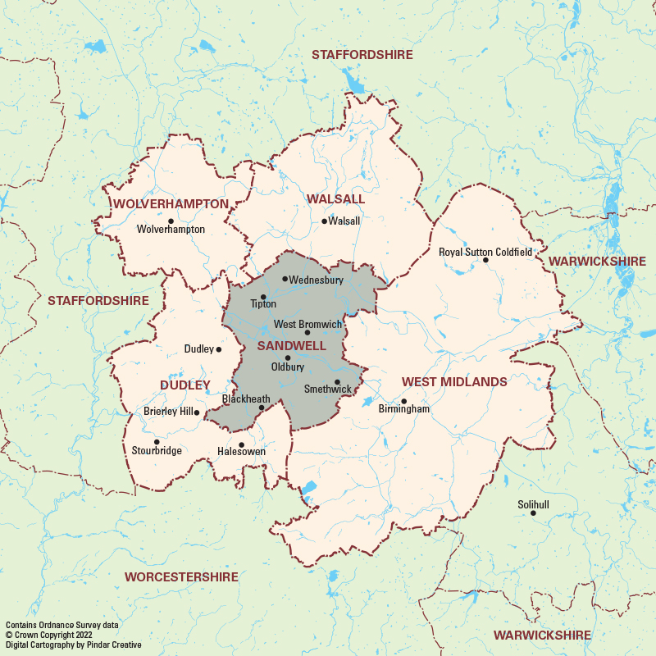
Sandwell – the place and the council
Population of 346,000
12th on indices of multiple deprivation
One of the most diverse boroughs in the country
Centrally located in west midlands region
Rich industrial heritage
Council workforce of 4,000 + indirect workforce of 1200
Part of the WM Mayoral Combined Authority
Post pandemic, Brexit, inflation - has hit Sandwell hard

Slide 3
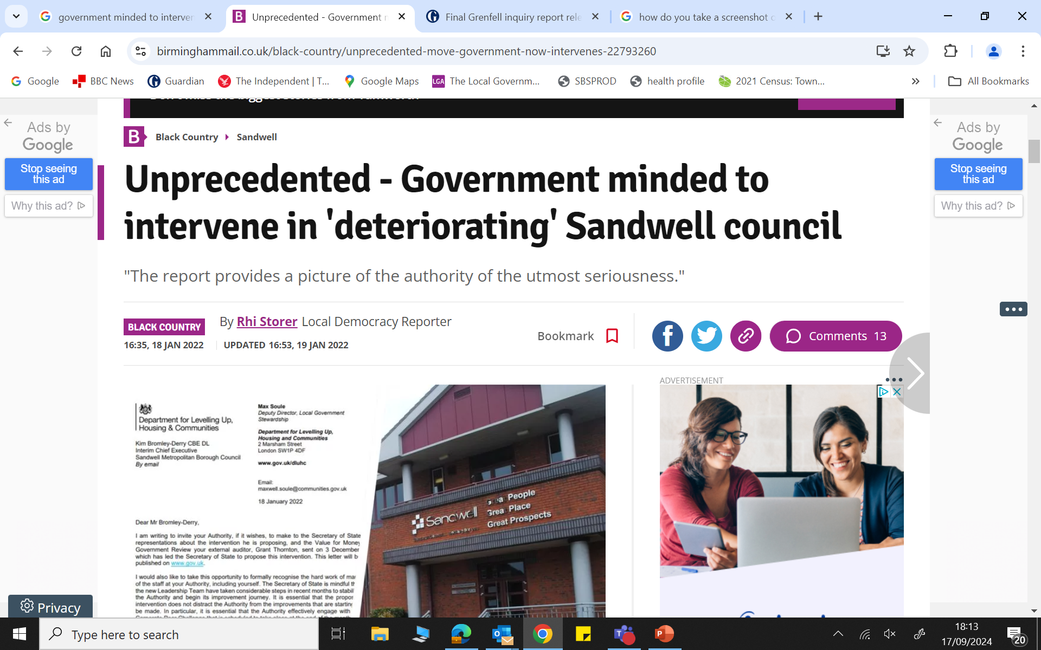
The Sandwell context
Intervention is now in the past but can still see it in the rear view mirror
A more stable and open organisation
Improvements in services and customer responsiveness
We are still uncovering legacy issues
Finding our place within the West Midlands region
Culture, behaviours and working in silos – still some way to go

Slide 4
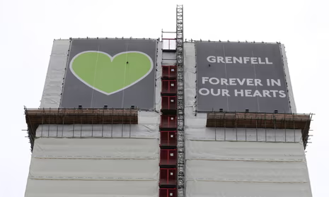
Challenges
Post pandemic – a different approach & attitude to ‘work’
Change fatigue and resistance
Citizen expectations of public services at a low point
Regulatory frameworks and compliance at their highest point

Slide 5
Challenges (2)
The gathering storm of financial and service pressures
Transformation – understanding what it means (change)
Are we representative/inclusive of the people we serve
Workforce planning - Skills and capability gap, recruitment challenges
Appetite for risk & innovation – Icarus syndrome (Thurrock, Slough, Woking….)
Defining the role of a council?

Slide 6
What is our purpose – Sandwell Council?
Provide services for our residents
Lead and develop our place
Represent and champion our communities

Slide 7
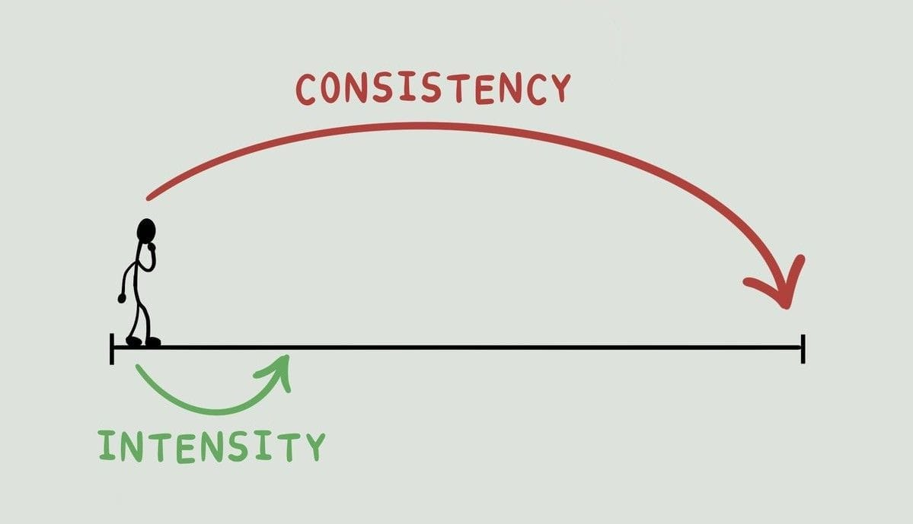
Where do we want to be?
Become a high performing, bold and progressive council for residents
Delivering high quality low cost services

Slide 8
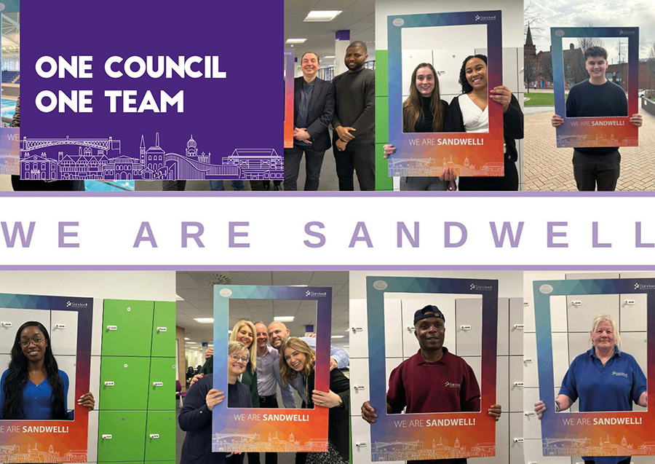
Fostering resilience with the workforce
Trust – judged by our actions
Communications – getting the right balance/hard to reach employees
Creating the space and opportunities where everyone can be heard
Don’t talk about the money when you talk about transformation
Co-production – the workforce creating and owning the solutions
How can you curate powerful moments of connection?
Fail fast and then move on
Inclusive

Slide 9
The approach
Doing the boring well
Describing what good looks like
Making it real – the case studies - good and bad
A culture of openness
Seeing our services through the lens of our residents
Purposeful partnerships (place based leadership)
Servant leadership
Smashing the silos

Slide 11
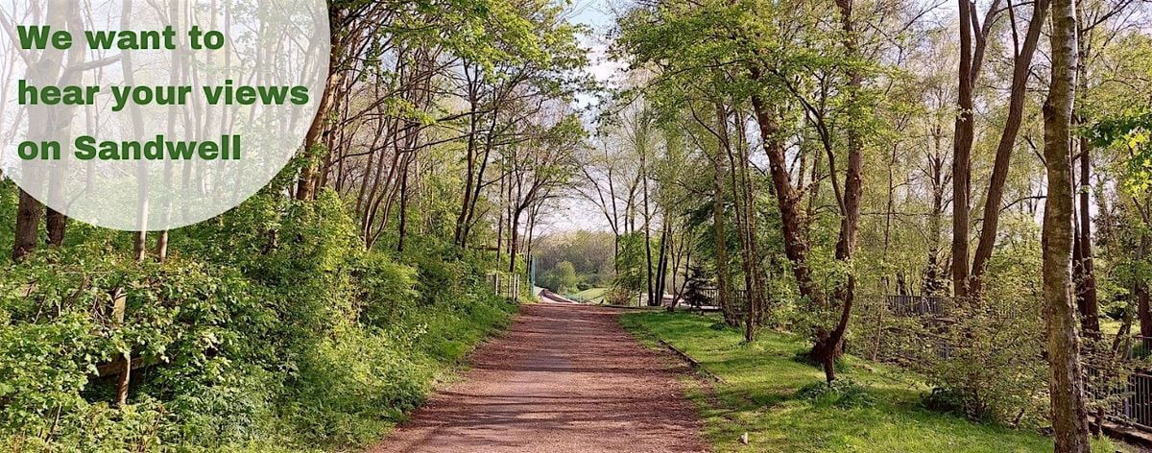
Telling a new story for Sandwell

Slide 12
Impact: How will we know when we have got ‘there’?
What is your HR dashboard telling you?
What are residents telling us?
What are our peers saying
Employee surveys – acting on what you know
How do staff feel on Sunday night?
Do we need a tripadvisor for local government?

Slide 13
In summary
You have to bring people on the journey with you
No place for heroic leadership
Changing culture takes time (and patience)
Clarity of purpose
Sharing best practice – outcome and impact
Investing in our people – developing and mindfulness

