Slide 1
Change, Resilience and Managing People Well Through Transformation
Notes:
Why We’re Doing New
What the New looks like
Show you video to launch Framework with organisation
Share some reflections on how Framework will land and success already seeing with restorative approaches

Slide 2
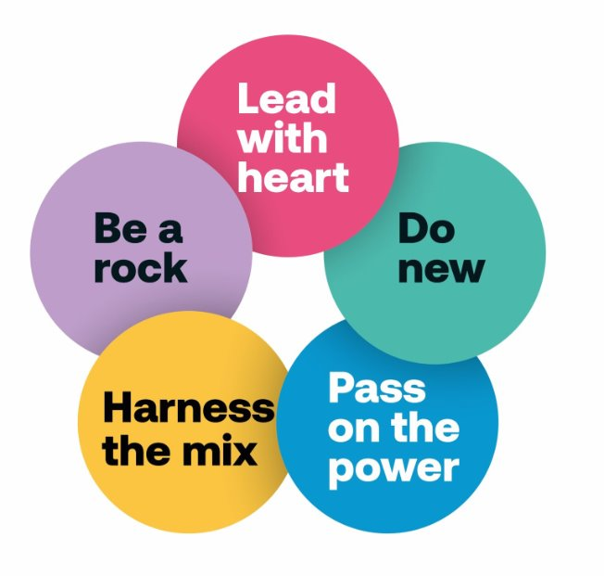
Our values drive everything we do
Notes:
Values – everything starts and ends with our values: who we are and how we do things
Developed in 2019, from the ground up, they are the foundation on which we’ve developed and continue to develop our organisational culture, including how we manage change
Values Refresh workshops over the last few months were attended by over a third of our colleagues, have confirmed that are values are embedded within our culture
Working with the IoL, data from the workshops has been analysed and used to develop a framework of behaviours and leadership competencies
We know that it’s only by investing in our colleagues and developing an inclusive, fair and innovative culture, that we can be a high performing organisation which serves our community in the most effective way
Lead with Heart
We’re here for the people of Hounslow.
We work together with them and for them with care and compassion, with patience and in partnership.
We put ourselves in other’s shoes, remembering that every person is different, and every interaction is a real moment in their lives.
We always feel first.
Behaviours: Lead with Heart
Always ask yourself how a resident would feel.
Take pride in the little things and show you care.
Listen to Hounslow people, don’t assume you know.
Do New
We need to do things differently if we’re going to help Hounslow people thrive in the future.
Hard work is important but it’s not enough on its own.
We need to challenge ourselves to break new ground, invent new approaches, try new ideas, keep moving forward and keep improving. That means being ready to stop doing things we’ve done before.
It means taking on risk and backing each other when we take a leap.
Behaviours: Do New
Nurture new ideas and back people when they have them.
Challenge process where it holds us back.
Test, learn, refine and go again.
Pass on the Power
The world keeps on changing and we need to change with it.
We won’t be able to adapt fast enough to the future needs of our residents if we stick to old fashioned command and control.
We need to hand over responsibility and give people more power to make decisions and take action themselves.
It’s about being transparent and straightforward.
It’s about providing tools and support. But most of all, it’s about being ready to trust each other to do the right thing.
Behaviours: Pass on the Power
Inspire and support rather than command and control.
Trust people to do the right thing, and do it right.
Share the responsibility and the credit.
Harness the Mix
We work together, across disciplines and roles.
We talk lots, share our insights, our skills and experience. ¡We’re not interested in siloes or defensiveness.
We’re always open to different approaches, we’re flexible and ready to adapt.
We break down the barriers between our parts and people to unlock the problem-solving power of our amazing mix of minds.
Behaviours: Harness the Mix
Seek different perspectives to solve problems and create opportunities.
Be willing and ready to adapt.
Always find the common ground and shared benefits.
Be a Rock
There’s lots to do and people need us.
It’s up to us to take the initiative. To take responsibility. To stand up and be counted. Everyday.
It’s about being super focused, effective and efficient. It’s about allocating our resources smartly and with good rationale – using data to help guide our decisions.
But most of all, it’s about having the strength and determination to keep on going through thick and thin.
Behaviours: Be a Rock
Take the initiative, bring energy and action.
Make strong, evidence-based, decisions.
Finish what you start, never pass the buck.

Slide 3
Managing Performance using Clear Review
Check-in conversations – monthly
Real time and near time goals
Wellbeing
Learning
Living the values
Regular and timely feedback
Notes:
The existing approach to managing performance through annual appraisal reviews didn’t align with our values
Wanted our performance management to be:
Holistic and ‘human’ – encourage colleagues to bring their whole-selves to work
Immediate and regular – short-term goals
Incorporate effective feedback mechanisms – colleagues learn and grow
Not ‘top-down’; a two-way conversation

Slide 4
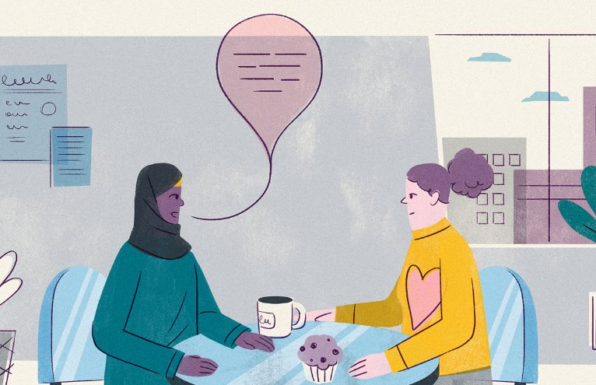
Resolution Framework
Notes:
Traditional approaches to grievance and discipline don’t sit well with values
Need and want to do something different
This next natural stage in our journey
AND Dovetails with other approaches
Clear Review Refresh – puts dialogue at the centre; natural way to raise issues
3 months in, the feedback from colleagues who have experienced a facilitated conversation or participated in a mediation, is positive

Slide 5
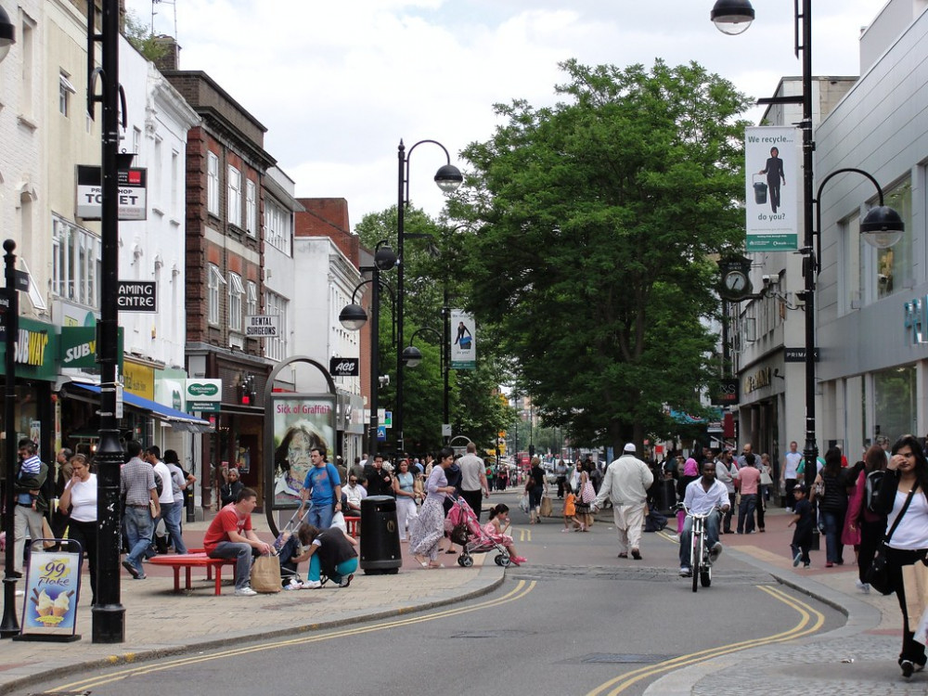
Creating a Fairer More Equal Hounslow
Notes:
Understanding our borough at every level and targeting action where it is needed most – Equalities Strategy Pillar 1
EDI a leadership focus - workshops with 200 senior leaders to understand EDI opportunities and challenges at a personal, systemic and organisation level with targeted action plans to ensure inclusion is a reality within Hounslow

Slide 6
Transformation Through Engagement (TTE)
Notes:
Transformation Through Engagement – when people going through change, we do that with people not to people, values at heart
We engage at the earliest opportunity, we communicate, listen and respond, and we develop services with our people
Where there are changes to roles, TTE principles mean that we work with individuals to find the best solutions for them, whether that means staying in the same service, moving to another job role or moving on to something different – a person-centred approach
TCE – that when our residents are engaging with us, we do that in a way where they feel heard and valued and seek to find resolution with them to any issues

Slide 7
Moving to our new approach
Notes:
We are on a journey to create a truly inclusive and vibrant organisation, with our values at its heart, where all our people can Connect, Belong, Grow and Flourish
The strategies, policies and processes we’ve put in place to endure our values ‘live’ in the organisation, are the foundation for how we manage people well through transition and change

