Slide 1
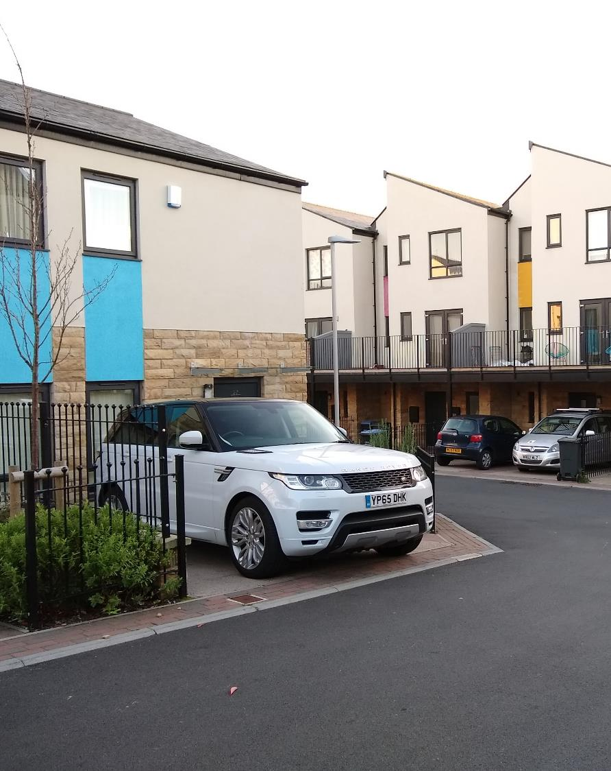

STEPHEN BROADBENT
CITY OF BRADFORD MDC
DESIGN CODE PRODUCTION FOR DEVELOPMENT MANAGEMENT OFFICERS
PAS/DLUHC WORKSHOP
Online – MS Teams
Tuesday 26th March 2024

Slide 2
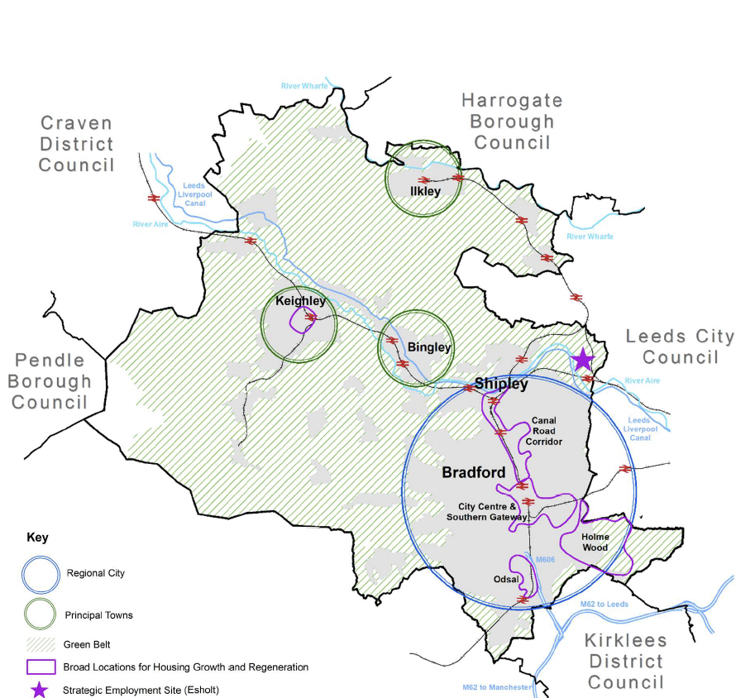




Context
Bradford District
Large and fast-growing metropolitan district
Very diverse in terms of population, settlements, landscape and topography
A need for 30,000 new homes in the District by 2040
The majority of new homes (about 80%) proposed to be located in main urban areas
A focus on regeneration and delivering more compact, healthy and sustainable forms of urban living.

Slide 3
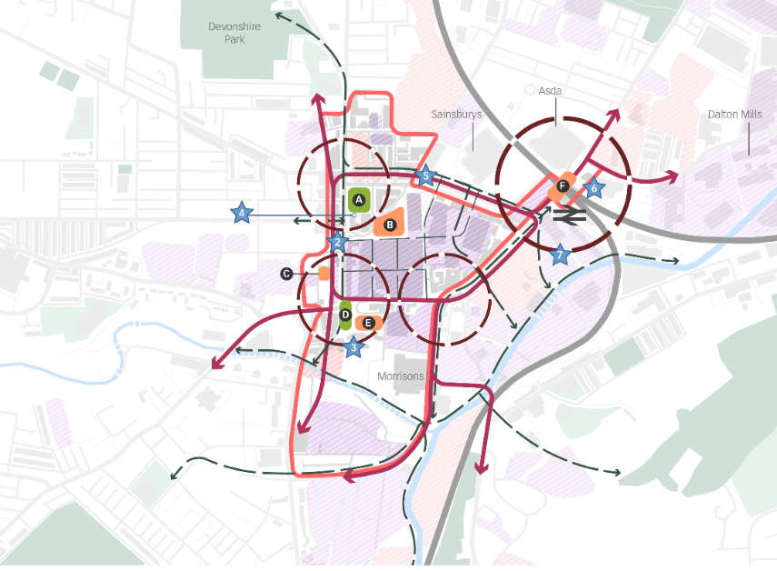
Context
Planning & Regeneration
Key local influences on the code:
Draft emerging Local Plan
Homes & Neighbourhoods Design Guide SPD (2020)
Development Frameworks/ Masterplans for key regeneration areas
Local initiatives e.g. Economic Strategy, Clean Air Zone, UNICEF Child Friendly District bid

Slide 4
DRAFT, OCTOBER 2023
Bradford Design Code
Purpose and status
Focuses on the design of new homes and streets
Currently at Draft Stage
BRADFORD
DESIGN CODE:
FOR NEW HOMES AND STREETS IN BRADFORD DISTRICT

Slide 5
Bradford Design Code
Focuses on the district’s priorities
OBJECTIVES:
MAKING LIFE HEALTHIER AND HAPPIER
ENABLING ENVIRONMENTALLY FRIENDLY LIFESTYLES
BEING FIT FOR PURPOSE
BECOMING PART OF THE ESTABLISHED LOCAL CHARACTER

Slide 6
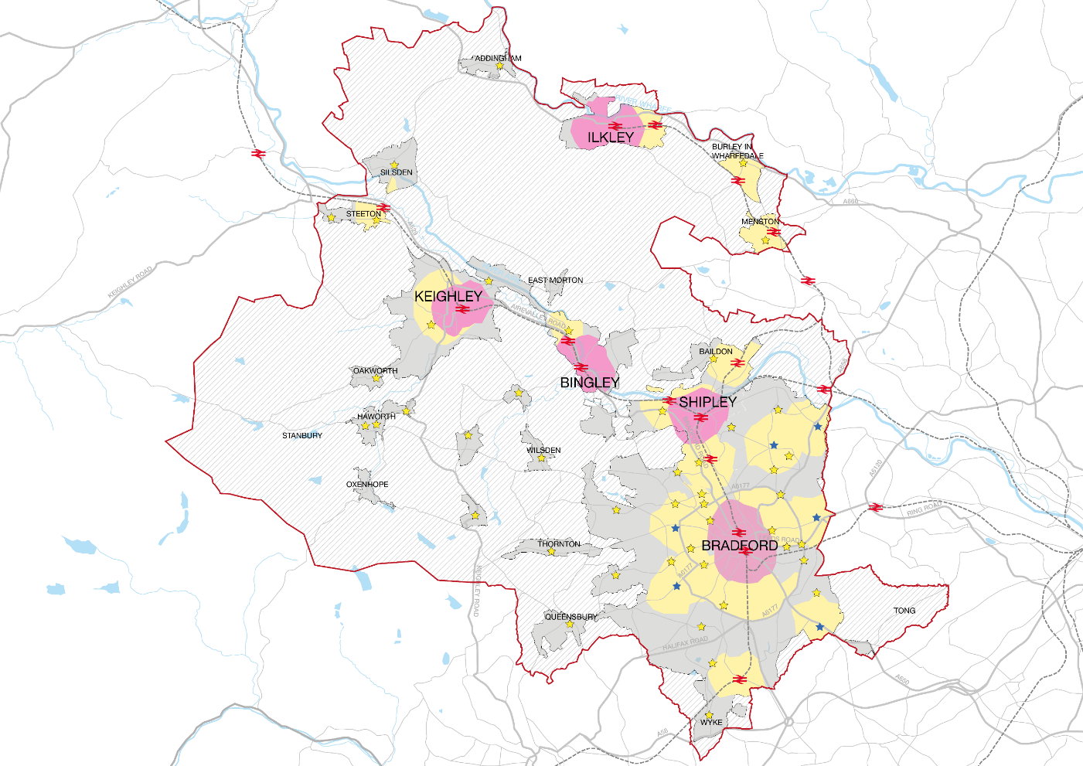
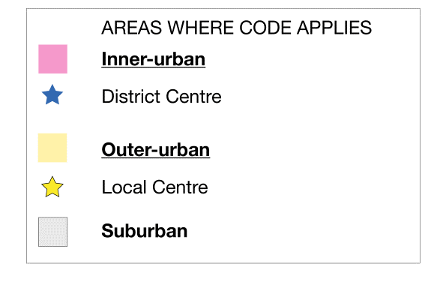
Bradford Design Code
The Coding Plan

Slide 7
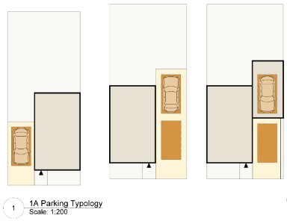
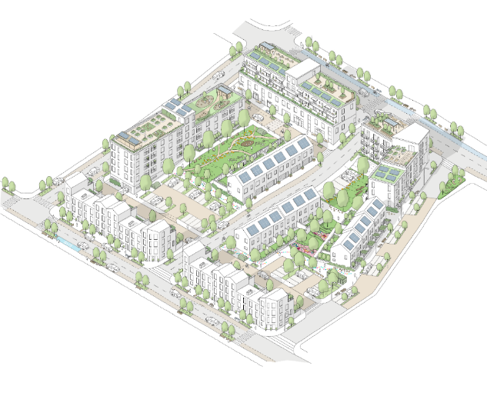
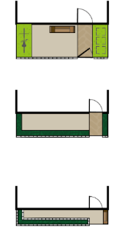
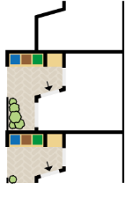
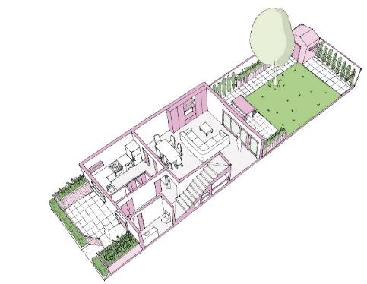
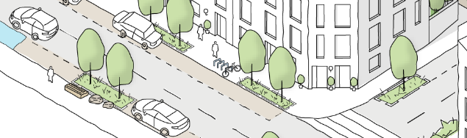
Bradford Design Code
Scales of Development
c) Car & Cycle Parking
d) Transition Zone
a) Neighbourhood
b) Street
e) Home

Slide 8
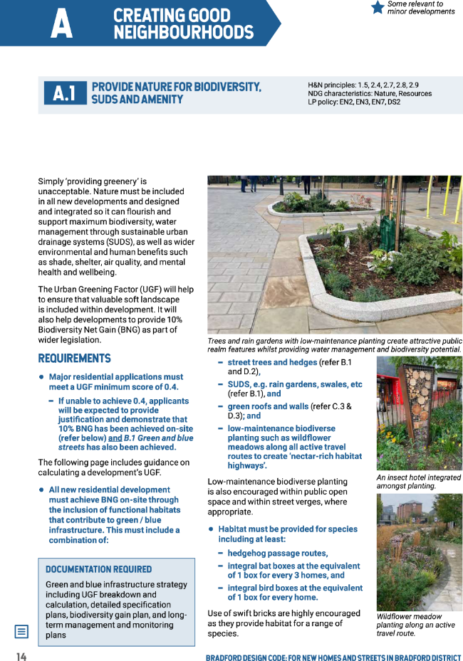

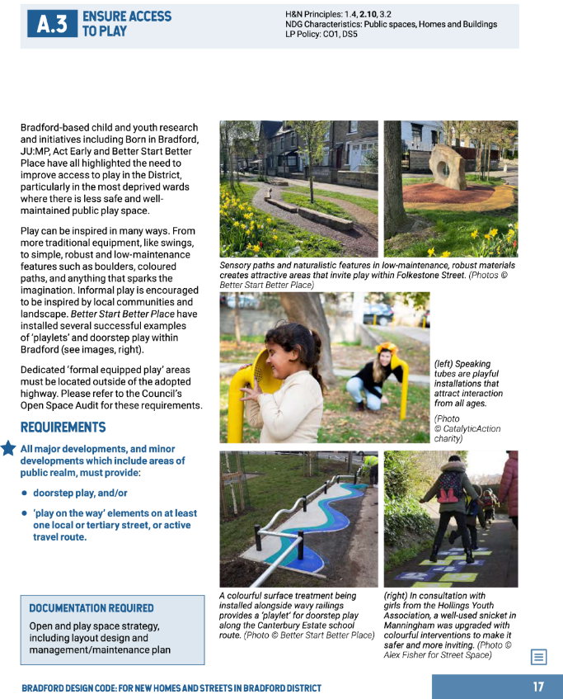
Code examples
Neighbourhood
Requirements for Nature, Urban Greening and Play

Slide 9
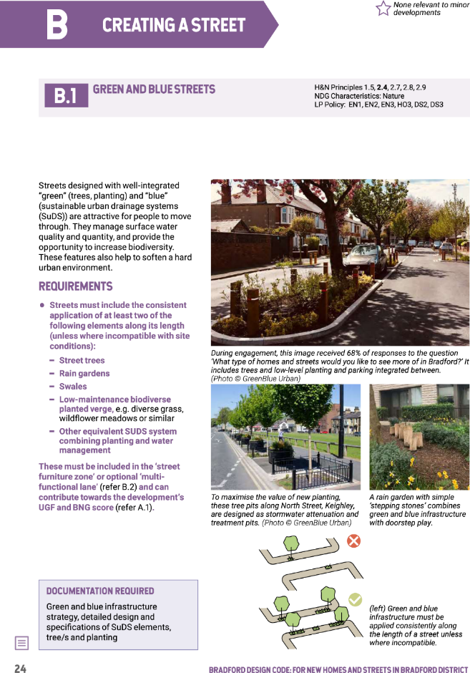
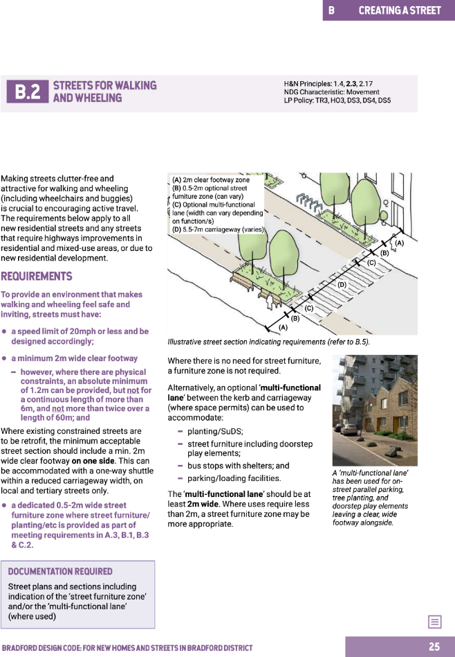
Code examples
Street
Requirements for Green and Blue Streets, and inclusive streets with clear wide footways.

Slide 10
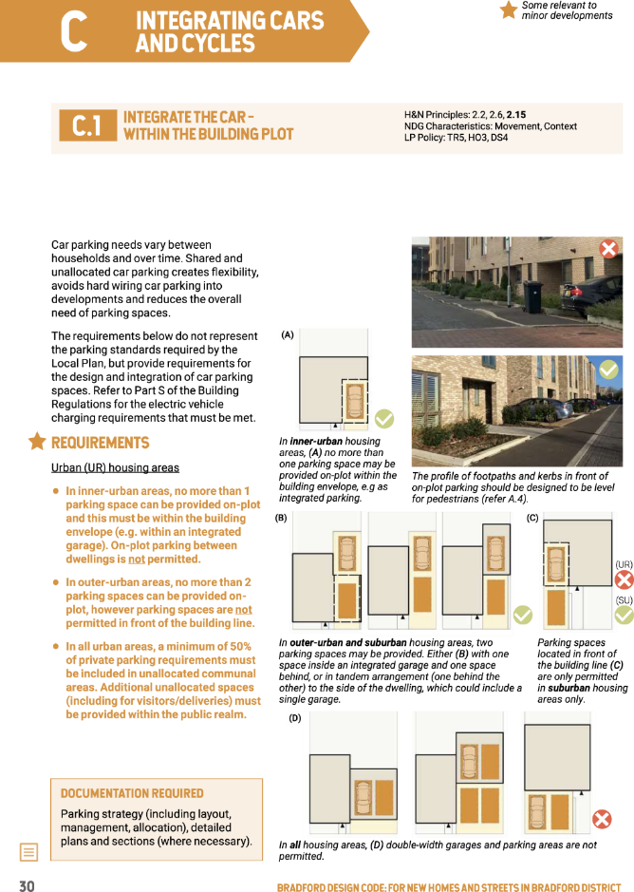
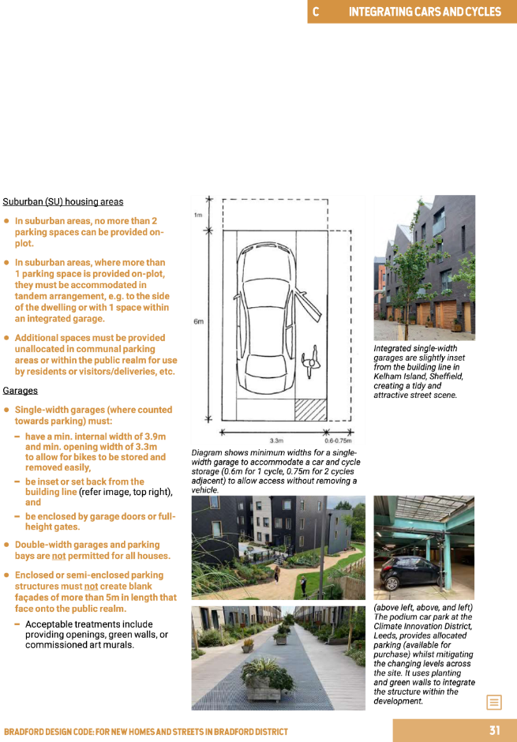
Code examples
Car Parking
Specific options for accommodating car parking on plot for different area types and housing types

Slide 11
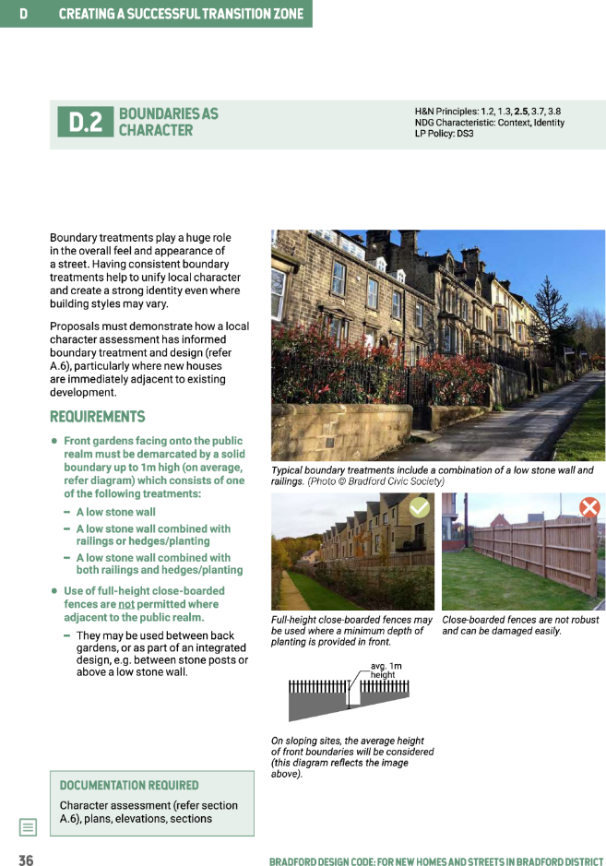
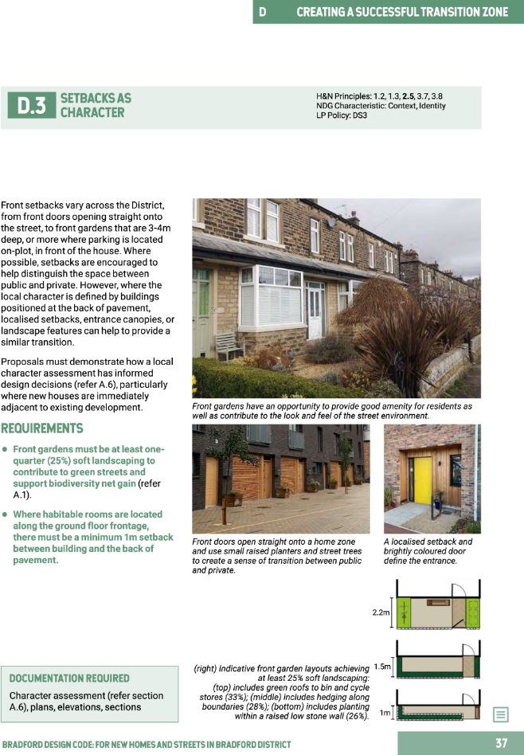
Code examples
Transition Zone
Options for boundary treatments, and minimum setbacks from the street

Slide 12
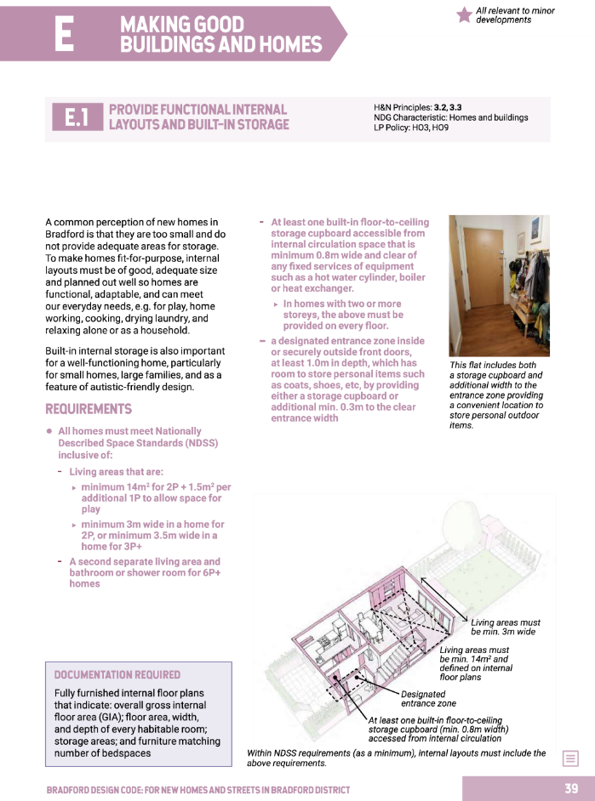
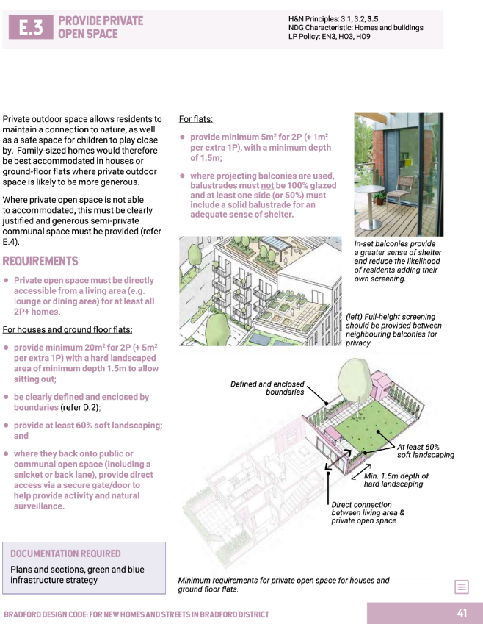
Code examples
Home
Requirements for internal space standards, layouts and storage, and minimum garden sizes/private outdoor spaces and soft landscaping.

Slide 13
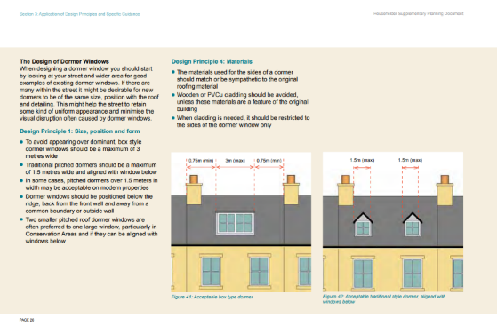
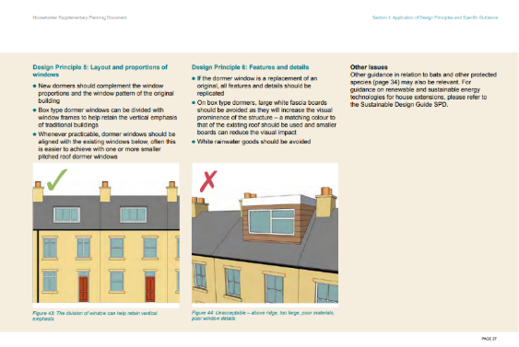
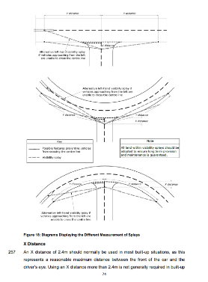
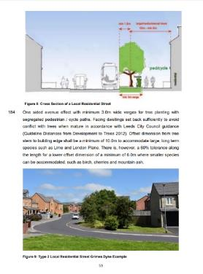
Benefits of a Design Code
for Development Management
It can assist with resources/skills gap
Sets minimum standards for the most important things
Provides clarity/firmness
Our most successful design guidance is ‘code-like’ e.g. House Extensions SPD, Street Design Guide

Slide 14
Stages of Engagement
with Development Management
Scoping
Procure-ment
Inception
Visioning
1st Draft Code
2nd Draft Code
Final Draft Code
workshop to inform development of brief
tender assessment panel
workshop (with wider project team)
workshop (with wider project team)
specific DM only workshop + written feedback
technical workshop including DM and others
1:1s with DM Team Leaders

Slide 15
Challenges
Issues raised by DM officers
Might add to the burden (of policies, guides, frameworks etc)
Length of code / amount of requirements
Format (Majors / Minors)
One size fits all approach – may need to allow for some discretion
Assessment method (what constitutes a Pass or Fail?)
Relationship with Local Plan policy
Legal issues
Robustness of codes (wording, deliverability and practicality)

Slide 16
Conclusion
Added value of involving DM
Lessons Learned
Next Steps:
  Review, streamline and refine document
  Design & Viability Testing
  Exercise with DM to test usability of the Code

