Slide 1
Revisiting the 21st Century Public Servant
LGA Innovation Zone
23rd October 2024
With Catherine Mangan and Dave Mckenna, INLOGOV, University of Birmingham
Andy Ferrier, Test Valley Borough Council

Slide 2
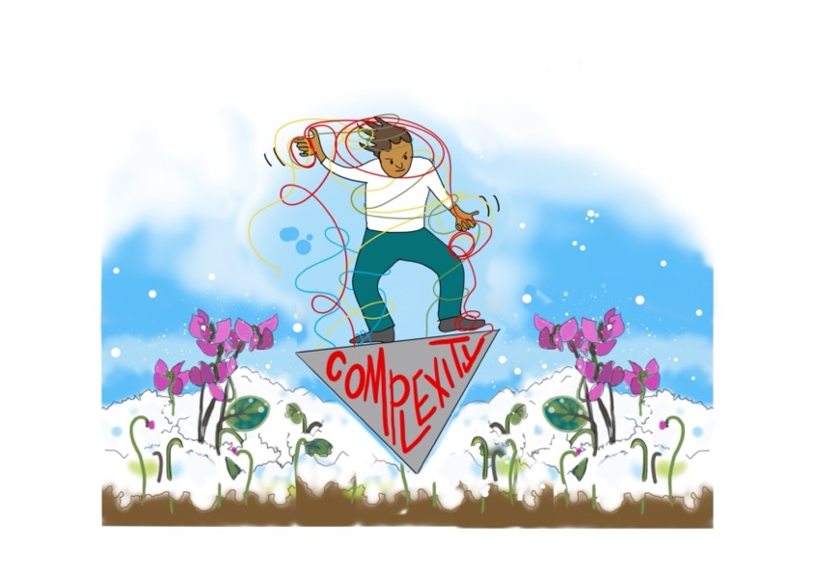
The 21st Century Public Servant
Catherine Needham, Catherine Mangan, Dave McKenna, Jason Lowther
University of Birmingham
Images by Laura Brodrick, Think Big Picture

Slide 3
The original research in 2014

Slide 4
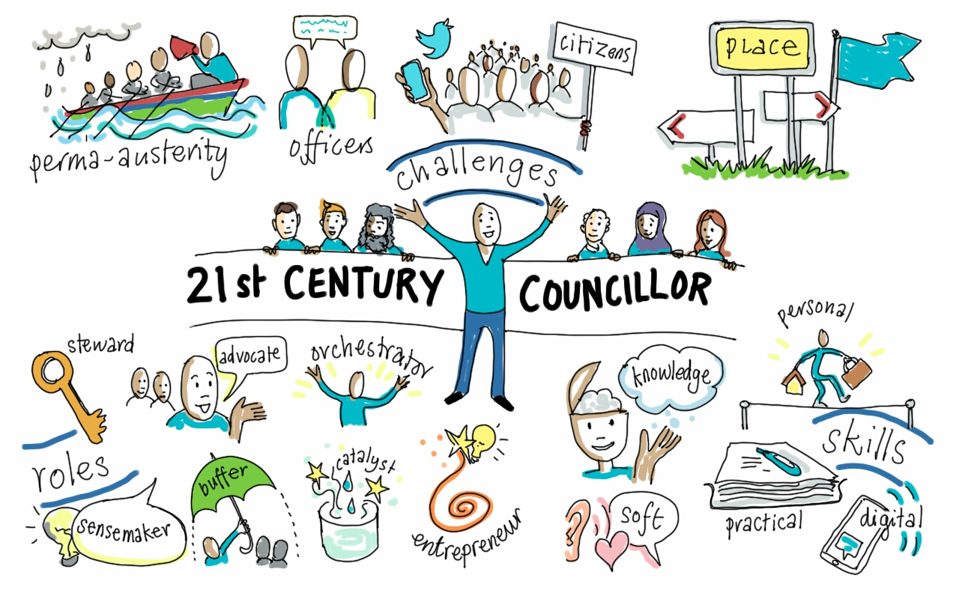

Slide 5
10 years on…
A new project to refresh the original research
Partnering with Local Government Association, Society of Local Authority Chief Executives (SOLACE) and West Midlands Employers.
Literature review (published on our 21stC Public Servant website)
32 interviews in case sites and beyond
Survey of NDGP cohort and alumni

Slide 6
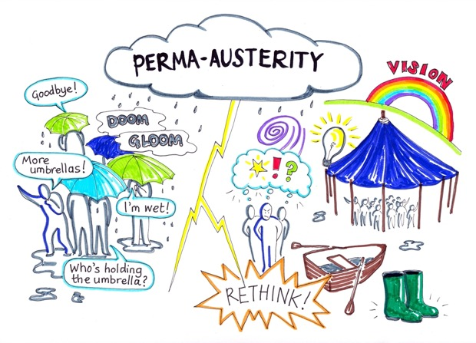
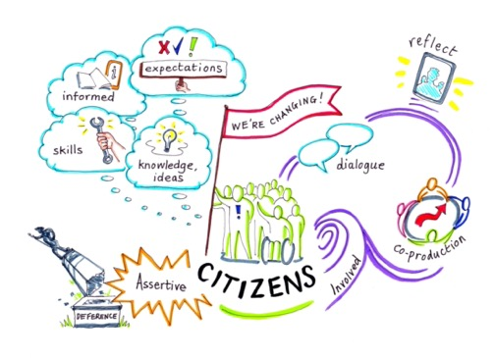
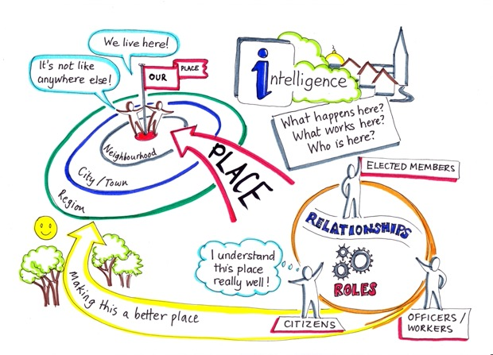
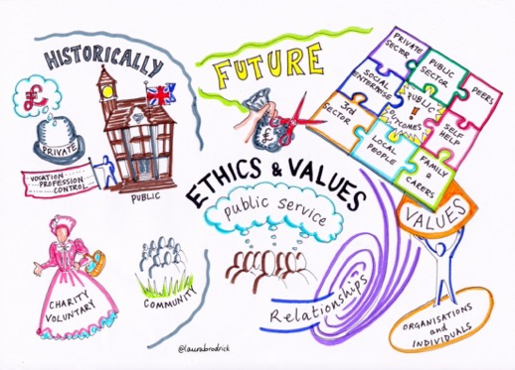
Some of the contextual issues are the same…

Slide 7
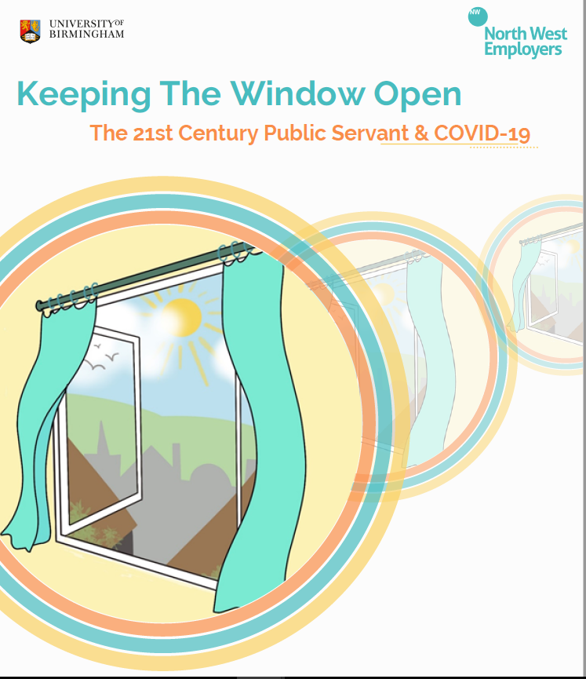
Other contextual issues are different
Global pandemic
Rising profile of equality, diversity and inclusion
Threats to civility in public life
Cost of living crisis
Climate change

Slide 8
The 10 characteristics of the 21st Century Public Servant now

Slide 9
Working in and with complexity

Slide 10
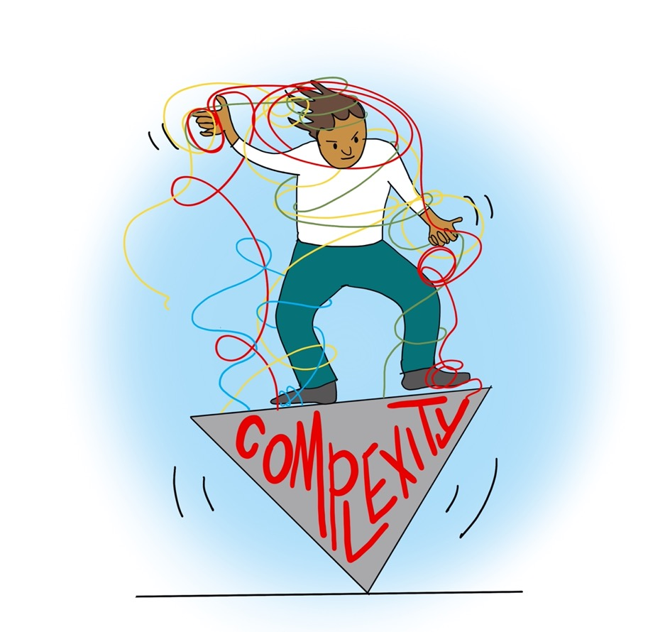
The 21stC Public Servant is operating at the thick end of the complexity wedge (the easy work has already been done)

Slide 11
2. The 21stC Public Servant is thinking whole system (taking a long-term and strategic view, despite daily pressures)

Slide 12
3. The 21stC Public Servant is a sense-exchanger (going beyond sense-making to help others to understand and influence)

Slide 13
Developing and valuing new ways of working

Slide 14
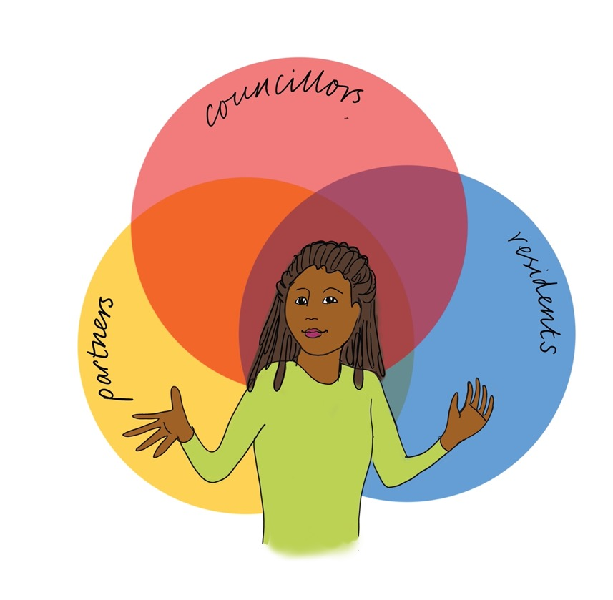
4. The 21stC Public Servant is a relationship curator (connecting with residents, senior leaders, councillors, partners with empathy and compassion)

Slide 15
5. The 21stC Public Servant is ambidextrous (combining expertise in a professional domain with the ability to lead across services)

Slide 16
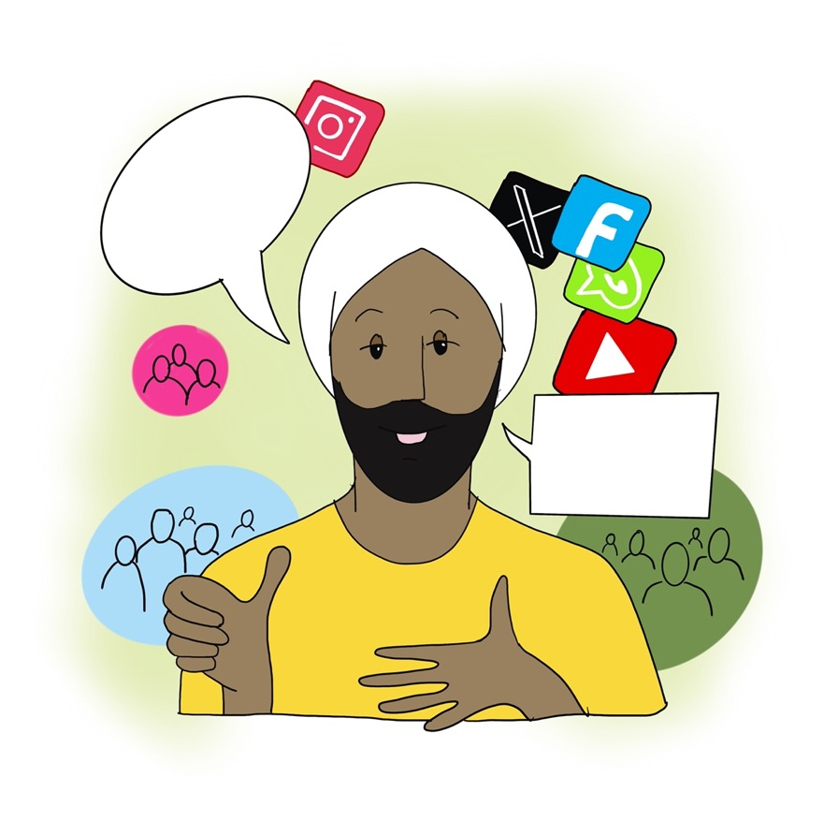
6. The 21stC Public Servant is multi-lingual (able to communicate in different ways, depending on the audience)

Slide 17
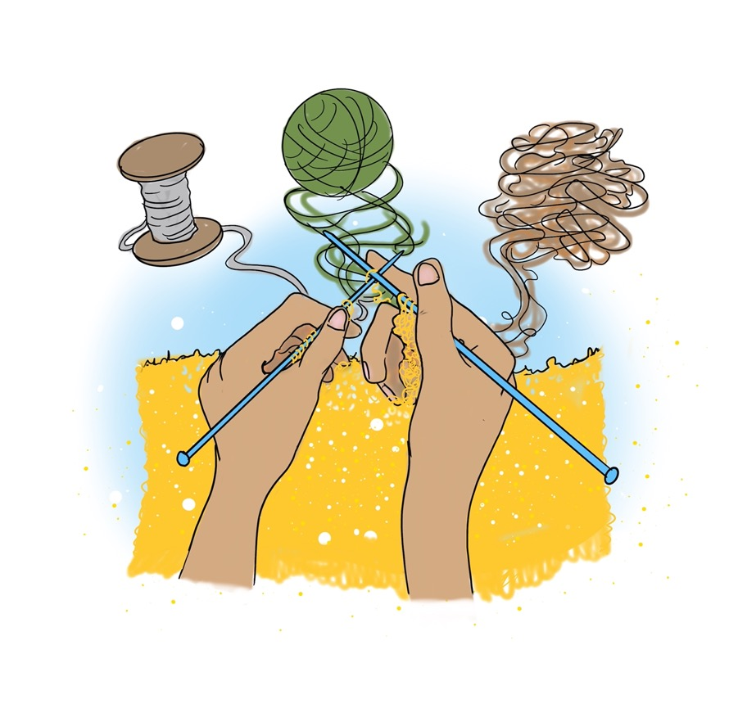
7.The 21stC Public Servant is a frugal innovator (weaving together resources from threadbare public services)

Slide 18
Thriving in this new environment

Slide 19
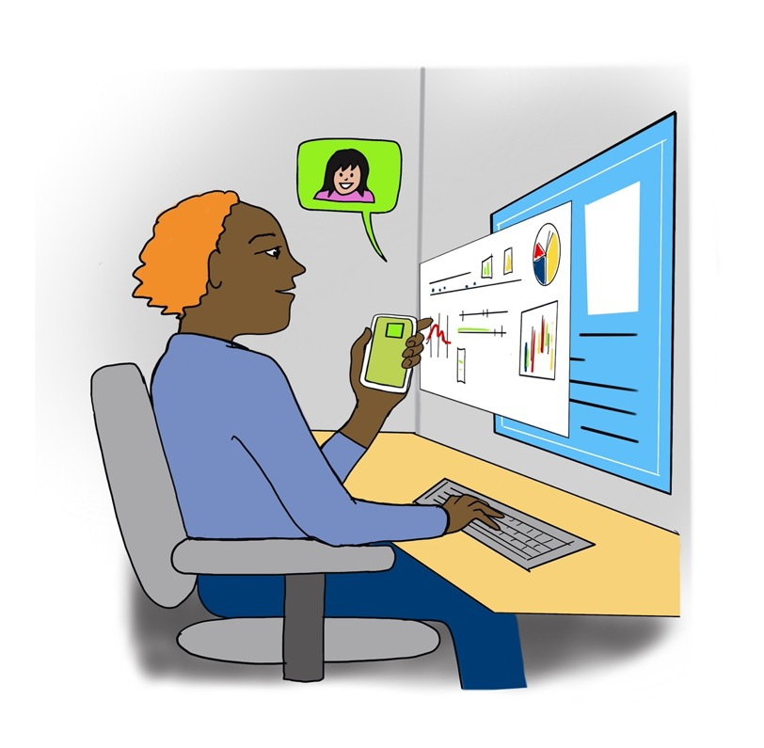
8. The 21stC Public Servant is data curious and digitally comfortable (making the most of big data and embracing AI)

Slide 20
9. The 21stC Public Servant is a hybrid operator (connecting in person, on-line, from their kitchen table, in the community)

Slide 21
10. The 21stC Public Servant is a hardy perennial (keeping going in harsh conditions)

Slide 22
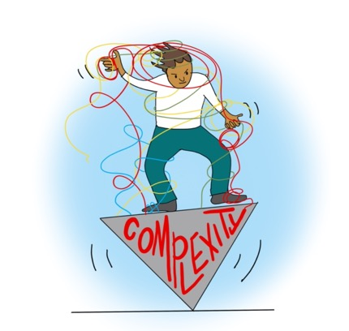
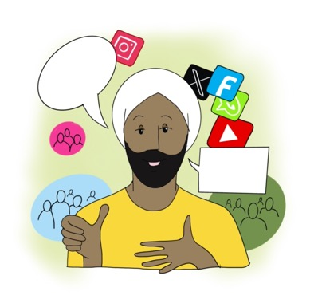
The 10 characteristics of the 21st Century Public Servant now
Thinking whole system
At the thick end of the complexity wedge
Multi lingual
Frugal innovator
Hybrid operator
Relationship curator
Data curious
Sense exchanger
Ambidextrous
Hardy perennial

Slide 23
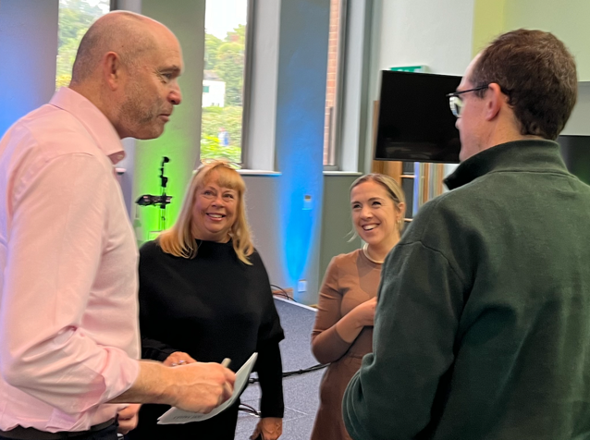
What does it mean to be a 21st Century Public Servant in Test Valley?

Slide 24
Let’s keep the conversation going
For report, updates and discussion go to our website 21stcenturypublicservant.wordpress. com/
Contact
c.needham.1@bham.ac.uk
c.mangan@bham.ac.uk
d.mckenna@bham.ac.uk
J.lowther@bham.ac.uk
Illustrations by @laurabrodrick
www.thinkbigpicture.co.uk

