Slide 1
Introduction to Planning for new Local Authority Councillors
Cllr Liz Green, Kingston upon Thames
Peter Ford & Steve Barker, PAS
Recorded for the LGA website
An hour and half
Presentation followed by Q&A
May 2023
www.pas.gov.uk
Notes:
1
Introduce the session – Local Government Association introduction to planning for new local planning authority councillors.
This is one of a series of short sessions that the LGA will be running on specific key topics for new councillors.
This morning we have a short of presentations for about an hour, which we are going to be recording it and which will be publish on the LGA website.
We will then stop the recording and take questions.
If you have any questions please feel free to drop them into the chat function of the meeting and we will try and answer some of them at the end of the session.
If you could please stay on mute during the presentation stage whilst the session is being recorded it would be appreciated.
Introduce the team -
Cllr Liz Green from Planning committee chair from Kingston upon Thames,
Peter Ford, who leads on the work of PAS around development management and myself, Steve Barker from PAS
Introduce PAS & LGA
LGA is here to support and lobby for local government. Works with all local authorities
PAS is Part of the LGA working to support local authorities to improve planning services.

Slide 2
The session: An introduction to planning for local authority Councillors
Topics:
The planning process
The plan
Decision making
The different Councillors’ roles
Notes:
Introduce the sections.
Planning can at times feel a bit complex , and challenging.
We aim today to run through the planning process, give some clarity to how and when things happen in the planning process.
We’re going to do this by looking at 4 Topics:
A brief overview of the The planning process
The plan
How Planning decisions are made
And the The different Councillors’ roles within the system.
2

Slide 3
Introduction to planning
The planning process
May 2023
www.pas.gov.uk
Notes:
3

Slide 4
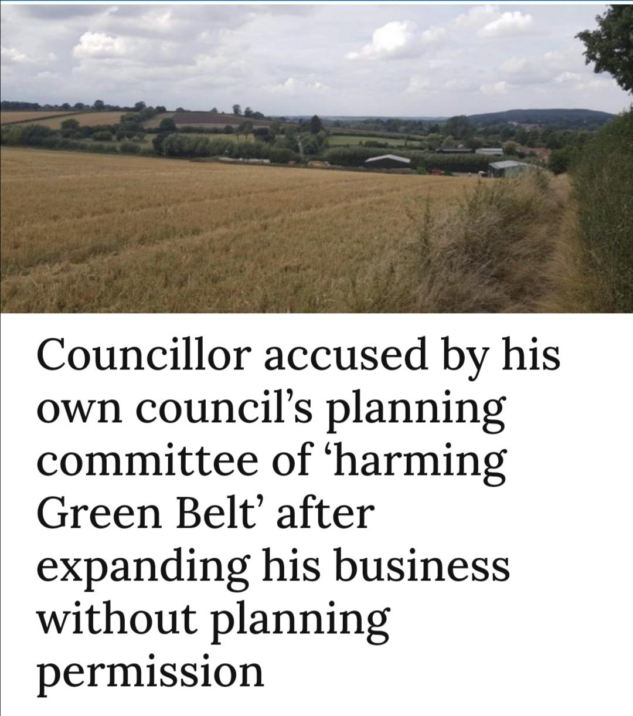
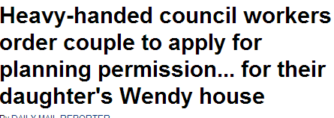
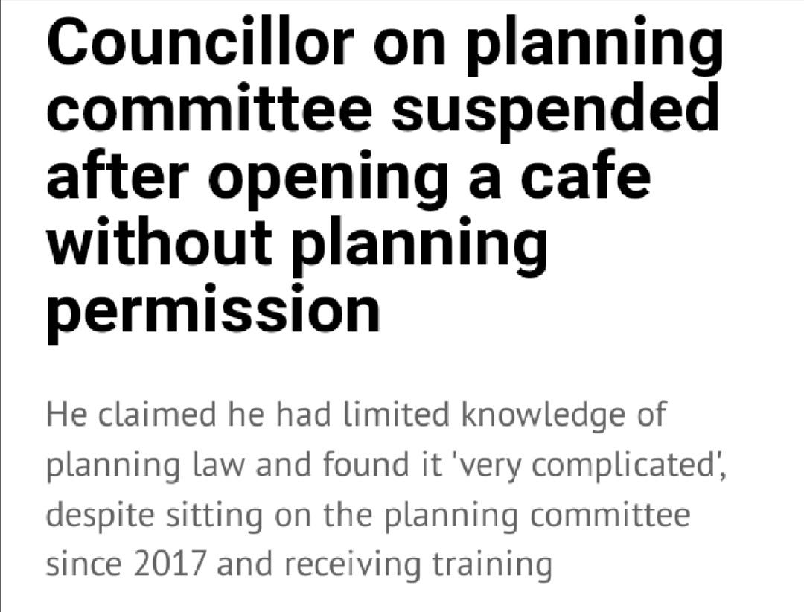
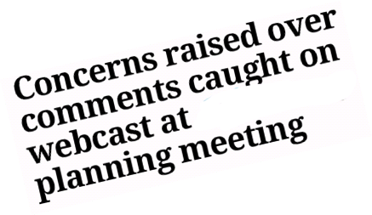
Planning creates headlines
Notes:
SteIt will come as no surprise to you that planning can creates headlines
Planning has a process - and The public and councillors engage throughout this process through to a decision being made and whether something is built or not.
It can seem complex at times and often seem to have its own language and complex rules .
4

Slide 5
The planning system
short to long term plans for development needs are produced across a local authority area
- public consulted
- evidence based
- following national rules (regulations)
most decisions on Planning applications for development are decided by Local Planning Authorities (99%), a small number are made by government (NSIPs & Appeals 1%)
public consulted on applications
applications decided by planning officers (90%+) or by elected councilors on planning committees
planning decisions can be enforced (policed/enforcement) with an applicant
Decision can be challenged by appeal or court
Notes:
Just to add a bit of technical detail to that overview..
All development requires a decision – Permitted Development, Local or National applications
We have a plan lead system – national & local policy is the framework
There is a presumption in favour of sustainable development
Decisions are only made on planning considerations
Decisions can be challenged through Planning Appeals, Judicial Reviews or Ombudsman Complaints
Councillors’ roles vary from
helping the public to engage and understand the planning system from helping to make the long term plan or on individual applications.
Helping to steer and Making decisions about the local plan policies aims and content
Making decisions on planning applications at planning committee
Planning is a technical process and can seem quite complex and daunting at times. Part of the councillors’ role, whether in steering and leading policy production, supporting members of your communities to engage on individual applications, or making decisions on applications is to help to give clarity and improve understanding of how and why decisions are made. – this can be very hard.

Slide 6
Introduction to planning
The plan
May 2023
www.pas.gov.uk
Notes:
6

Slide 7
Planning in England is policy-led
national policy
National Planning Policy Framework (NPPF)
National Policy Statements
Specialist policy such as Gypsy and Traveller guidance
Planning Practice Guidance
local policy
Development / local plan
neighbourhood policies
neighbourhood plans
Notes:
Include London plan and other regional plans
7

Slide 8
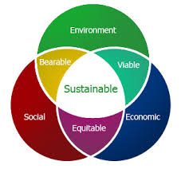
Sustainable development; the ‘presumption’
At the heart of the National
Planning Policy Framework (NPPF)
2. Achieving sustainable development
7.… the objective of sustainable development can be summarised as meeting the needs of the present without compromising the ability of future generations to meet
their own needs.
Notes:
The NPPF has the principle of ‘sustainable development’ running through it. Section 2, para 7 in the latest NPPF (July 2021) outlines the over-arching ECONOMIC, SOCIAL AND ENVIRONMENTAL objectives of sustainable development.
Sustainable development is summarized as meeting the needs of the present without compromising the ability of future generations to meet their own needs.
Right from the start the English Planning System struck a balance between the need to protect important heritage and the natural environment and the need for new development.
Another important principle was that people should be allowed to do what they wanted to their own property unless there was a sound justification in the public interest to prevent it. Where no special protections were in place it was for the Planning Authority to justify refusal, rather than the developer to justify approval.
Those principles of managing a mix of development and protection, and a presumption in favour of development remain today.

Slide 9
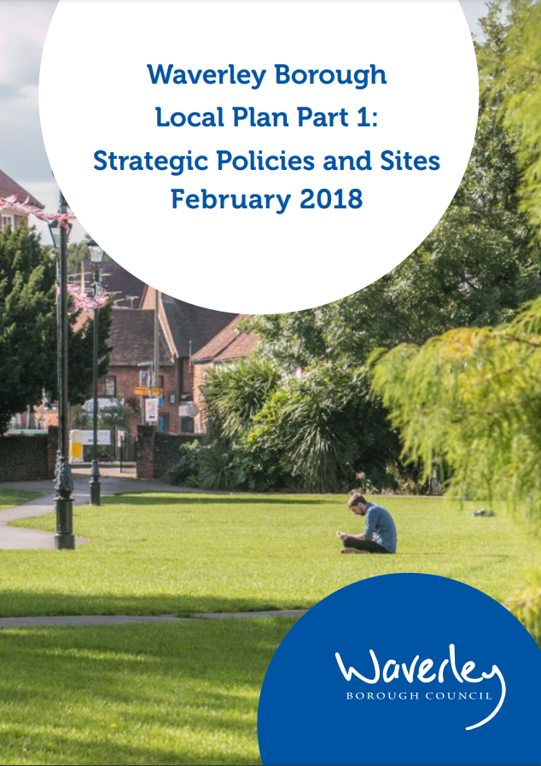
‘Basic principle’: start with the plan
“……have regard to the provisions of the development plan, so far as material to the application, and to any other material considerations”.
Notes:
Restated in 2004 TCP Compulsory Purchase Act
It’s the law.
Having an up-to-date local plan is the best position to be in.
9

Slide 10
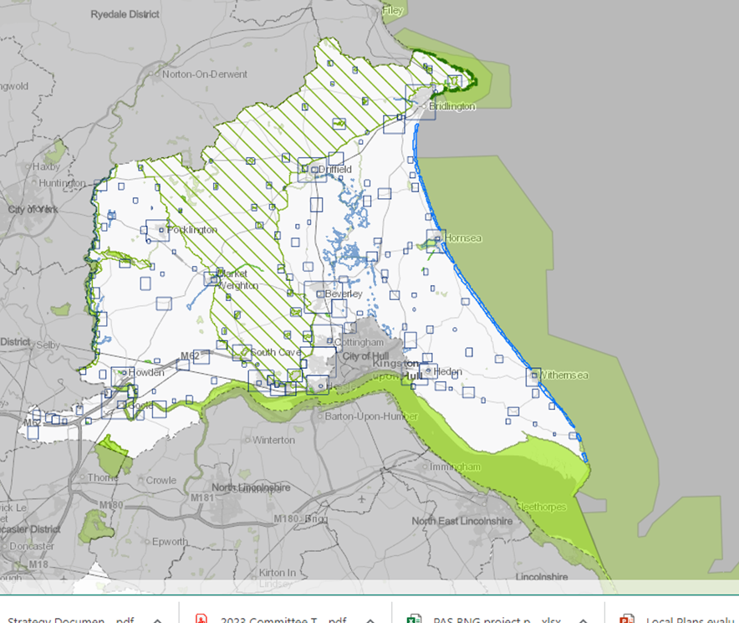
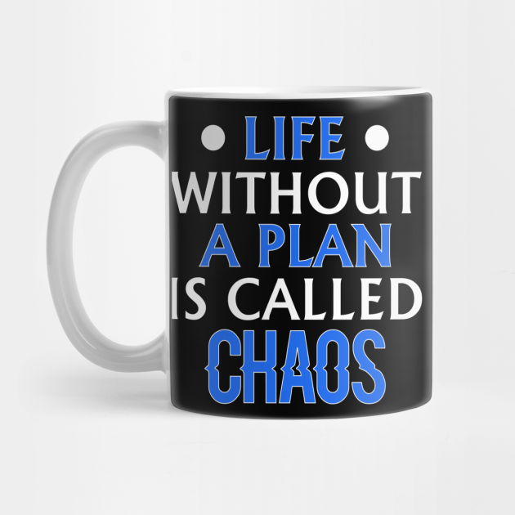
You can’t do Planning without a Plan
Why do we need planning policy?
To provide some certainty to residents
To help developers and employers make informed decisions and judge the risk of investment
To help make difficult decisions
Notes:
Plan production is not easy and can take time and tough decision making.
It’s evidence lead and needs to be justified – and past a test by a Planning Inspector.
But having a local plan is what allows a local authority to say where the development should go
Not having a plan can leave a local authority open to applicants/developers putting in applications in areas that an authority doesn’t want to see development and you’ll have little control.
The plan gives a local authority more control over what development happens where and when.
If you don’t have plan NNPF is all there is – so national government is making the decision!!!

Slide 11
Introduction to Planning
Decision making
May 2023
www.pas.gov.uk
Notes:
11

Slide 12
The role of decision-making
Not just about stopping bad developments from happening
It is about delivering your Local Plan for the whole community
Being positive & proactive to encourage delivery
Notes:
It should be a positive and proactive process that delivers good development.
Refusals are failures that are the last resort rather than being a starting point for decision makers.
The role of the Planner should be celebrated as creating sustainable linked communities

Slide 13
Make no mistake..
What you have to do on Committee is difficult.
Officers make lots of straight forward decisions that don’t get the headlines, but you have to:
Make most of the really contentious decisions
And they can be life changing for some people

Slide 14
Make no mistake..
You make those decisions in the public arena:
Planning Committees are the showpiece of the Council and in most cases watched by more people than any other Council meetings
And then re-apply for your job every few years at the elections

Slide 15
When to get involved: The life of a Planning Application
Notes:
This slide takes Members through the planning application process from start to finish.
It is a good opportunity to have a discussion with Members on when they should get involved and when it is not appropriate. For example:
Pre apps – if the Council has a policy of involving Members then this is the best time to get involved
Registration / validation – no point because it is a procedural process
Formal consultation period – need to alert the case officer if Members have concerns and possible Member referral to Committee
Assessment – need to speak to the officer before this time but Members can take an active role in negotiations where appropriate to ensure residents’ concerns are understood
Report – Normally too late as the officer is bringing together all the issues and to form a recommendation
Prior to Committee – important that Members ensure that officers understand their concerns before the actual meeting
Appeal – If Members have made representations that have led to a refusal they can make additional comments to the Inspector to reinforce their objections if allowed and if appropriate
The committee: The Red Circle:
Write your scheme of delegation so that you are clear what applications need to be referred to Committee
Most Committee agendas only have a handful of items to allow the agendas to be manageable – and to give the committee the required time to look at the complex applications
Professional officers are employed by the Council to make Planning decisions so it should not be necessary for Committee to make the decisions on any more than 5% or 10% of applications – the most contentious, the most complex, the ones with the biggest impact.

Slide 16
Duty of an elected member
Making decisions: your duty is to the whole community
Avoid bias: predisposition v predetermination
Consider the implications for the wider community not just those making representations
Only take into account material planning considerations including precedents and previous decisions – “benchmarks”
Base decisions on evidence not hunch – reasonableness
Jurist or elected representative?
Notes:
It is a criminal offence to fail to disclose or register members’ interests.
Councillors are able to express an opinion on a proposal at an early stage, but still be involved in taking a decision upon it provided they retain an open mind
It is important for Members to understand the difference between Predisposition and Predetermination.

Slide 17
Examples of predisposition and predetermination
Predisposition – A councillor expresses concern about the impact of a development on local residents and will only support the application if conditions could be put in place to overcome the harm
Predetermination - A councillor makes a statement on social media to say that they will support local residents by voting against the development due to the harm it will cause
Notes:
A councillor who is predetermined must NOT sit on Planning Committee
A councillor who has a predisposition should sit on Planning Committee
17

Slide 18
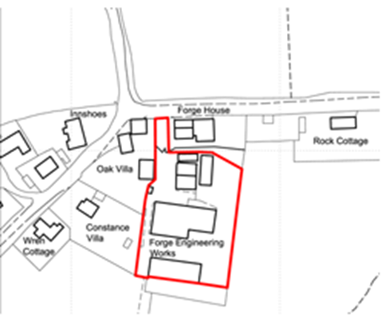
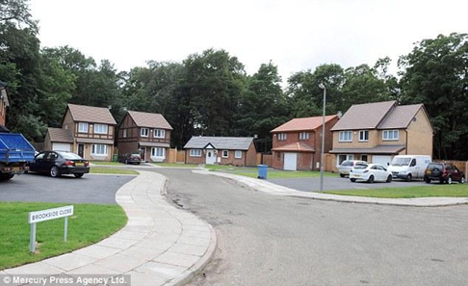
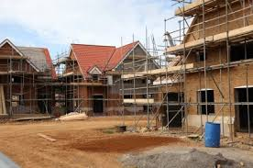
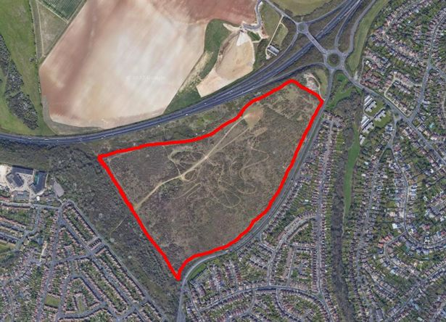
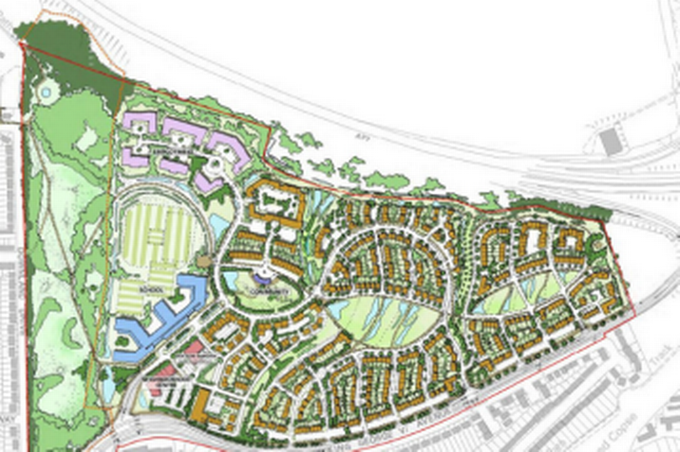
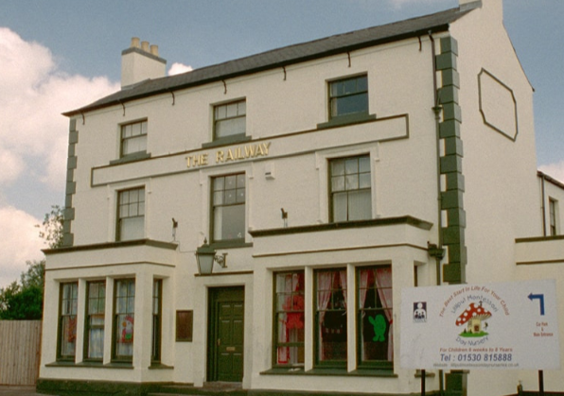
Type of Application
There are lots, but the ones most likely to come to Committee are:
Full Planning Permission
Outline
Reserved Matters
Listed Buildings

Slide 19
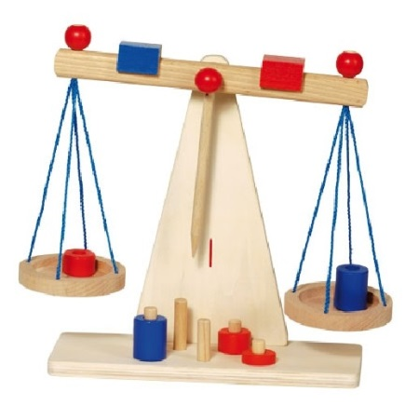
Material Considerations
Material considerations are decided by statements of national policy or by decisions of the courts
the weight that should be attached to each consideration in any particular case is for the decision maker
Notes:
What are the things that we weigh up to make a planning decision?
So remembering that “……have regard to the provisions of the development plan, so far as material to the application, and to any other material considerations”.
What are those material considerations?

Slide 20
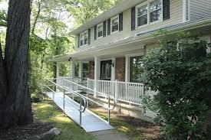
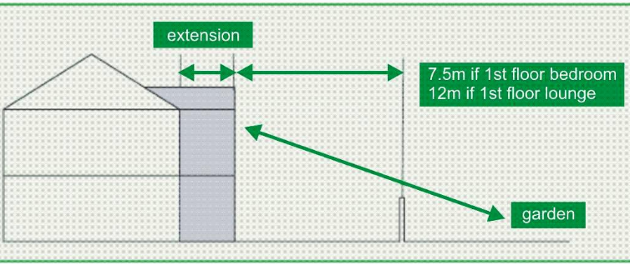
Material Considerations
Overlooking / loss privacy
Loss of light / overshadowing
Effect on listed building
Layout, density
Development plan
Previous decisions/appeals
Natural environment
Flood risk
Parking
Highway safety
Traffic
Noise
Design, materials
Govt. policy
Disabled access
Notes:
You may want to add to this list to highlight particular issues that have come before Planning Committee recently.
You may want to reinforce material and non material considerations through a quiz
Infrastructure – schools, GP surgeries, hospitals, untilites

Slide 21
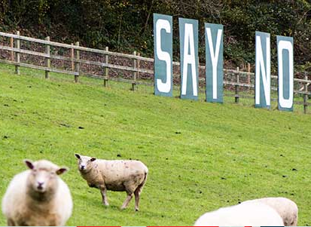
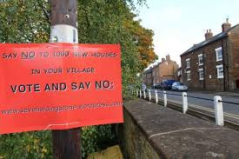
Non-material Considerations
House prices and house insurance
The conduct of the applicant – THIS MAY CHANGE!
The strength or volume of opposition / objection
Loss of a private view
Damage to property or Party Wall Act matters
Loss of trade
Boundary disputes or covenants
Notes:
it is not the number of objections, but the evidence in support of the planning reasons for objection, that is the material consideration.
Private view is put in italics because a strategic public view could be a material planning consideration
With regard to Party Wall Act matters and covenants concerns of Members could be addressed through the use of an informative to ensure that an applicant is aware that they need to address such matters outside of the planning application process

Slide 22
Planning involves balancing issues
economic growth
climate change
meeting rural housing need
countryside protection
long term strategies
today’s pressures
brownfield development
town cramming
retail “market forces”
viability of town centres
individual interest
public interest
Notes:
Sometimes these are very difficult – hard choices to make.
Planning decisions made directly affect the right of people to use their land. Planning processes are established by planning laws, regulations and precedents.
Although all these matters are part of the balance some issues have greater weight than others e.g. lack of 5 year housing land supply significantly weighs the balance in favour of approval

Slide 23
Listening to objections:
Sometimes vocal local groups can drown out other residents.
Some people feel disenfranchised, afraid to comment, or are just trusting the authority to make the right decision
It’s not the volume of objections but the content that is relevant
Notes:
Protesters are self selected and while they might well represent the majority view we simply do not know whether that is the case
In planning one good planning reason completely outweighs huge strength of feeling or support with no planning reason.

Slide 24
‘Basic principle’: start with the plan
It’s YOUR plan – it’s used for making decisions.
Get involved with any future review of the plan and encourage others to get involved.
And
One good planning reason outweighs a huge volume public support / objection

Slide 25
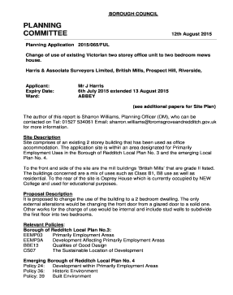
Committee application and determination
Prepare, read the papers!
How much weight to give to the issues?
Considered conditions/reasons before meeting?
Taken advice on legal/enforceable/reasonable?
Discussed concerns with officers before Committee?
Notes:
READ THE PAPERS IN ADVANCE & TALK TO OFFICERS IN ADVANCE TOO
Once it is agreed that an application will be determined by planning committee the committee member needs to be aware of their role in this process and the factors which should (and should not) be taken into account
This section will also provide councillors with an opportunity to discuss the usefulness of speaking at committee and committee site visits in the decision making process.
Always try and discuss concerns with officers before Committee so that Officers are
25

Slide 26
Committee application and determination
Come to committee with an open mind, not an empty mind
Notes:
This relates back to predisposition and predetermination.
Members should go into the meeting having thought about the application and any concerns they have.
They should then be ready to ask the questions to the officers (or even better let the officers know the questions they will be asking) to enable them to either agree with the officer recommendation or have sound reasons for going against the officer recommendation

Slide 27
Taking advice
You are not expected to be experts
Lot of issues surrounding planning applications can be very technical.
However, you are expected to listen to the experts when they offer your advice.
If you decide not to follow advice be ready to defend your position with evidence
Notes:
You are not expected to be experts
And lot of issues surrounding planning applications can be very technical. And you get professional advice from your technical professionals employed to advise you – ie your planning officers.
However, you are expected to listen to the experts when they offer your advice.
If you decide not to follow the advice that is offered you need to be ready to defend your position and, if necessary, provide evidence to back that up.
Your officers are there to help you and work with you – not to find
Your officers are also experts and it is their job to offer you advice. They will work through all the technical advice and public comments, and will often seek amendments to a scheme to address concerns.
They will consider local and national policy, along with the planning history in the area, and will come to a conclusion with a recommendation to approve or refuse.
Sometimes the conclusion is clear cut, but sometimes it is a lot more balanced.
Officers will be recommending the safest position for you to take.
Where either the technical advice or the Planning Officers’ recommendation is clear cut it is difficult to sustain a different position. Highway safety is often an issue where this comes to a head.
However, where the situation is more balanced and an argument can be put forward to support differing positions then the implications of not following expert advice are less serious. An example might be a contemporary building in a conservation area, where there might be different, but equally valid opinions.

Slide 28
Listen to what officers are telling you
Officers are there to help you make ‘sound’ decisions not force you to go with their recommendation
Ask officers for their opinion before you vote
Is the recommendation ‘finely balanced’ or ‘clearly in conformity with an adopted policy’?
Officers are there to help you before as well as during the meeting
Notes:
Committees work best when Members and officers work together. Officers give Members the information they need to make a decision and officers advise Members so that Members make sound decisions even when they are against the officer recommendation.
A ‘finely balanced’ decision means that it could be argued both way. A proposal that is ‘clearly in conformity with an adopted policy’ should not be overturned unless there are very clear evidenced reasons to do so.
It is really important that both Members and officers respect each other’s role in the decision making process

Slide 29
Introduction to Planning
Councillor role
May 2023
www.pas.gov.uk
Notes:
29

Slide 30
The councillor’s role depends on…
Political Group member
Parish councillor
Ward member
Member of the planning committee
Strategic Committee member
Notes:
You take on different roles depending on what positions you hold.
Most will be part of a political group
Some will be previous or current parish coucillors
You’re all ward councillors
Some will sit on the planning committee
A few might be either planning policy portfolio holder or sit on a local plan steering group
Some of you will be several of these things concurrently, but you need to consider which hat you are wearing. You need to be clear when considering planning policy and particularly planning applications.
We’ll go through these different roles

Slide 31
Political group member
Pre-election
Non-political decision making
Others in your group
Others in opposition groups
National party
Notes:
Political party member
Pre-election
Before election you’ll probably have been a member of your party and you are now part of a political group on council.
You will have thoughts on development in your borough or your ward, it may have been a key plank of your manifesto or campaign but planning decisions cannot be whipped.
Non-political decision making
It can be tempting to bring politics into planning, but that way leads to problems. If a developer or objector gets a whiff of politics in the planning decision and they can take it to review or appeal.
Be careful how you talk about planning applications or potential development sites. If you say “I will work against any development on this site” you are pre-determining yourself for the future, as well as the present (which is fine to do just know that is what you are doing).
Others in your group
If you say “As x political party, we will never allow this site to be developed” you might be pre-determining everyone in your group, so none of you can sit on a planning application for that site!
Respect your colleagues and don’t put pressure on planning committee members on political grounds.
Other in opposition groups
Same as with your own group - don’t pressure them.
National party
Respect the position of national party, but you are elected to look after your local ward and borough, so use your judgement.

Slide 32
Parish Councillor
Whole ward or borough
Commenting on applications v. decision making
Discussion at the parish meeting
Notes:
Parish Councillor
Whole ward and borough
Some of you will have been or are parish councillors, so may previously discussed and commented on planning applications. You may still do that in your role as a parish councillor, but be aware that you are now a district or unitary councillor and you must do what is best for the whole council area, not just one parish anymore.
I came across one councillor who has 16 parishes in his ward. If you sit on one of those or even more, you still need to think about the whole area you are elected to represent.
Commenting v decision making
You are part of the decision making body (council) now, so bear that in mind. The local plan you judge applications by is YOUR plan (even if you weren’t elected or weren’t in administration when it was agreed).
Discussion at parish meeting
If you are a sitting parish council member, you might want to consider if you wish to be present or contribute when the parish discusses planning applications.
You will need to consider if this could be perceived as a conflict of interest if it helps the parish you live in, but the neighbouring parish considers it harmful. “This new hall will great for us, so I’ll help get it approved”. Or could be seen as pre-determination if you sit on planning committee or undue influence to colleagues if not. “I hear your views and it’s clear everyone is against this application so I’ll make sure it isn’t passed”.

Slide 33
Ward member
Inform
Navigate
Object or support
Call into committee
Also planning committee member?
Notes:
Ward Councillor
Want to spend a little time on this. You have a key role.
Inform/consult
You can help your residents find out about a planning application in their area. Formal council consultations only go so far, you are free to let more residents know about the application and encourage them to respond (not which way to respond).
You can also help spread the word about consultations on planning policy. You can door knock or leaflet to make sure everyone knows how to contribute to the process.
Navigate the system
Make sure you understand the system yourself. It varies between councils so read your policies and if you don’t understand what can be done and what can’t, ask! You can speak to more experienced colleagues or officers.
The rules vary depending on the type of application. Some you can’t consider all aspects you would for a full application, but residents will expect your help on these as well.
Permitted development
Telecommunications masts
Tree protection orders
You can help residents navigate the system. It is complex and can be scary (especially if they end up wanting to speak at the committee). You can help them understand planning grounds for objection or support. Help them to express their views in a way that gets the points across to the decision makers (councillors or officers).
Residents can have a habit of wanting to write long emails covering many non-planning grounds. You can encourage them to concentrate on the main issues in a concise way to make sure they’re case for objection or support is as strong as possible.
Don’t underestimate just how important these 2 aspects are in your ward role. Residents look to you for help.
Object or support
You can object or support an application yourself as an individual or with any fellow ward councillors.
If you are personally affected by an application (more than most other residents or it’s on your register of interests - i.e. it’s on your road, your kids school, partner’s place of work etc) you may have different rules. Ask your monitoring officer, if you are allowed to speak or not.
Call-in
You can, probably, call in the decision to committee - spend some time understanding the rules your council has for councillors calling into committee. It varies widely across councils.
Object/Support and Call-in
If you also sit on the planning committee be careful. You can still object or support the application but be aware these will probably stop you from sitting on that decision. If you don’t, think about if you are hearing just the loud few, not the silent majority.
Think carefully about your planning grounds for your comments or your call-in. Think about how it will look. Will you appear to be nimby? “objects to a block of flats in their ward but quite happy to put it in others!”
Are you objecting to any development on the site or are you looking to get conditions added into a permission to minimise the impact on existing residents? What are your objections, what do you think could be done to overcome them?

Slide 34
Member of the planning committee
Understanding your planning policies
Pre-determination v pre-disposition
Balancing exercise
Listening to different viewpoints
Working with officers
On public display!
Notes:
Member of the planning committee
Understand your planning policies
Read and understand the planning policy documents. If you need more help understanding, ask the officers. Initial training can only cover an element of the mass of information you’ll need to read and comprehend. There may be further training available on, maybe section 106s, viability assessments, design, heritage and conservation etc. Try to take up all available training offered to you. Use the PAS website as well.
Predetermination v predisposition
Remember predetermination v predisposition - I err on the side of caution and don’t even give an opinion, unless I am prepared to pull myself off that committee. It doesn’t mean I can’t inform my ward residents about an application or support my ward residents to make their objections by helping explain the process. I say that I am happy to listen and help them on the process, but due to the quasi-judicial nature of planning I won’t be giving an opinion until the decision making committee.
I don’t want to undermine the rules as set out by Pete earlier, but if unsure err on the side of caution, especially as a new councillor and speak to your planning officer or monitoring officer if necessary.
Balancing exercise
Your job is to weigh up the pros and cons of any application. No application (in my experience) meets 100% of policy. No application is perfect or without any merit, so there will always be a balancing exercise to undertake. You must not, or even not appear to be, favouring one side over the other. You must be objective using your planning policy to reach a reasoned conclusion.
Listening
Do listen to all views - this can be emails from residents before the meeting, comments during the consultation, developers, parish councils, resident associations, design reviews.
I always insist on the full redacted comments on the application, so I can read in the residents own words, not just the officer summary. Sometimes it can be a lot of work by officers to do the redaction, but being able to say to residents you have read their actual comments (when they accuse the officer of missing some key points) is powerful and shows you are listening (even if you don’t agree with them).
Actively listen to anyone speaking at the committee.
Developers will want to tell you why their application is a good one, don’t dismiss everything they say “as they are the developers”. But also don’t take everything they say as gospel, they will not point out where the application doesn’t meet policy or potentially creates harm.
Working with officers
Read the agenda papers - There is nothing more annoying that a councillor who hasn’t and has to be corrected at the meeting. However, don’t be afraid to ask questions. If you have read the papers and it isn’t clear to you, then how will it be clear to residents?
If you are going to ask a technical question at committee then let the officers know in advance so they can have the answers to hand. There are no brownie points in making everyone wait whilst the officer pulls out the file to take a measurement from a drawing just because you wanted to ‘surprise’ the officer! I have also been known to ask questions where I do know the answer, but I want it given in a public forum, so it is clear for everyone interested in the application.
Don’t be afraid to ask officers about adding conditions or informatives. If you think it may improve the application, by reducing the impact then ask. For example, if there are traffic concerns during construction can modify or add in mitigations such as hours of construction traffic, or route to take to and from site? Your officers will be able to advise if that is a reasonable request. If you know you might look to do that in advance of the meeting, then officers can come prepared with wording for a condition or even provided in late material.
The officers are on your side. A good working relationship with key officers is a positive. They are the professionals, but they are not infallible, so discussion is a good thing.
On public display
Planning committees can be popular events! You’ll often have a public gallery.
Whilst there is no requirement for you to explain your vote, when it comes to that point, if residents have come along to the meeting or are watching online, then you may wish to express your views after the debate before the vote. It can help residents understand why you are voting the way you do and that you have listened to their concerns.

Slide 35
Strategic Committee Member
Steering groups
Cabinet or committee member
Fairness
What will it actually produce?
Notes:
Strategic committee member
You may be part of a steering group that is working on a planning policy, either full local plan, neighbourhood plan or a specific policy. Or you may be the portfolio holder or part of the committee/cabinet that will approve it.
You need to use evidence for your approach and apply fairness. You cannot decide elements that are in contradiction from a ‘higher’ plan like the NPPF.
You need to try and think how what the plan says will affect actual applications. And remember this isn’t all about housing numbers, as plans cover many other aspects of local development.

Slide 36
Change is the only constant
Not in force yet
More about plan making than determining applications but it will affect it
Need an up to date plan
Notes:
Keep yourself informed throughout your time as a councillor! Planning policy changes all the time and more changes are always coming, so it is a continuous learning exercise.
If you want more information on changes coming ask your planning chair or officers for training on it. The better you understand how it affects your ward and your borough, the better placed you will be to either help residents or make decision at committee.
36

Slide 37
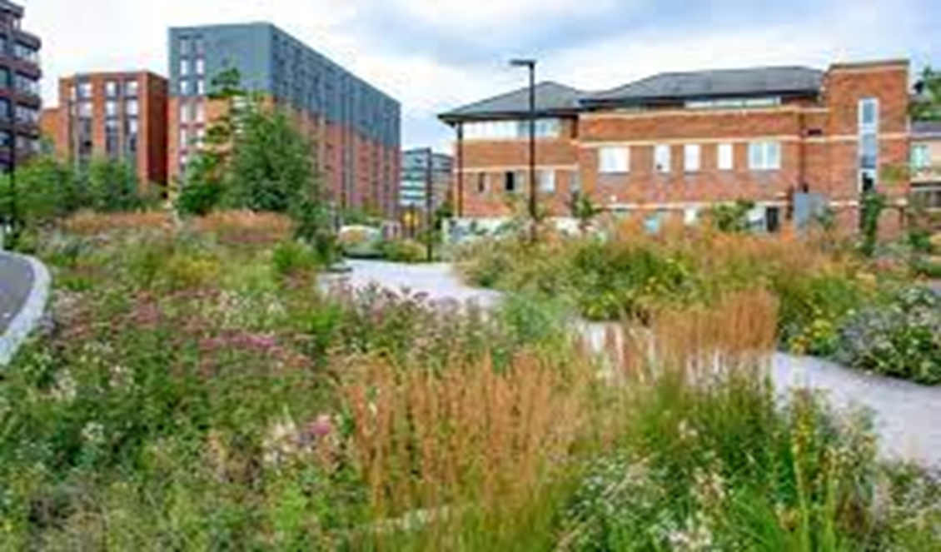
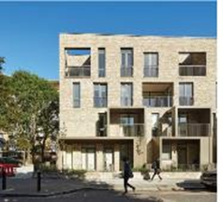
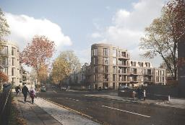
Planning is key
Leaders of place
Positive change
Embrace it
It’s why you were elected!
Notes:
Planning is really important. On the committee or through your work as a ward councillor or considering your planning policy, you are aiming to make positive changes that will still be around in hundreds of years.
You are leaders of your place, you are helping improve it for the future - isn’t that why you got elected in the first place? Embrace the opportunity that the planning process gives you.

Slide 38
Understanding the jargon
AH – Affordable housing
AMR – Annual Monitoring Report
AONB – Area of Outstanding Natural Beauty
AQMA – Air Quality Management Area
BNG – Biodiversity Net Gain
CIL – Community Infrastructure Levy
CPO – Compulsory Purchase Order
DAS – Design and Access Statement
DP – Development Plan
EIA – Environmental Impact Assessment
GPDO – General Permitted Development Order
HDT – Housing Delivery Test
HER – Historic Environment Record
HMO – House in Multiple Occupation
HRA – Habitats Regulation Assessment
LBC – Listed Building Consent
LDC – Lawful Development Certificate
LDO – Local Development Order
LNR – Local Nature Reserve
LP – Local Plan
LPA – Local Planning Authority
NDO – Neighbourhood Development Order
NPPF – National Planning Policy Framework
OAN – Objectively Assessed Need
PD – Permitted Development
PINS – Planning Inspectorate
PPA – Planning Performance Agreement
PPG – Planning Practice Guidance
Pre app – pre application discussions
RIGS – Regionally Important Geological Sites
S106 – Planning obligation
SA – Sustainability Appraisal
SAC – Special Areas of Conservation
SEA – Strategic Environmental Assessment
SEP – Strategic Economic Plan
SFRA – Strategic Flood Risk Assessment
SHLAA – Strategic Housing Land Availability Assessment
SPA – Special Protection Areas
SPD – Supplementary Planning Document
SRN – Strategic Road Net
SSSI – Site of Special Scientific Interest
work
TA – Transport Assessment
TPO – Tree Preservation Order
UCO – Use Class Order
Notes:
This slide can be as long as you want it to be and a useful ‘takeaway’ for future reference

Slide 39
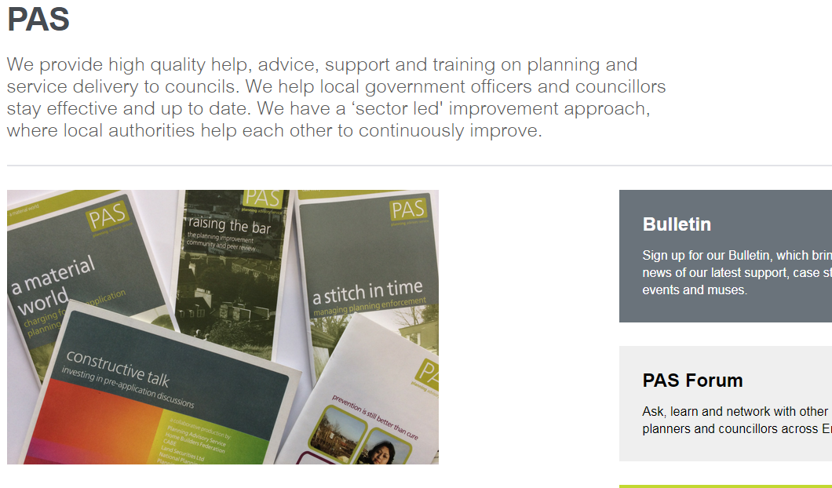
Thank You
We’ll stop the recording here and take questions
Presentations and recording will be available on the LGA site
Stay in touch: we are at local.gov.uk/pas
Notes:
Thank you
PAS produces a free monthly bulletin were we share information and access to session that we run. Accessed via the PAS website.

